Slide 1
Fusion of Indirect Methods and Iterative Learning for Persistent Velocity Trajectory Optimization of a Sustainably Powered Autonomous Surface Vessel
Kavin M. Govindarajan, Devansh R Agrawal, Dimitra Panagou, Chris Vermillion
CCTA 2025

Slide 2
Outline
Motivation
Problem Formulation
Methodology
Real-Time Realization & Results
Conclusion & Future Work

Slide 3
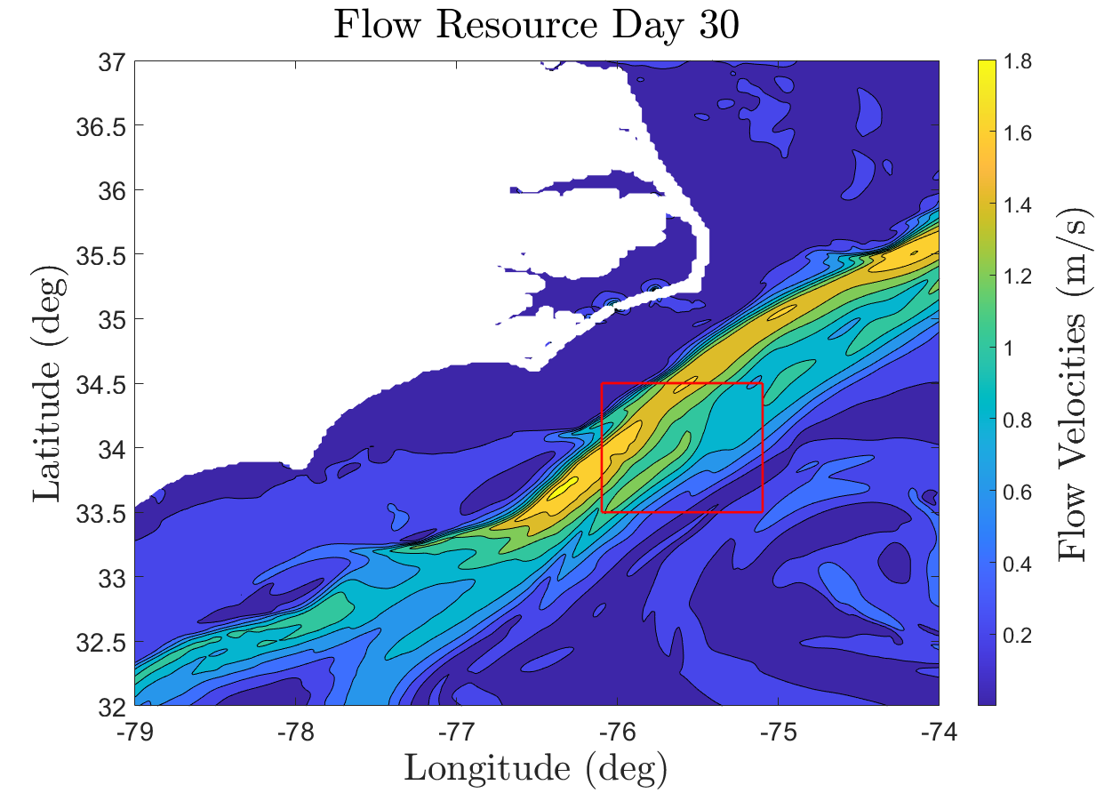
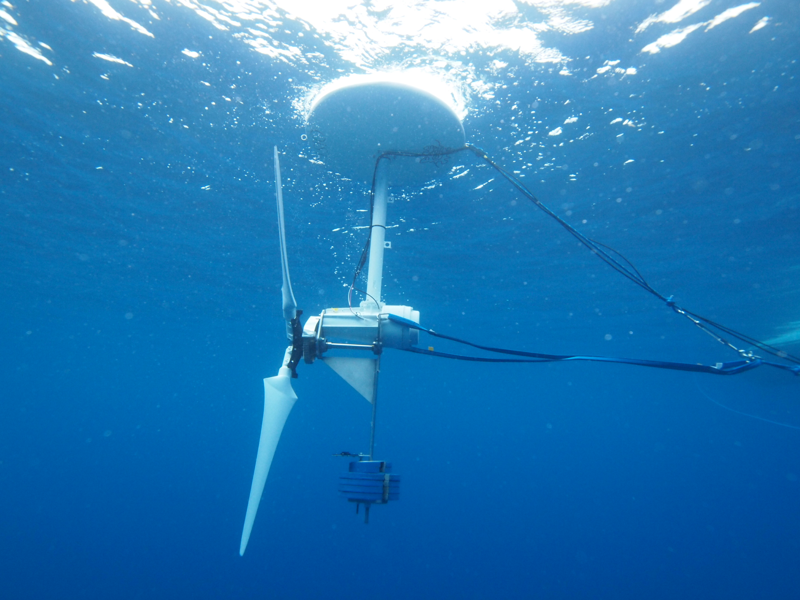
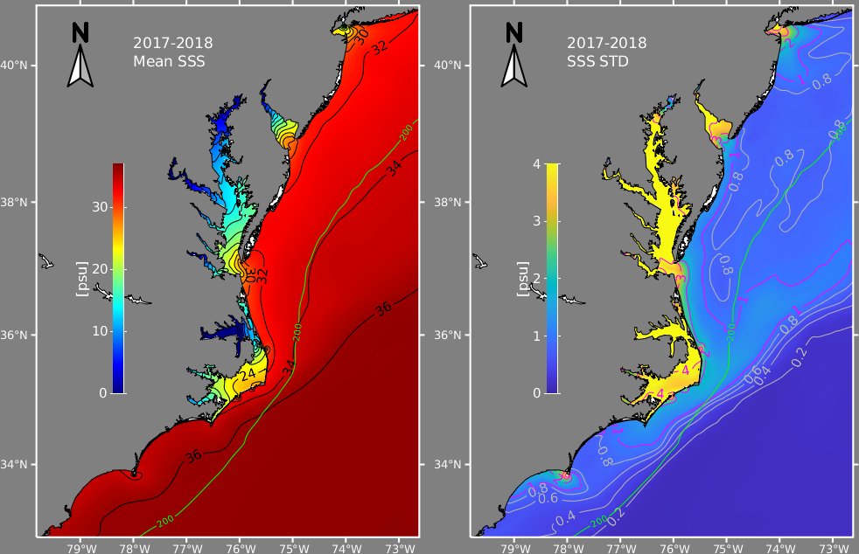
Why do we want to run persistent missions?
Marine Hydrokinetic Energy -
Flow Velocity vs Depth Data
Understanding Ocean Circulation -
Sea Surface Salinity (SSS)
160 TWh/yr of Technical Energy Capacity ~ 14.5 million homes [1]
Mean SSS off the Atlantic Coast of the United States [2]
Two features:
Data varies with space and time
We want to collect data over long periods of time
[1] K. Haas, “Assessment of energy production potential from ocean currents along the United States coastline,” Georgia Inst. of Technology, Atlanta, GA (United States), Tech. Rep., 2013.
[2] Bane, John, et al. "Atmospheric forcing of the Hatteras coastal ocean during 2017–2018: The PEACH program." Dynamics of Atmospheres and Oceans 102 (2023): 101364.

Slide 4
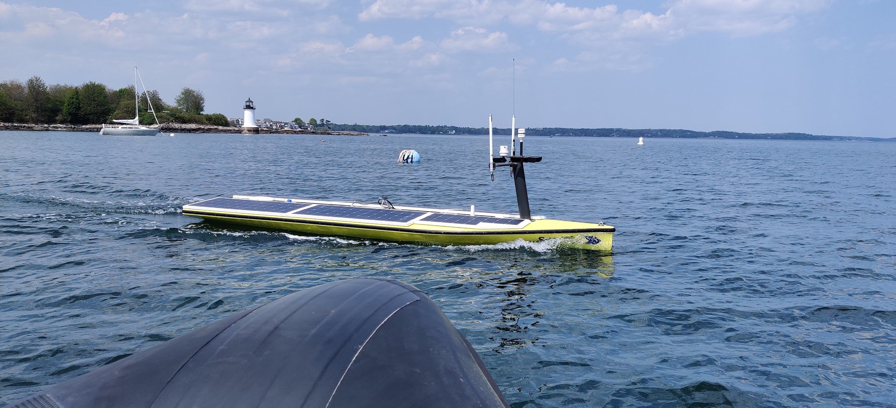
A Solar-powered ASV
Attribute | Value
Length | 4.8 meters
Beam | 1.39 meters
Draft | 0.42 meters
Weight | 300 kilograms
Solar Panel Area | 4.17 meters²
Brushless Motor | 500 Watts
Battery Capacity | 6.75 kiloWatt Hours
Top Speed | 4.5 knots
Cruise Speed | 3 knots
SeaTrac SP-48 ASV

Slide 5
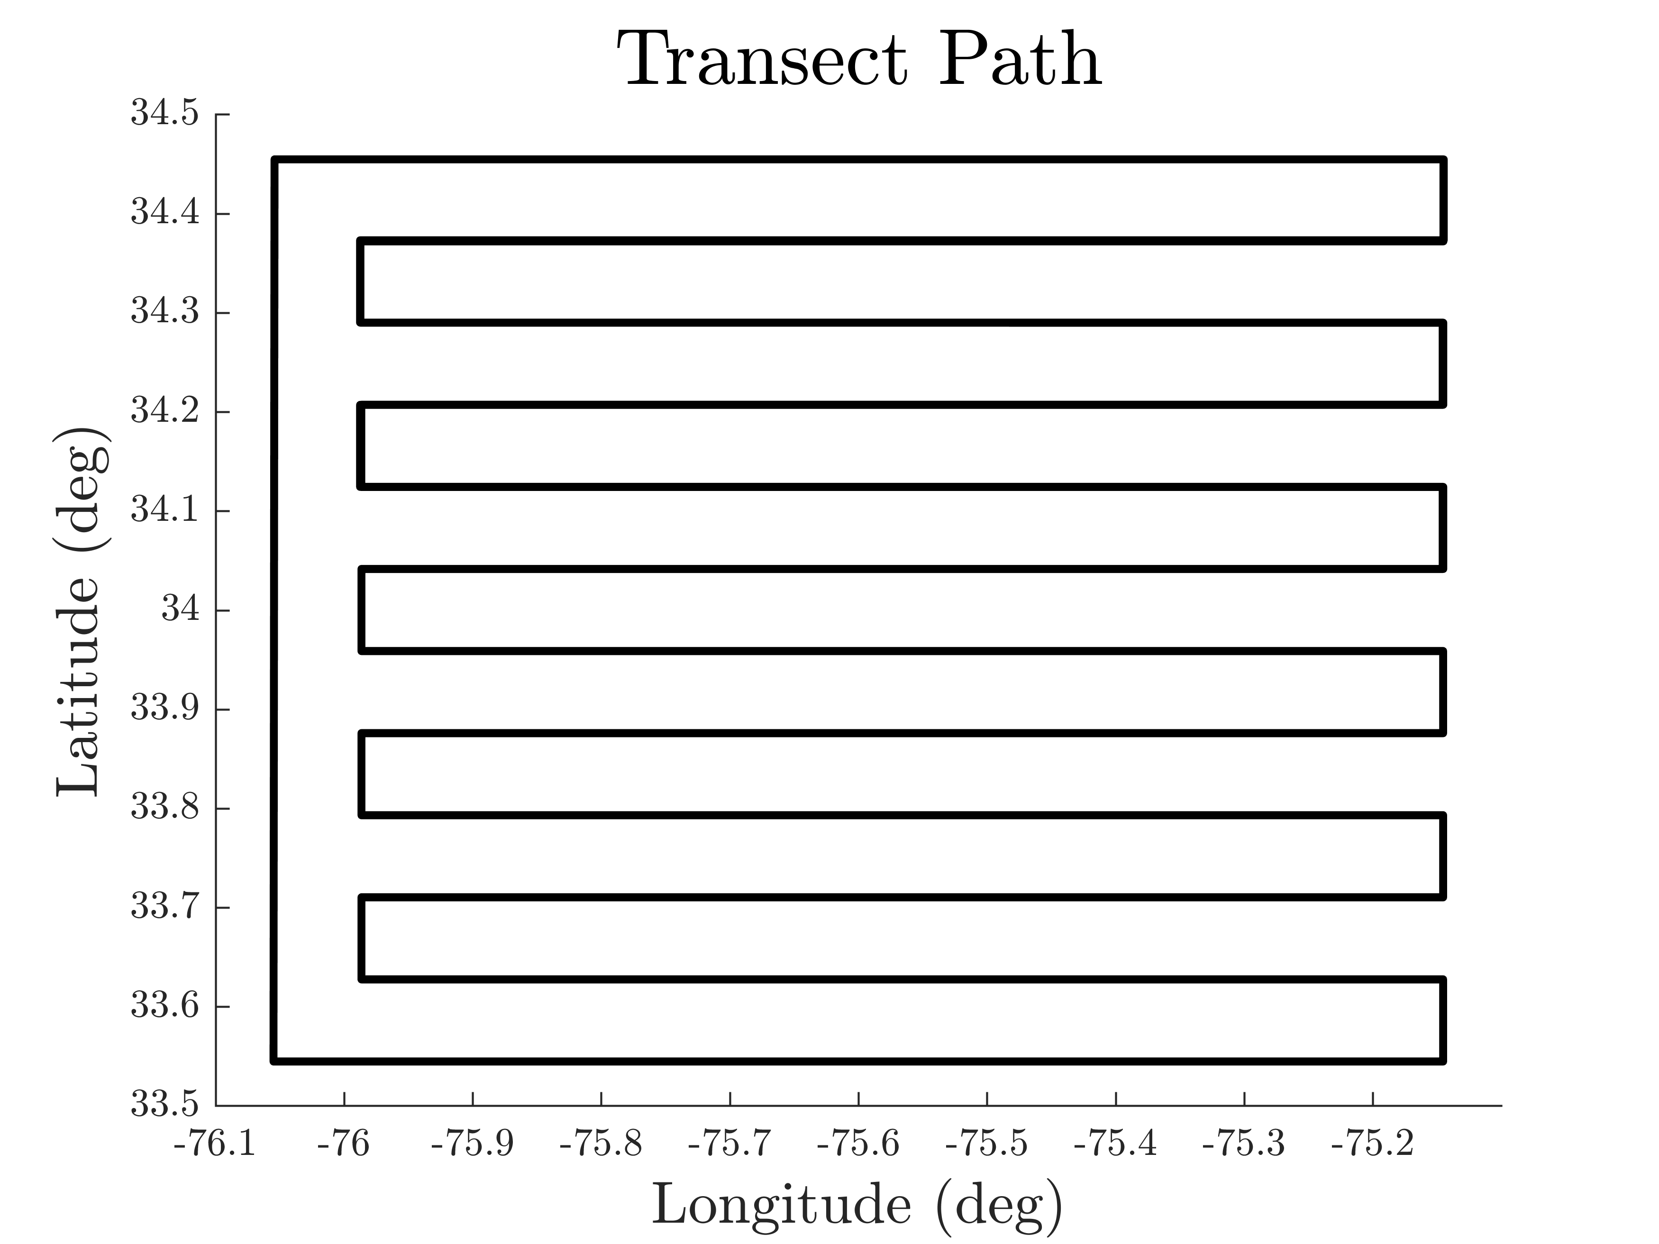
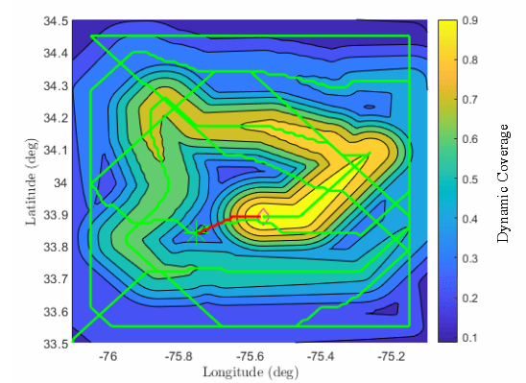
How can we control the ASV?
Direction:
Speed:
Finite horizon
Infinite horizon
  “Segmented” missions via recharging [3][4]
  Finite-horizon MPC with terminal reward for infinite-horizon performance [5]
[3] B. Haydon, J. Reed, and C. Vermillion, “Persistent mission planningof an energy-harvesting autonomous underwater vehicle for gulf streamcharacterization,” IEEE Transactions on Control Systems Technology,vol. 32, no. 2, pp. 653–662, 2023.
[4] G. Notomista, C. Pacchierotti, and P. R. Giordano, “Online robottrajectory optimization for persistent environmental monitoring,” IEEEControl Systems Letters, vol. 6, pp. 1472–1477, 2021.
[5] K. Govindarajan, B. Haydon, and C. Vermillion, “Predictive velocitytrajectory control for a persistently operating solar-powered autonomoussurface vessel,” in 2023 American Control Conference (ACC), 2023, pp.2077–2083.

Slide 6
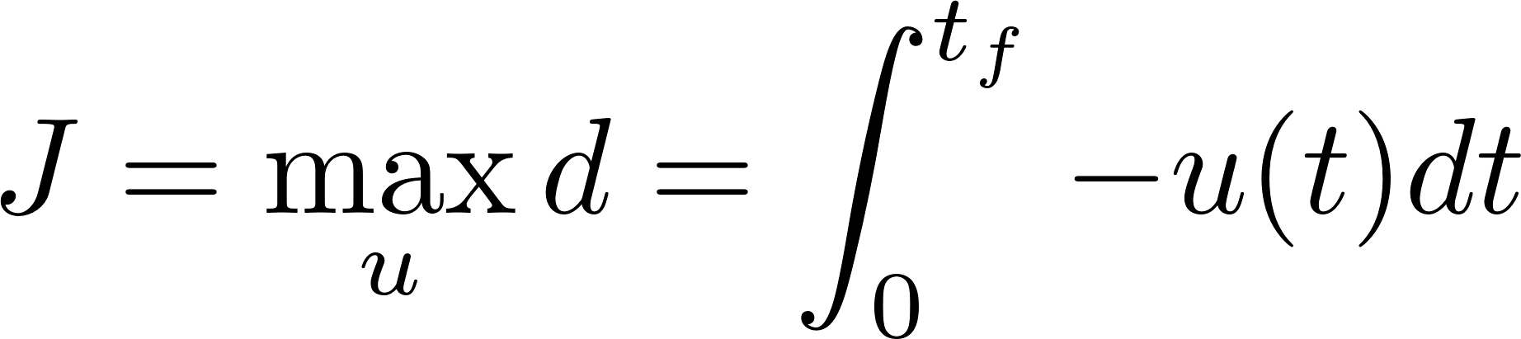

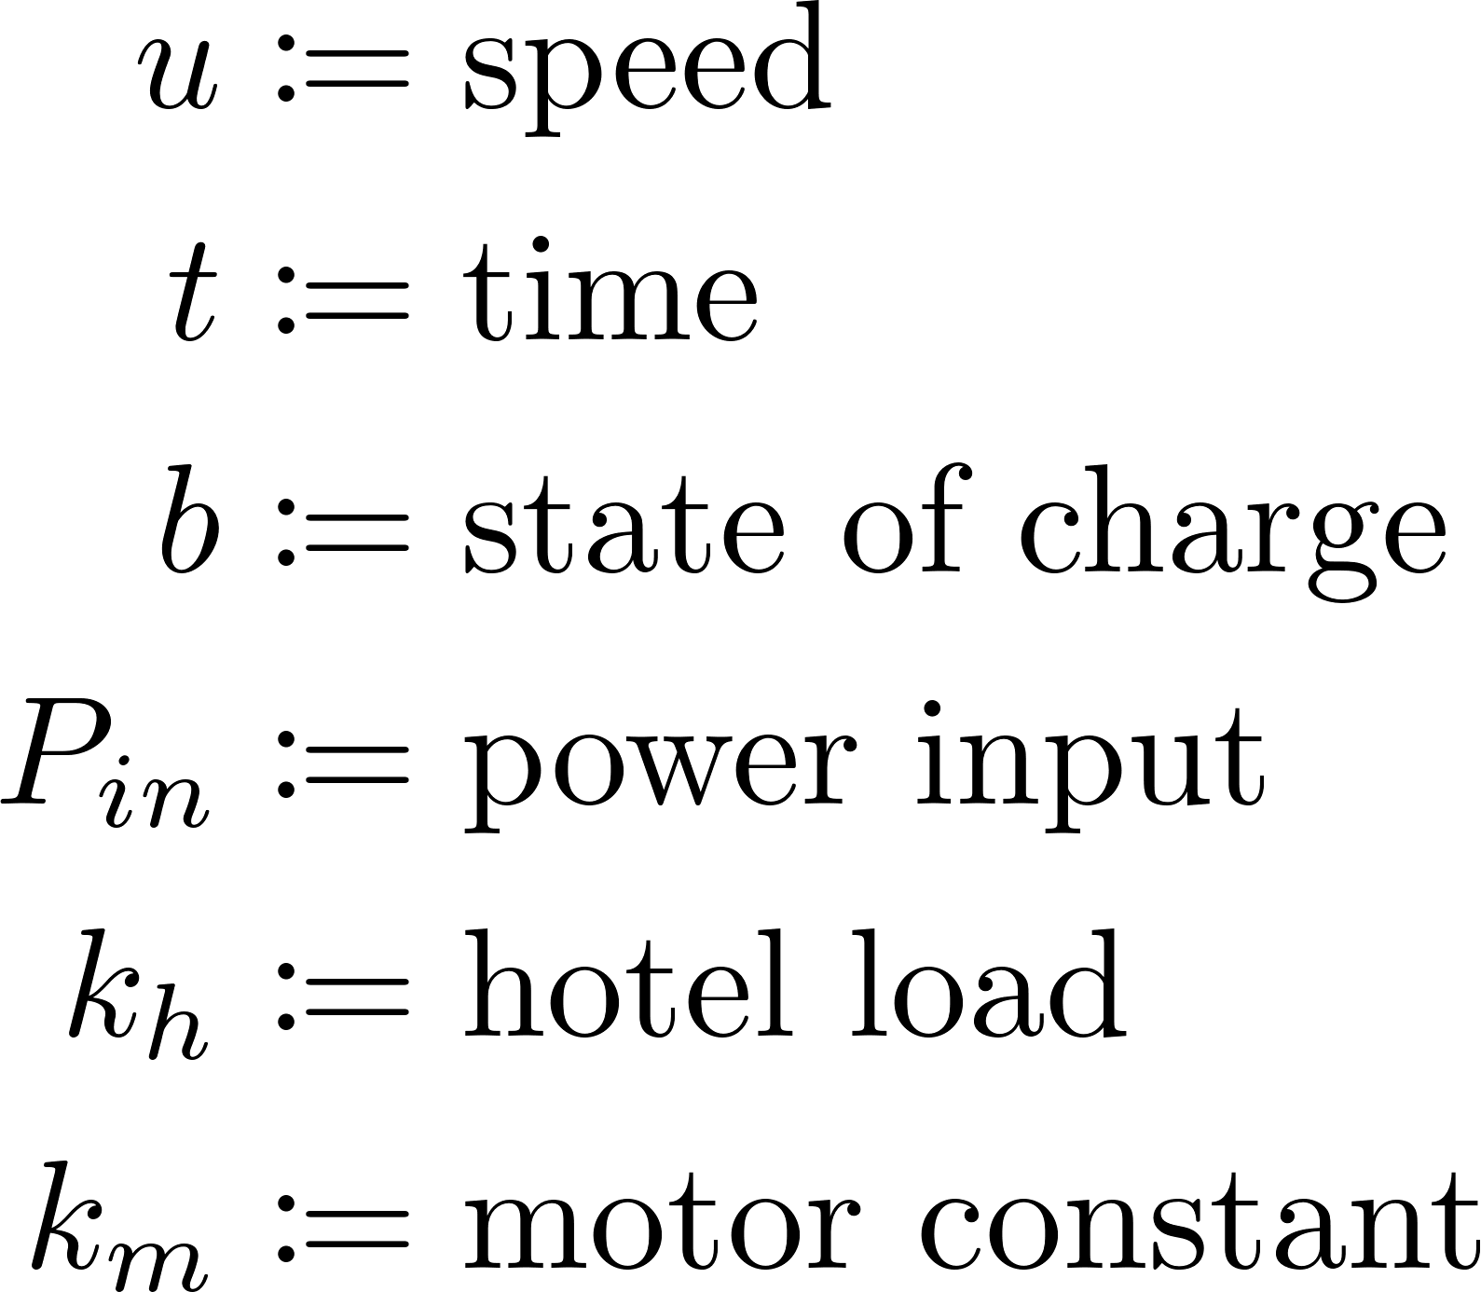

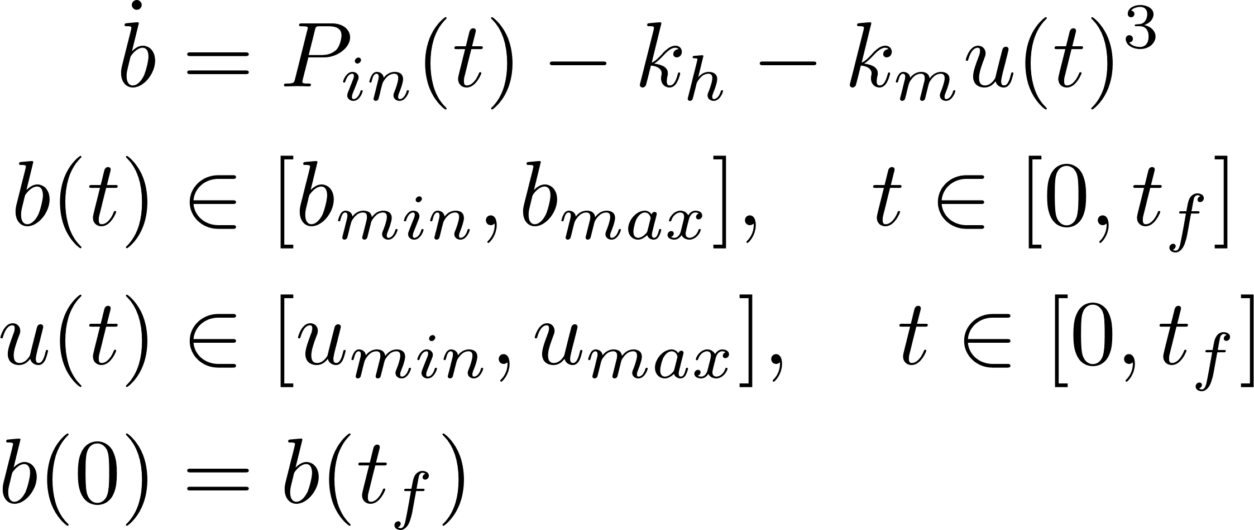
What are we trying to solve?
We seek to maximize distance as a proxy for information!
Battery dynamics
Battery constraint
Speed constraint
To solve this:
NLOpt solver-> difficult to converge to a solution
Indirect methods -> messy singular arcs

Slide 7
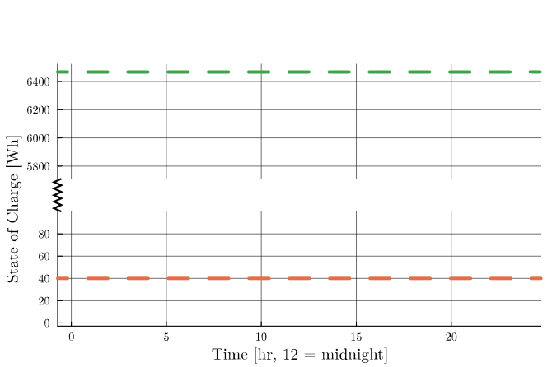
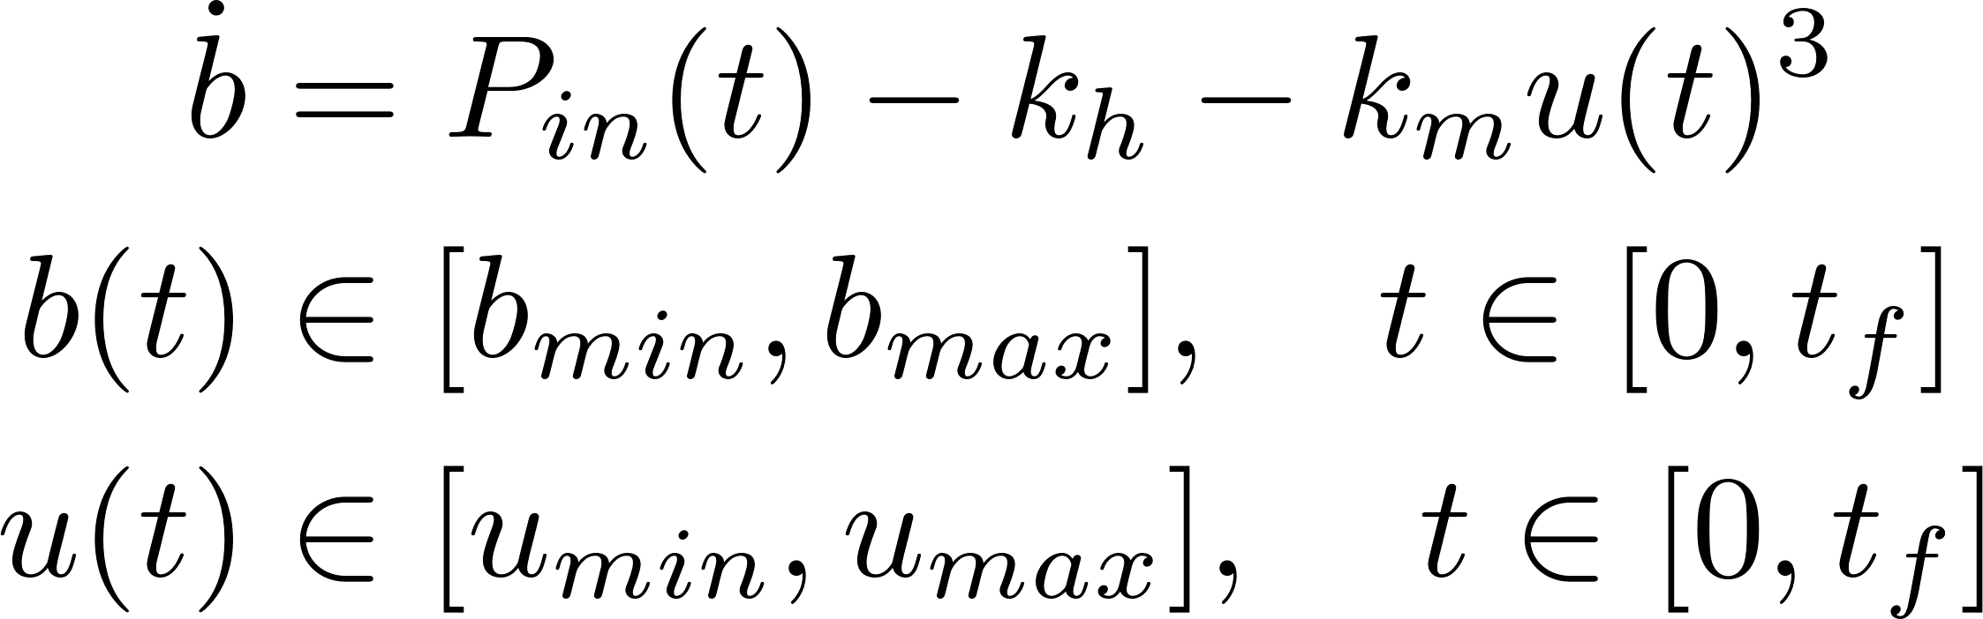
Why is this difficult to solve?

Slide 8
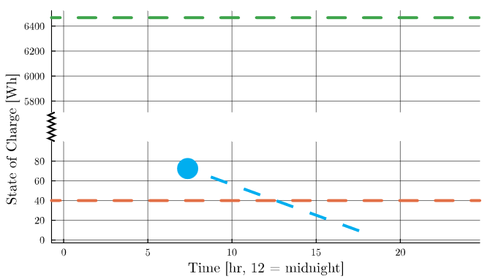
Why is this difficult to solve?

Slide 9
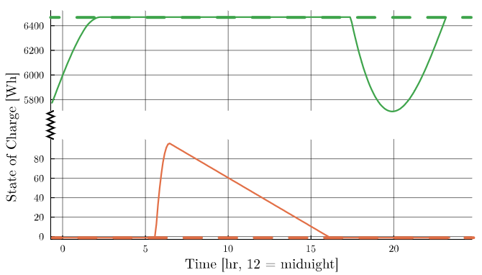
Why is this difficult to solve?

Slide 10
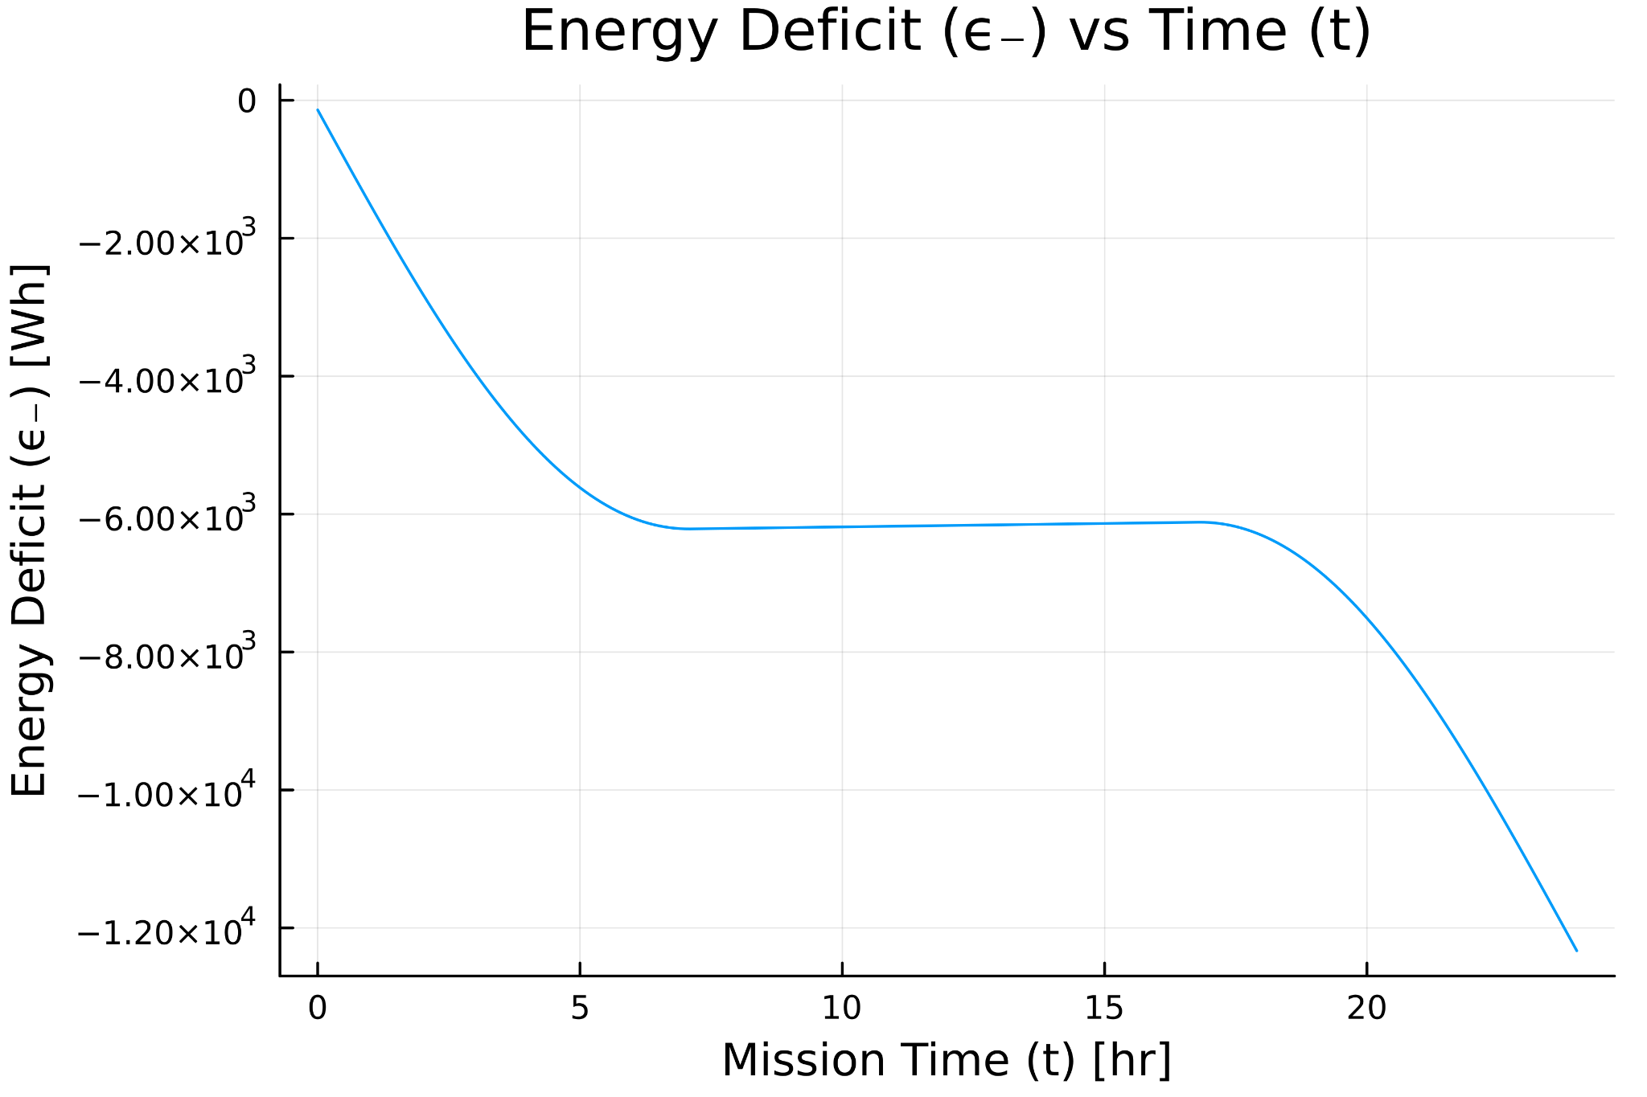
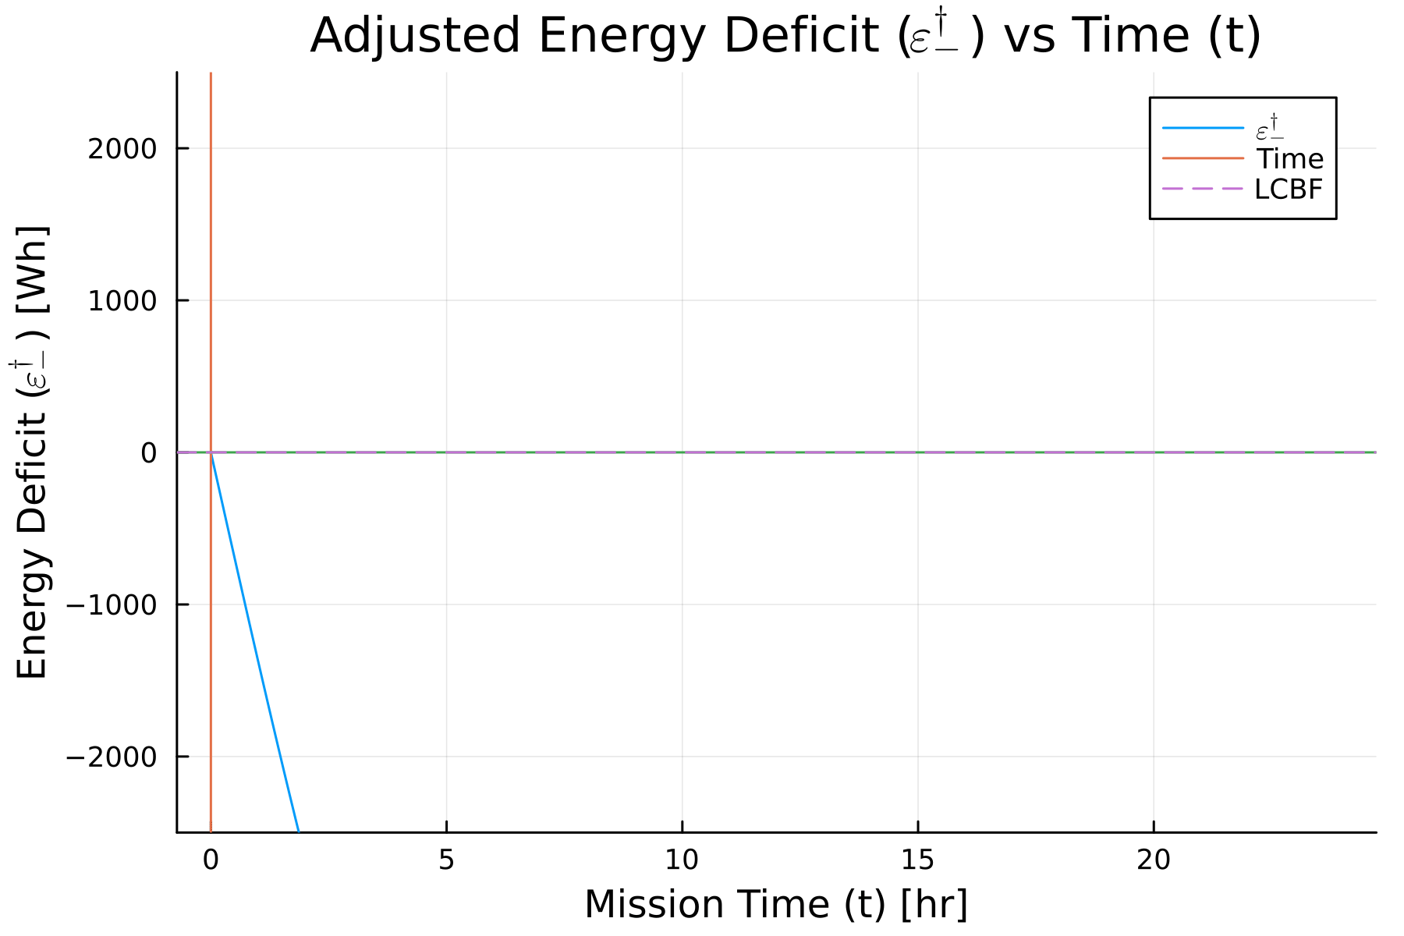
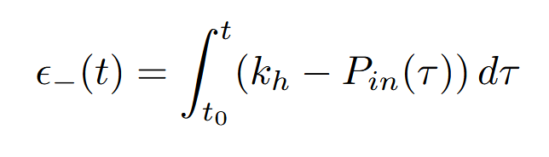
Lower SOC Constraint

Slide 11
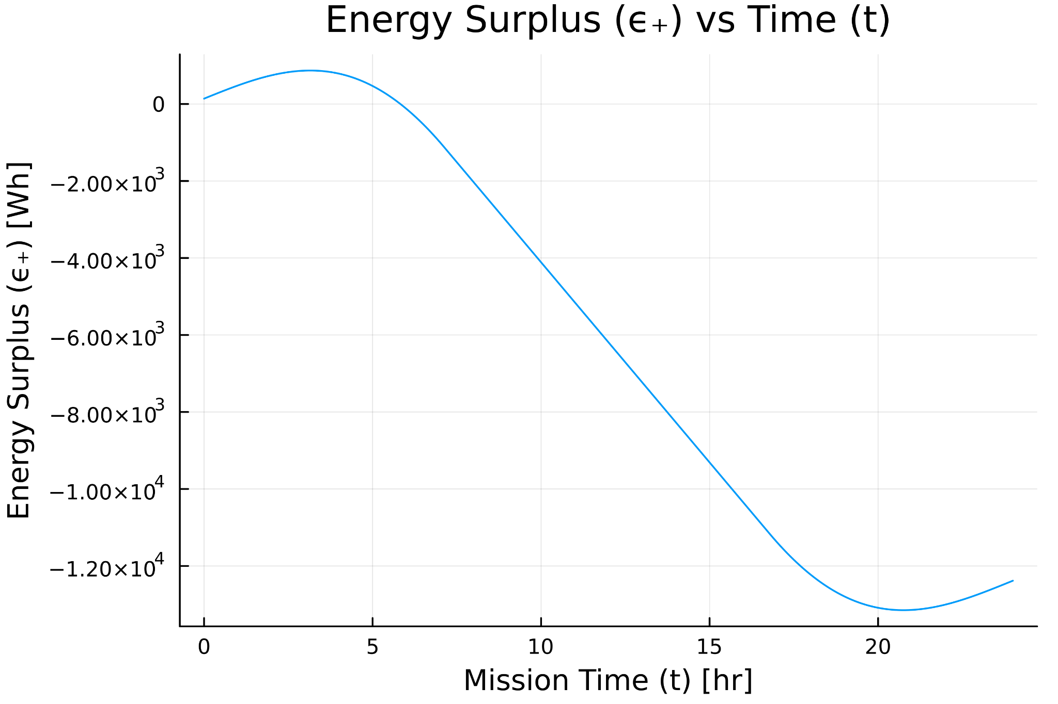
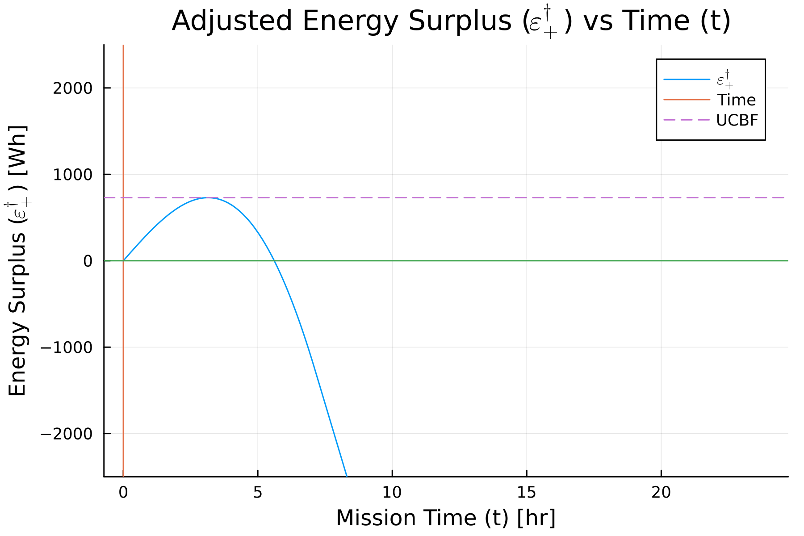
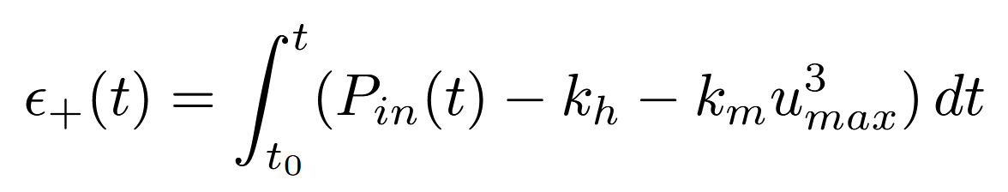
Upper SOC Constraint

Slide 12
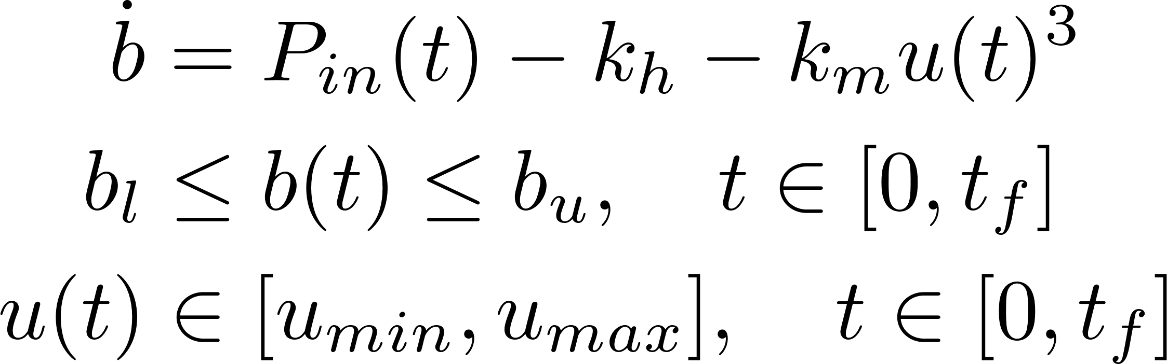
Why is this difficult to solve?

Slide 13
What are we trying to solve?
We can now solve this using indirect methods!!

Slide 14
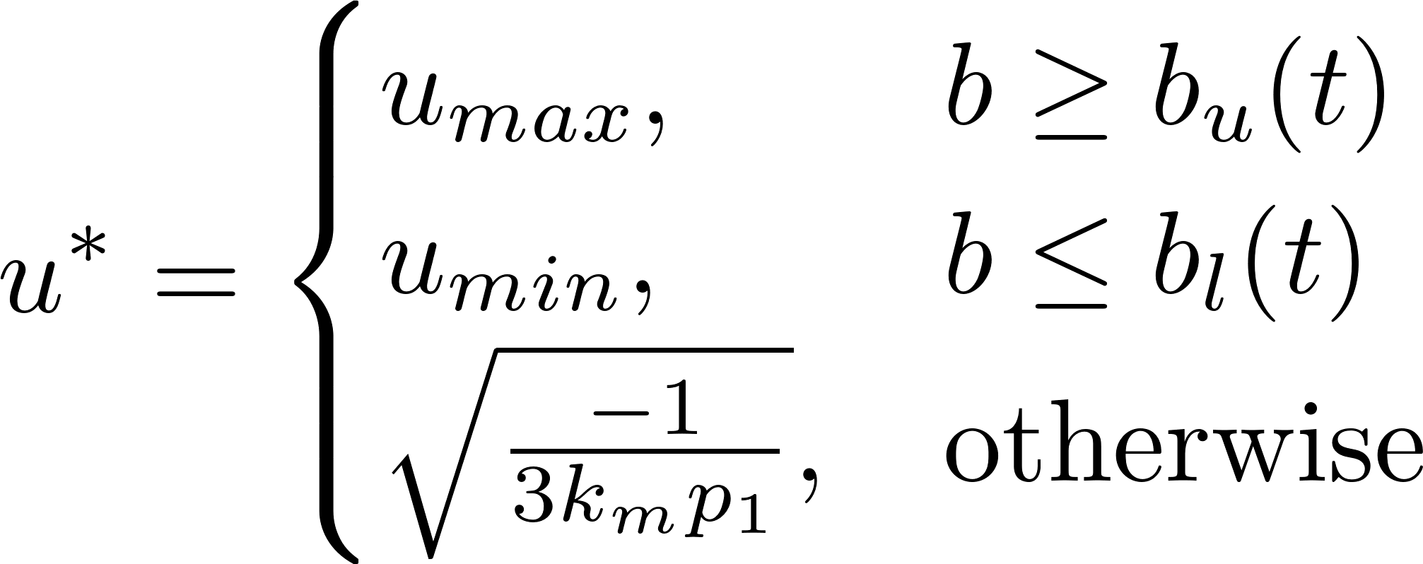

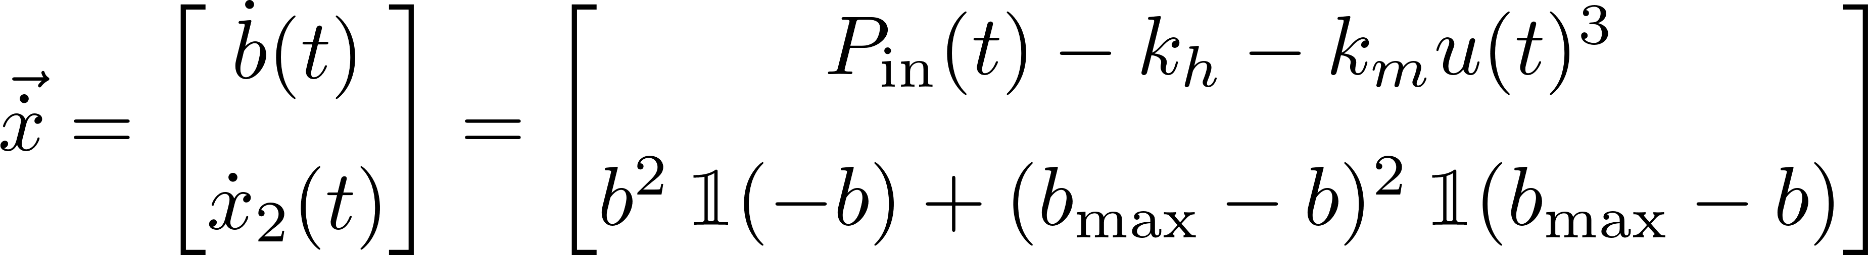

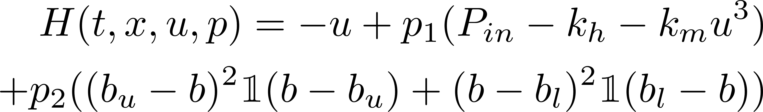
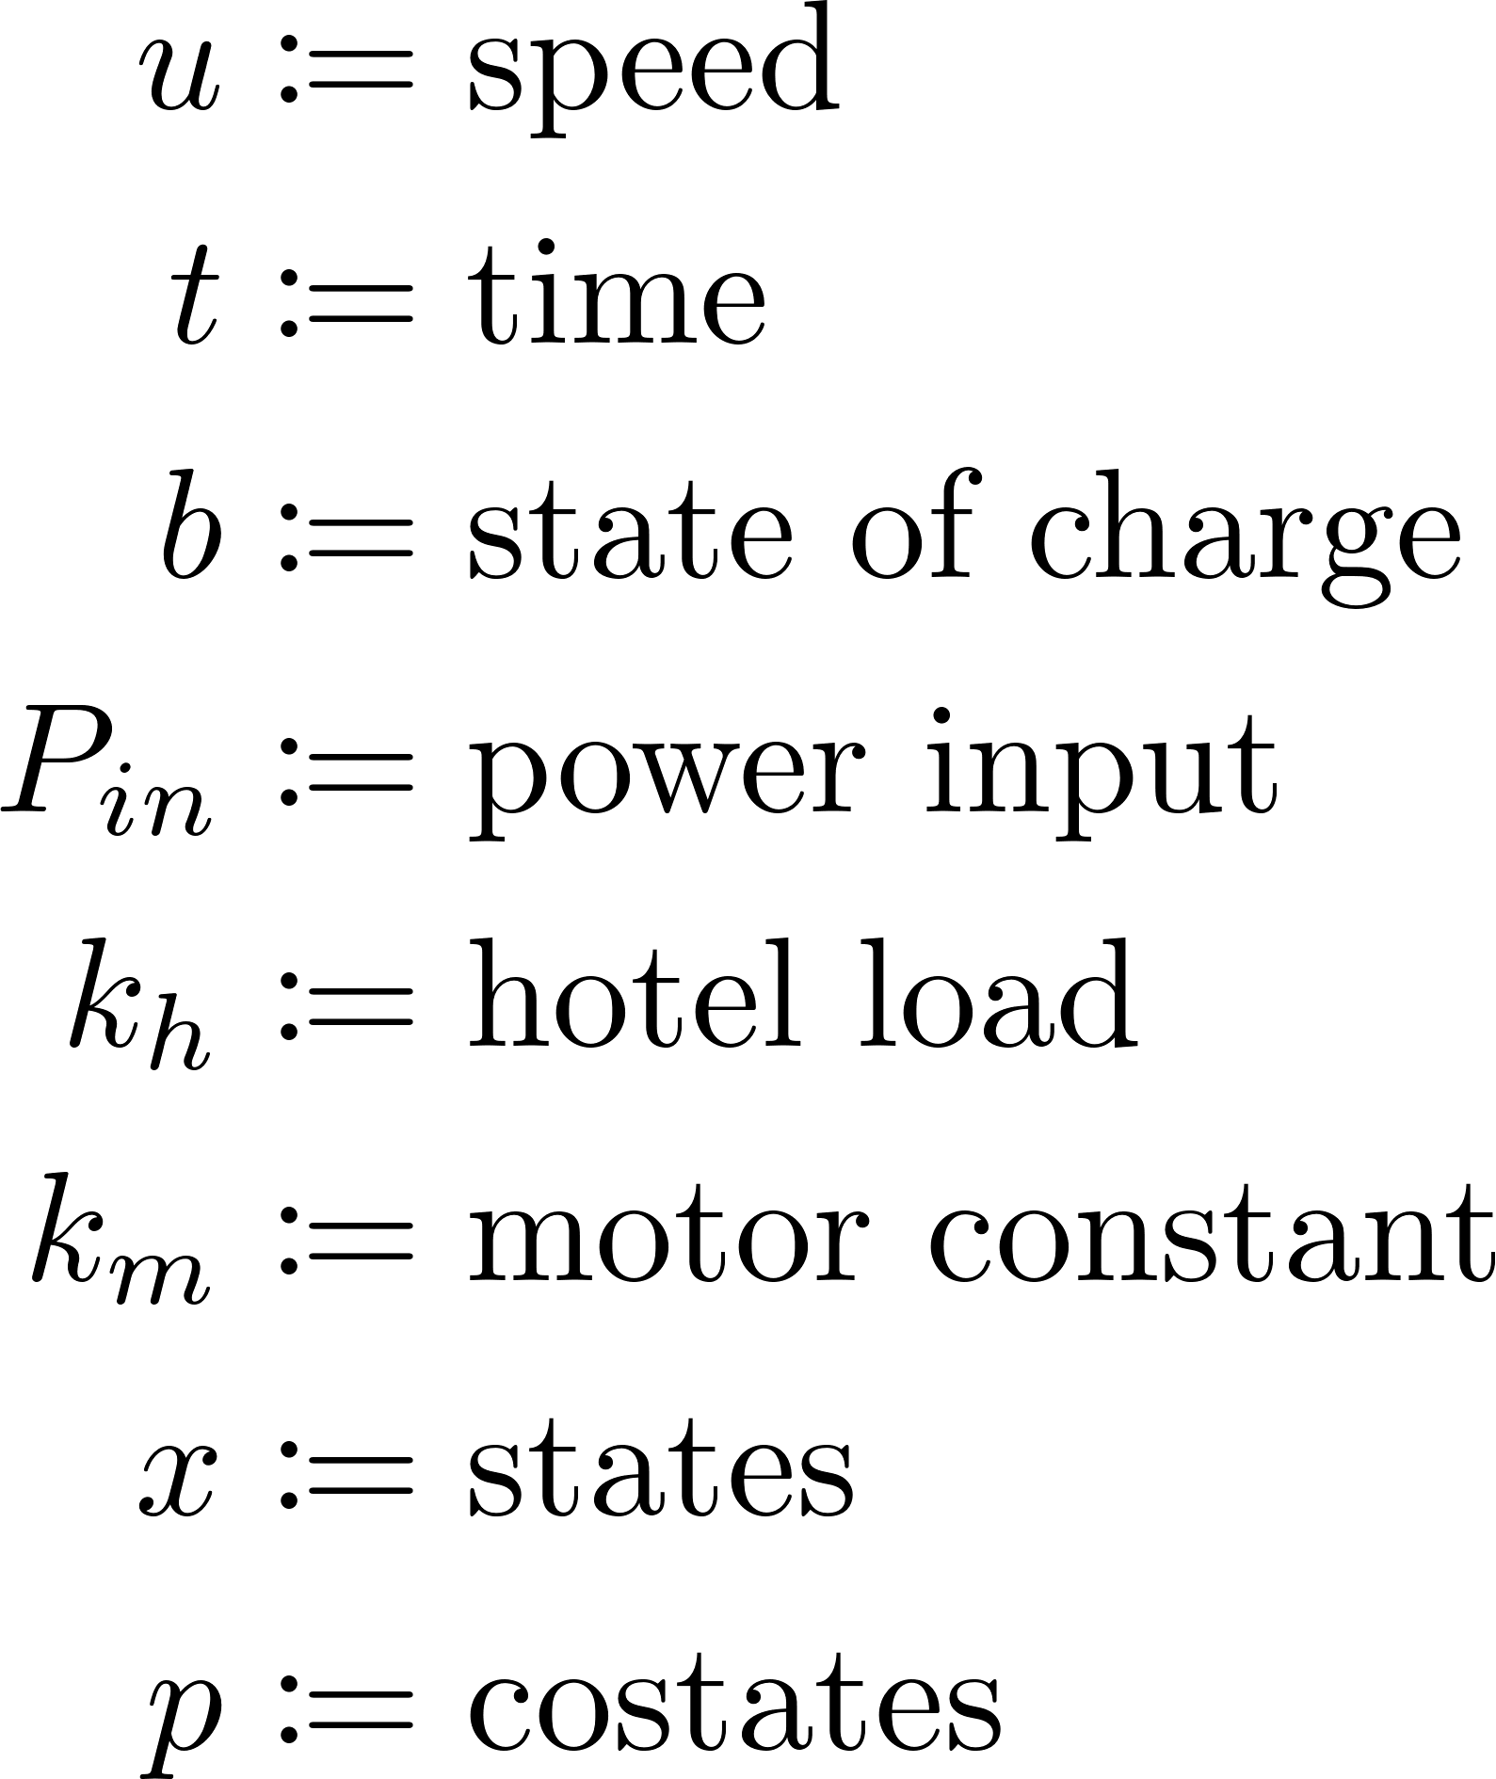

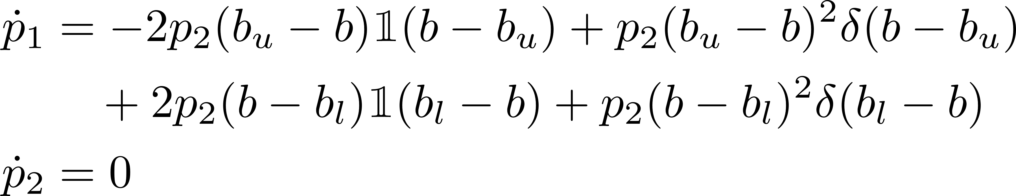
The Control Solution

Slide 15
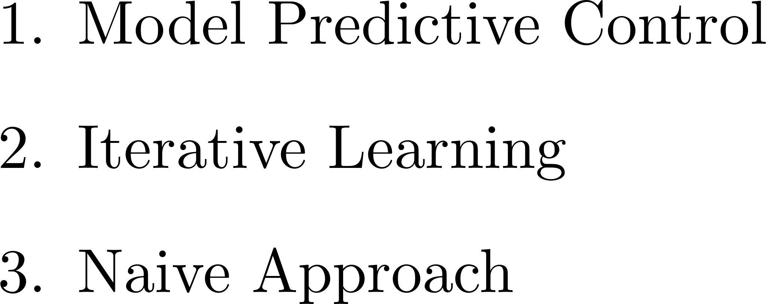

How do we solve for the costate?
$u^{∗}$ is piecewise constant!!

Slide 16
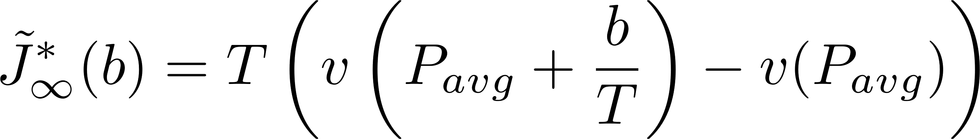







Model Predictive Control
$$v_{b}$$
$$P_{avg}$$
$$T$$
$$t$$
$$N$$
$$∞$$

Slide 17
How do we solve for the costate?
$u^{∗}$ is piecewise constant!!

Slide 18

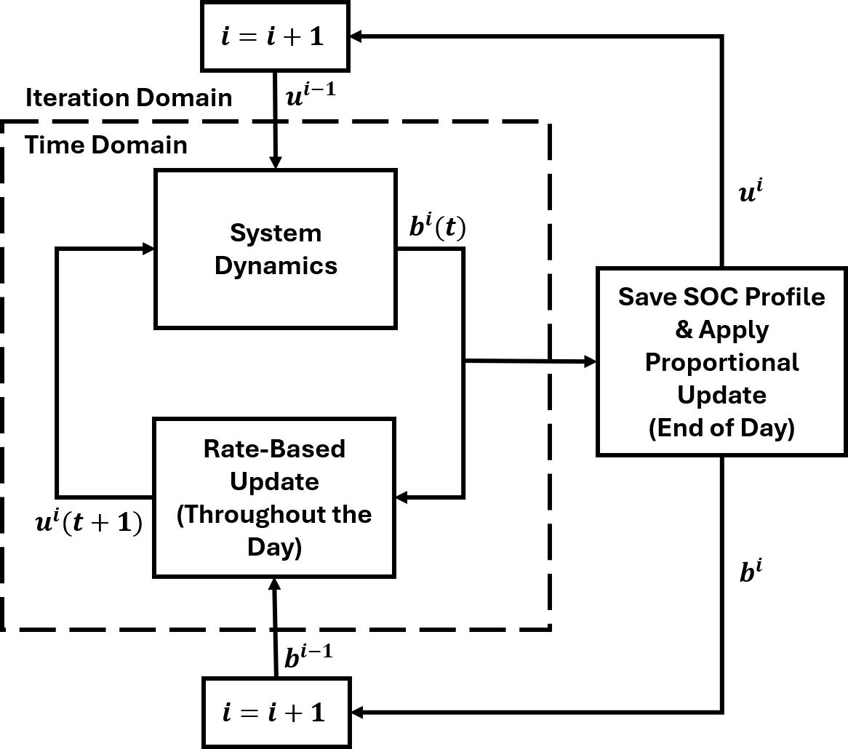
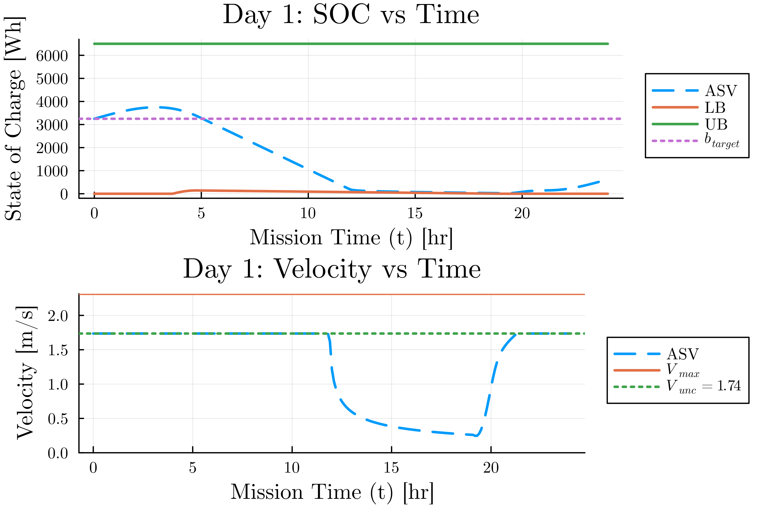
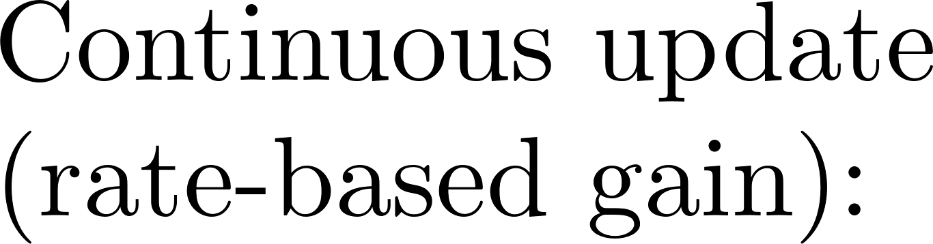
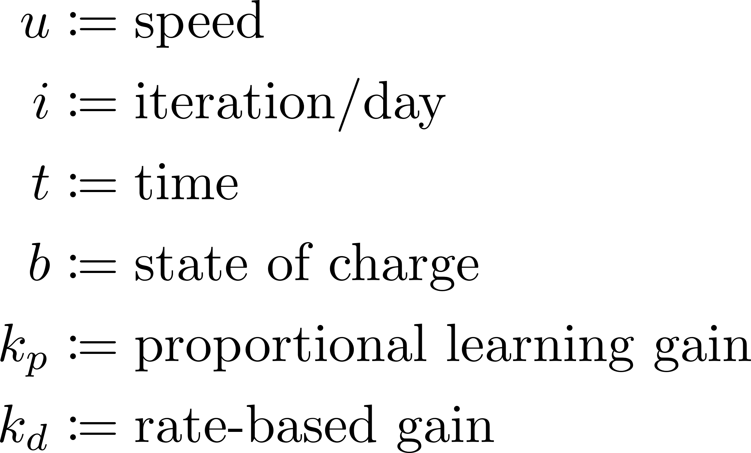
Iterative Learning Update Law

Slide 19
How do we solve for the costate?
$u^{∗}$ is piecewise constant!!

Slide 20

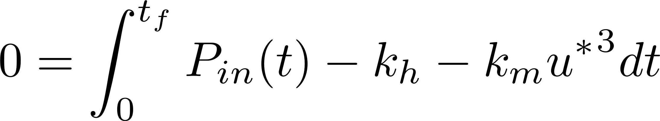

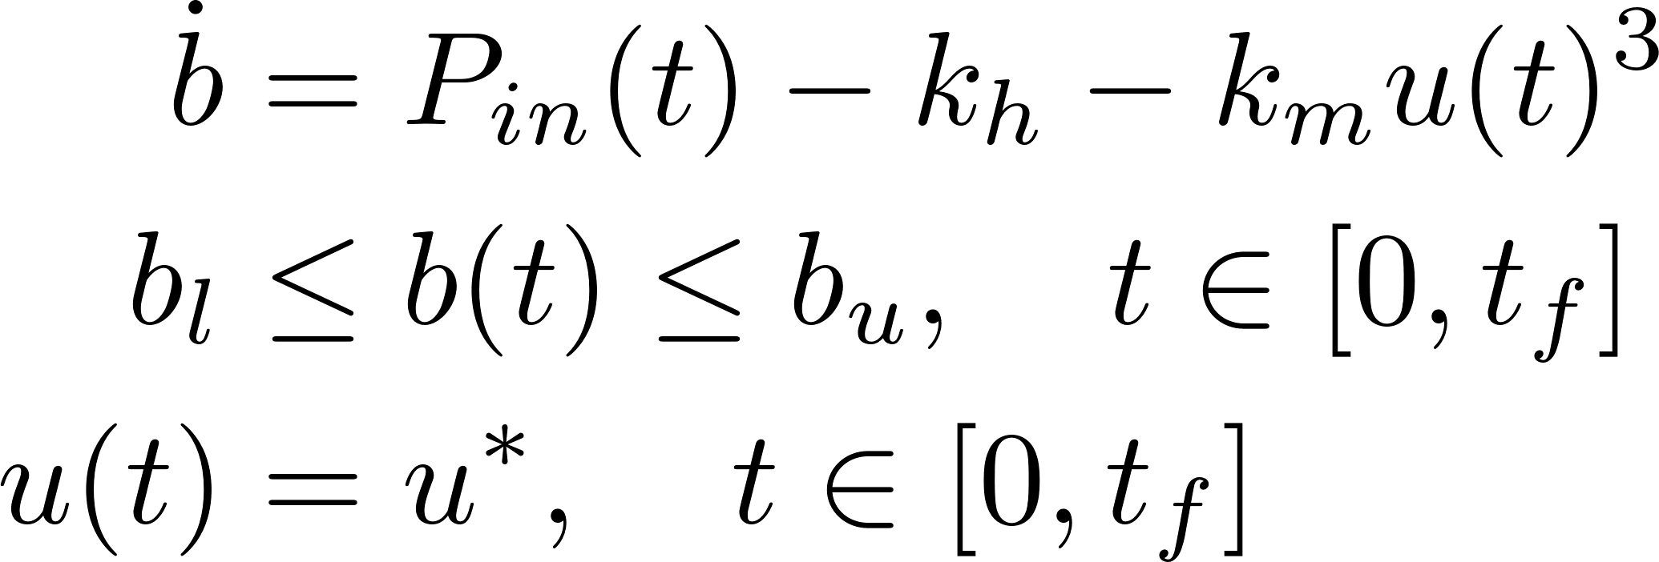
Comparison Constant Velocity Strategies
2 Cases:
Constant velocity w/ SOC constraints
Constant velocity w/o SOC constraints

Slide 21
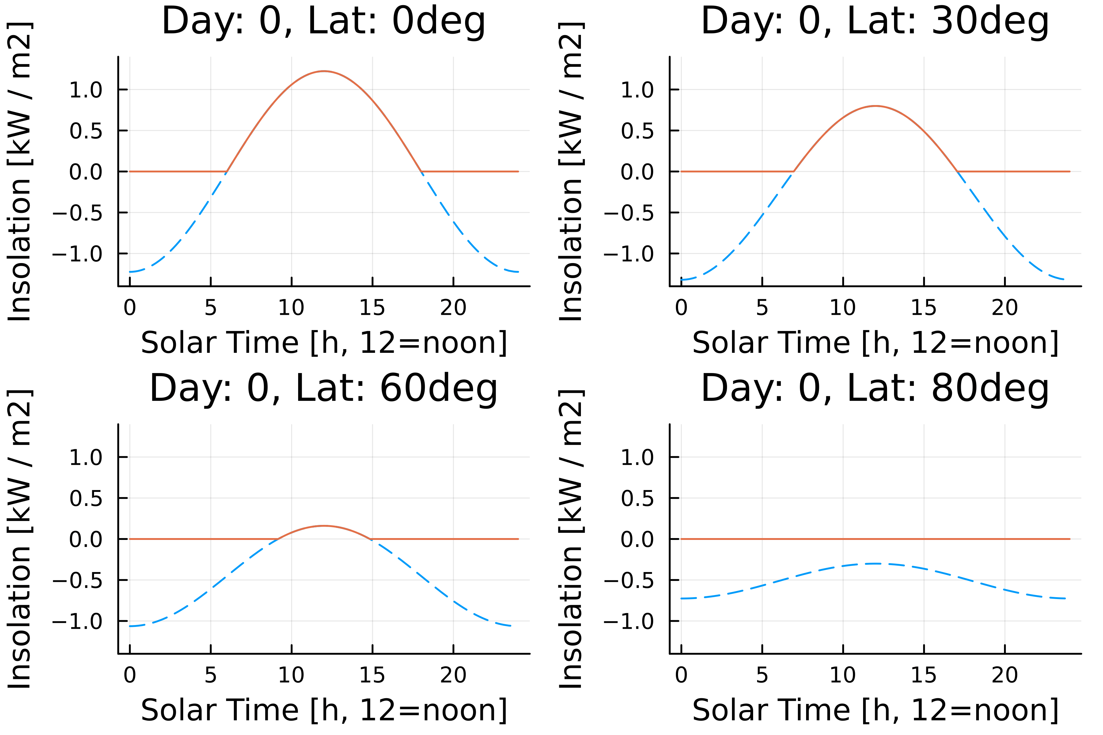
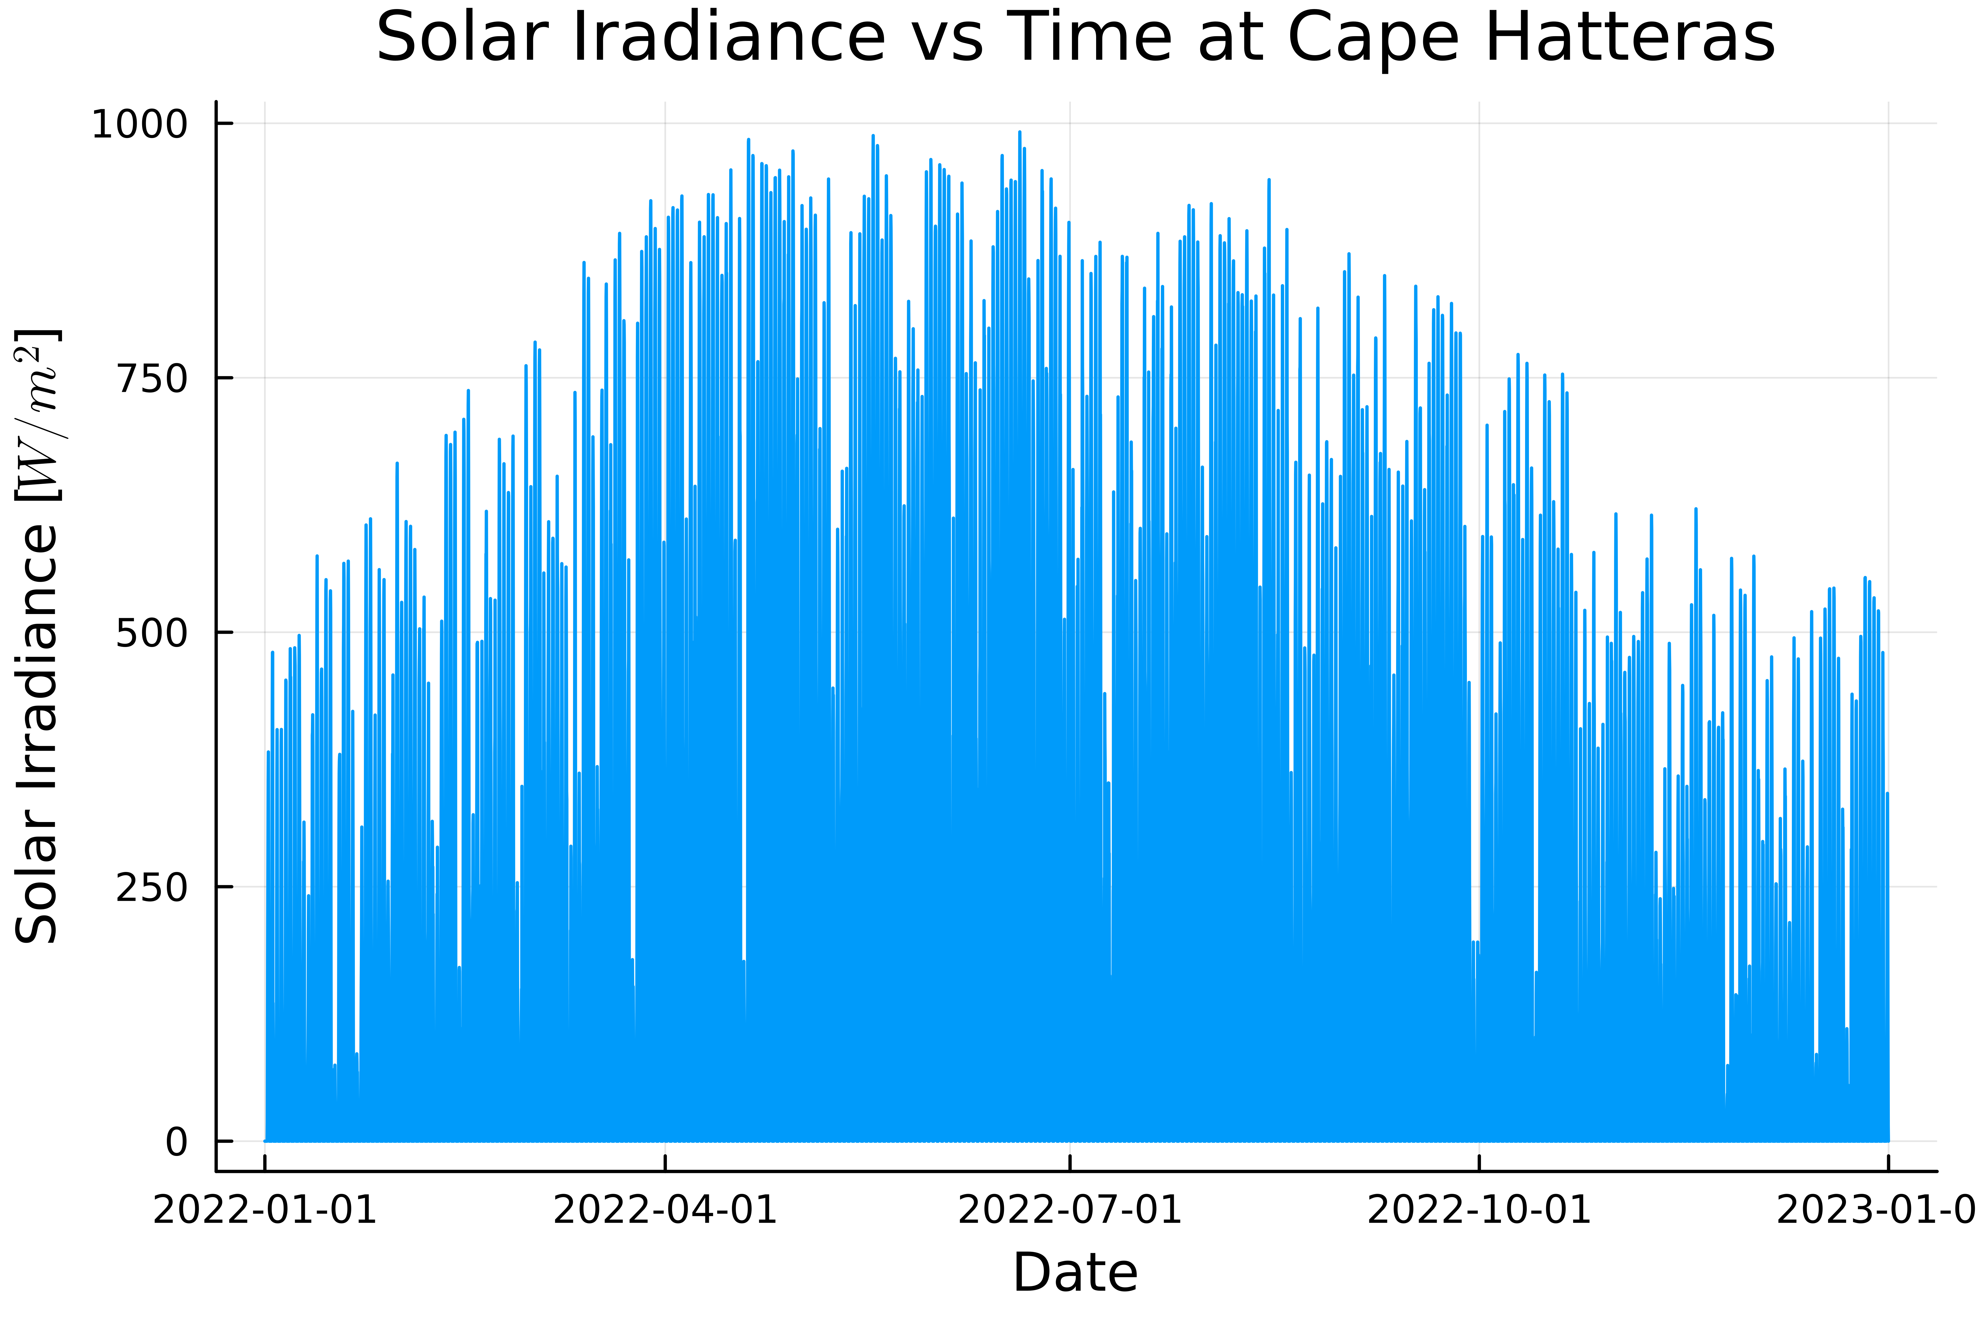
Real time realization: Irradiance models
Ideal Irradiance Model [6]
Historical Irradiance Model: ERA5 [7]
[6] R. L. Hulstrom, Insolation Models and Algorithms, 2003, pp. 61–141.
[7] H. Hersbach, B. Bell, P. Berrisford, S. Hirahara, A. Horányi, J. Muñoz-Sabater, J. Nicolas, C. Peubey, R. Radu, D. Schepers, et al., "The ERA5 global reanalysis," Quarterly Journal of the Royal Meteorological Society, vol. 146, no. 730, pp. 1999–2049, 2020.

Slide 22
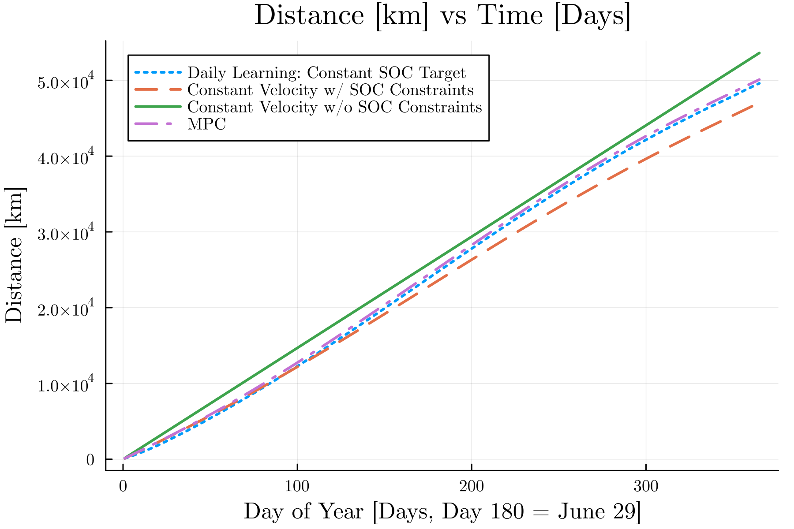
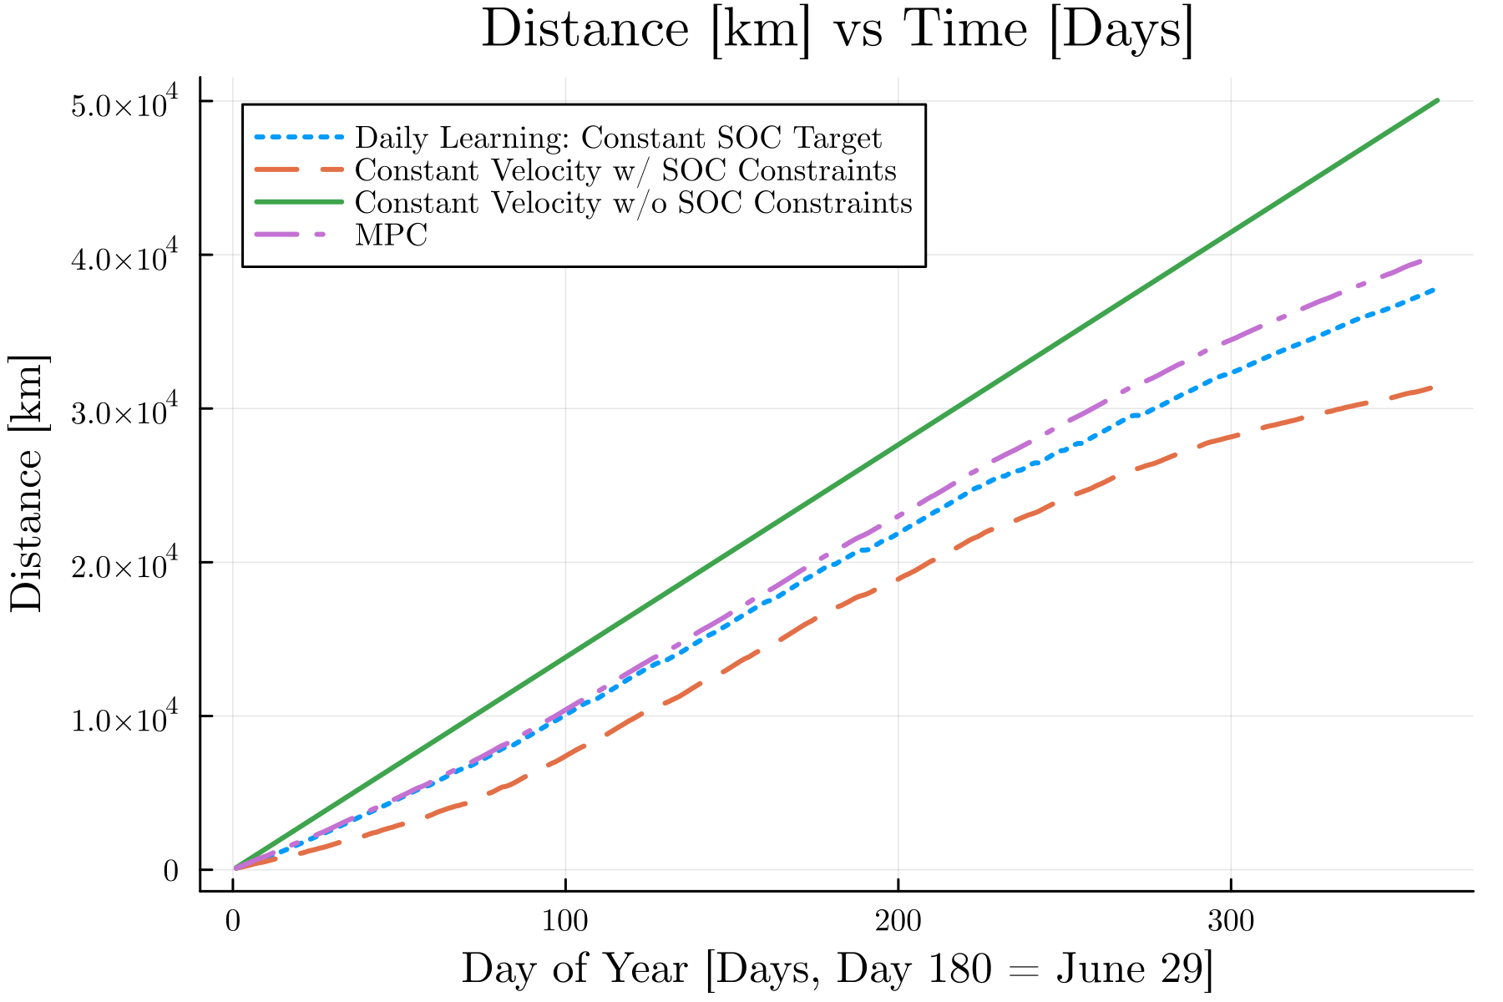
Real time realization: Results
Ideal Irradiance Model
Historical Irradiance Model

Slide 23
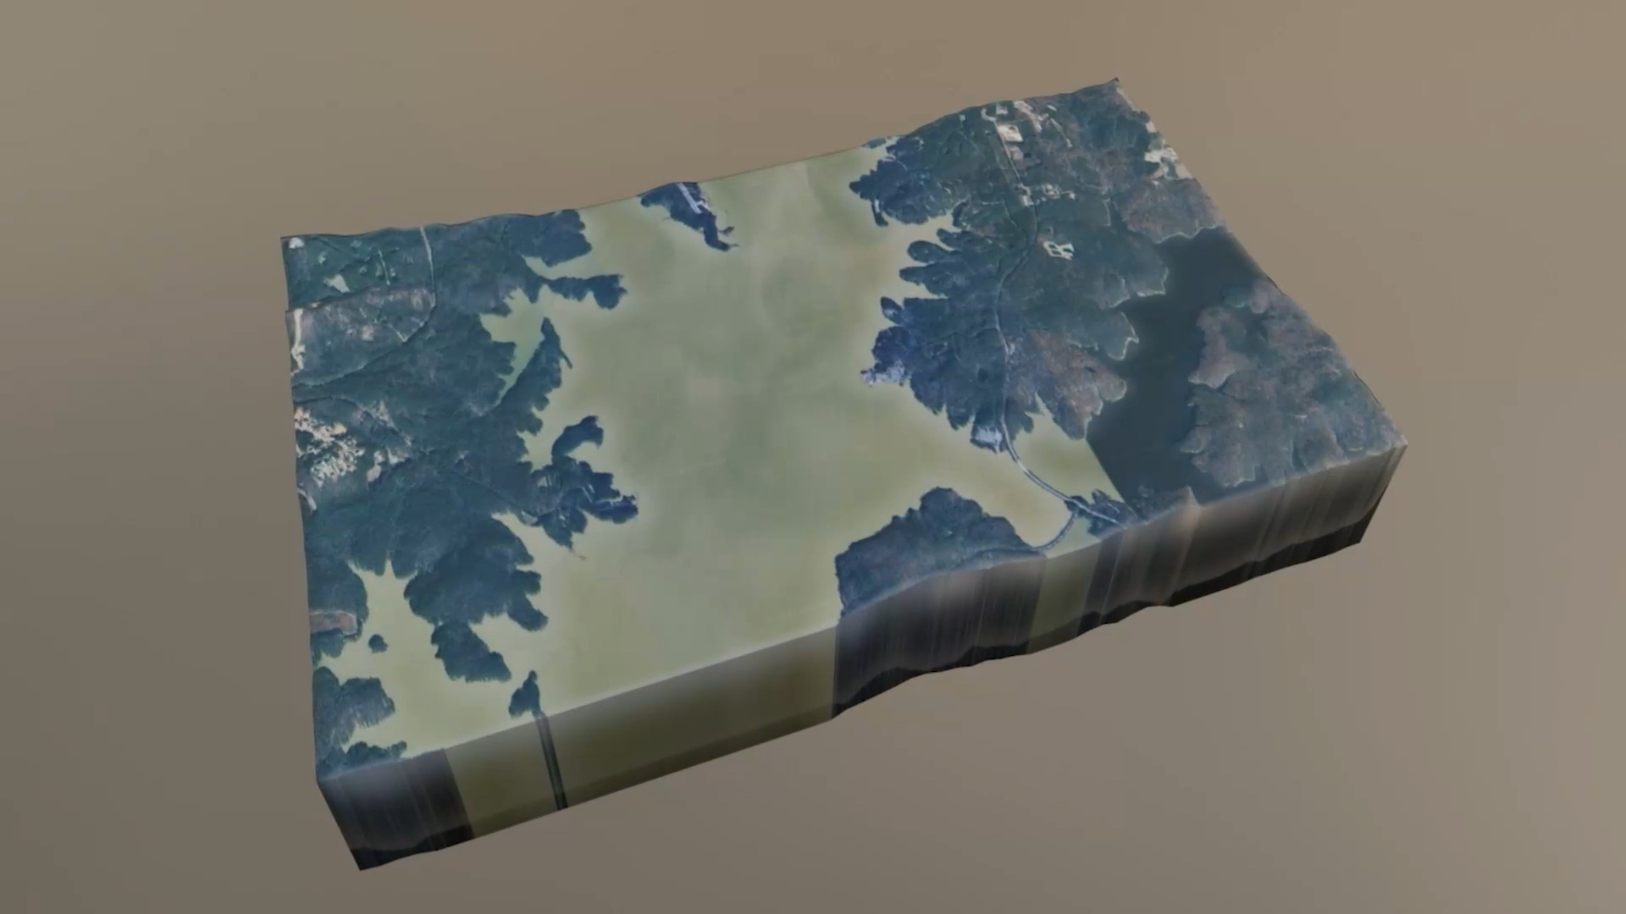


Conclusion
Takeaways:
Proposed ILC approach nearly matches MPC performance w/o need for a forecast
Proposed ILC approach is less computationally intensive
  MPC: 21 hrs 36 min
  ILC: 20 seconds
Ongoing work:
Real-world information-gathering mission
Swapping distance metric for information metric
Questions?
Email: kmgovind@umich.edu
Github: https://github.com/kmgovind/persistent-speed-control
Supported by: NSF Award Number 2223844

Slide 24
Backup Slides

Slide 25
Questions?
Supported by: NSF Award Number 2223844

Slide 26
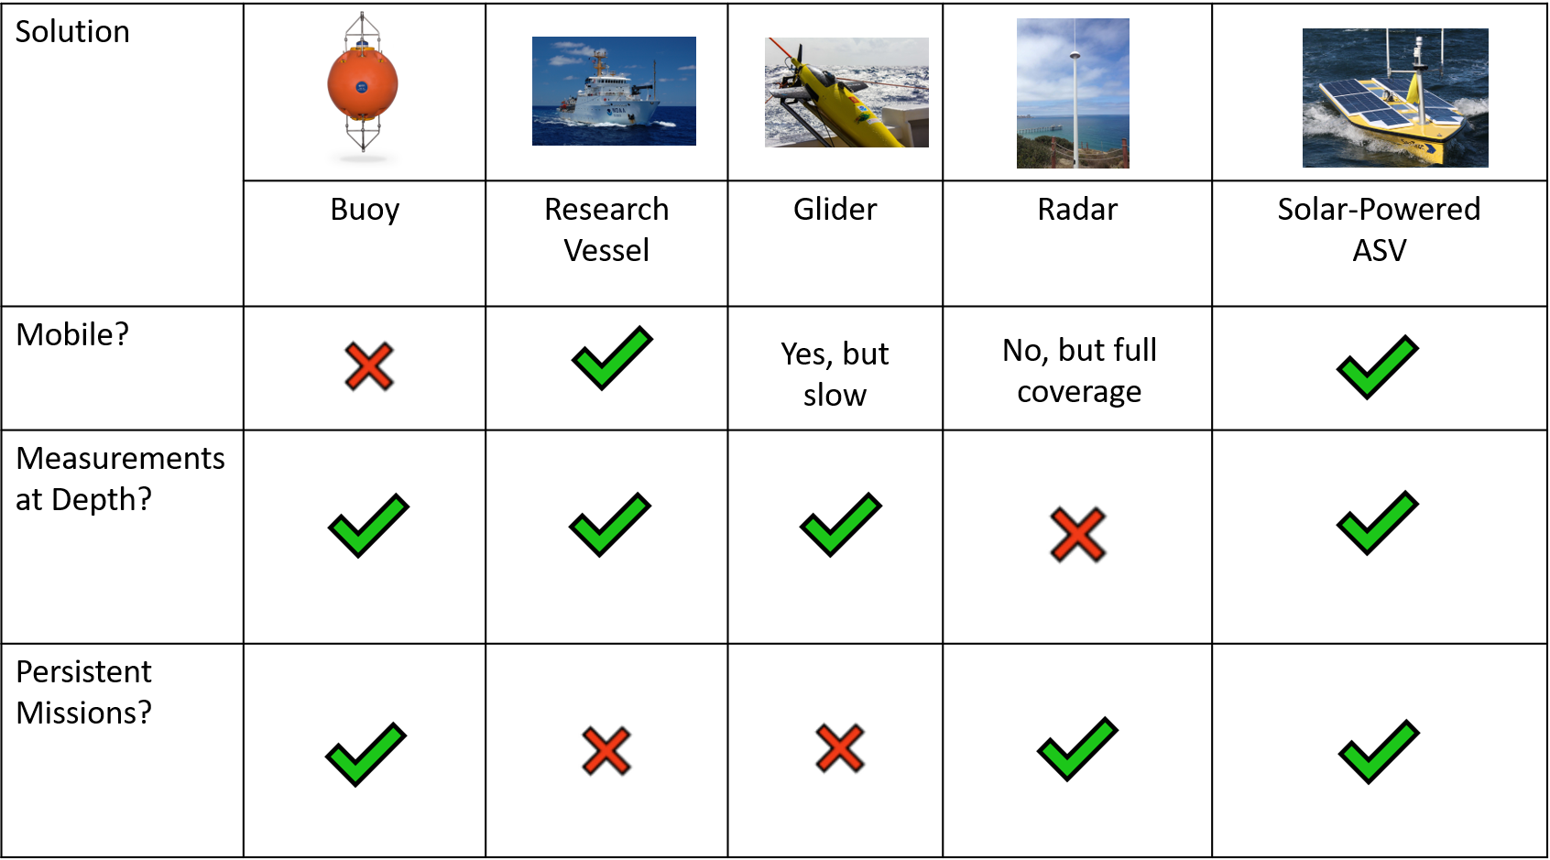
How do we collect oceanographic measurements?

Slide 27
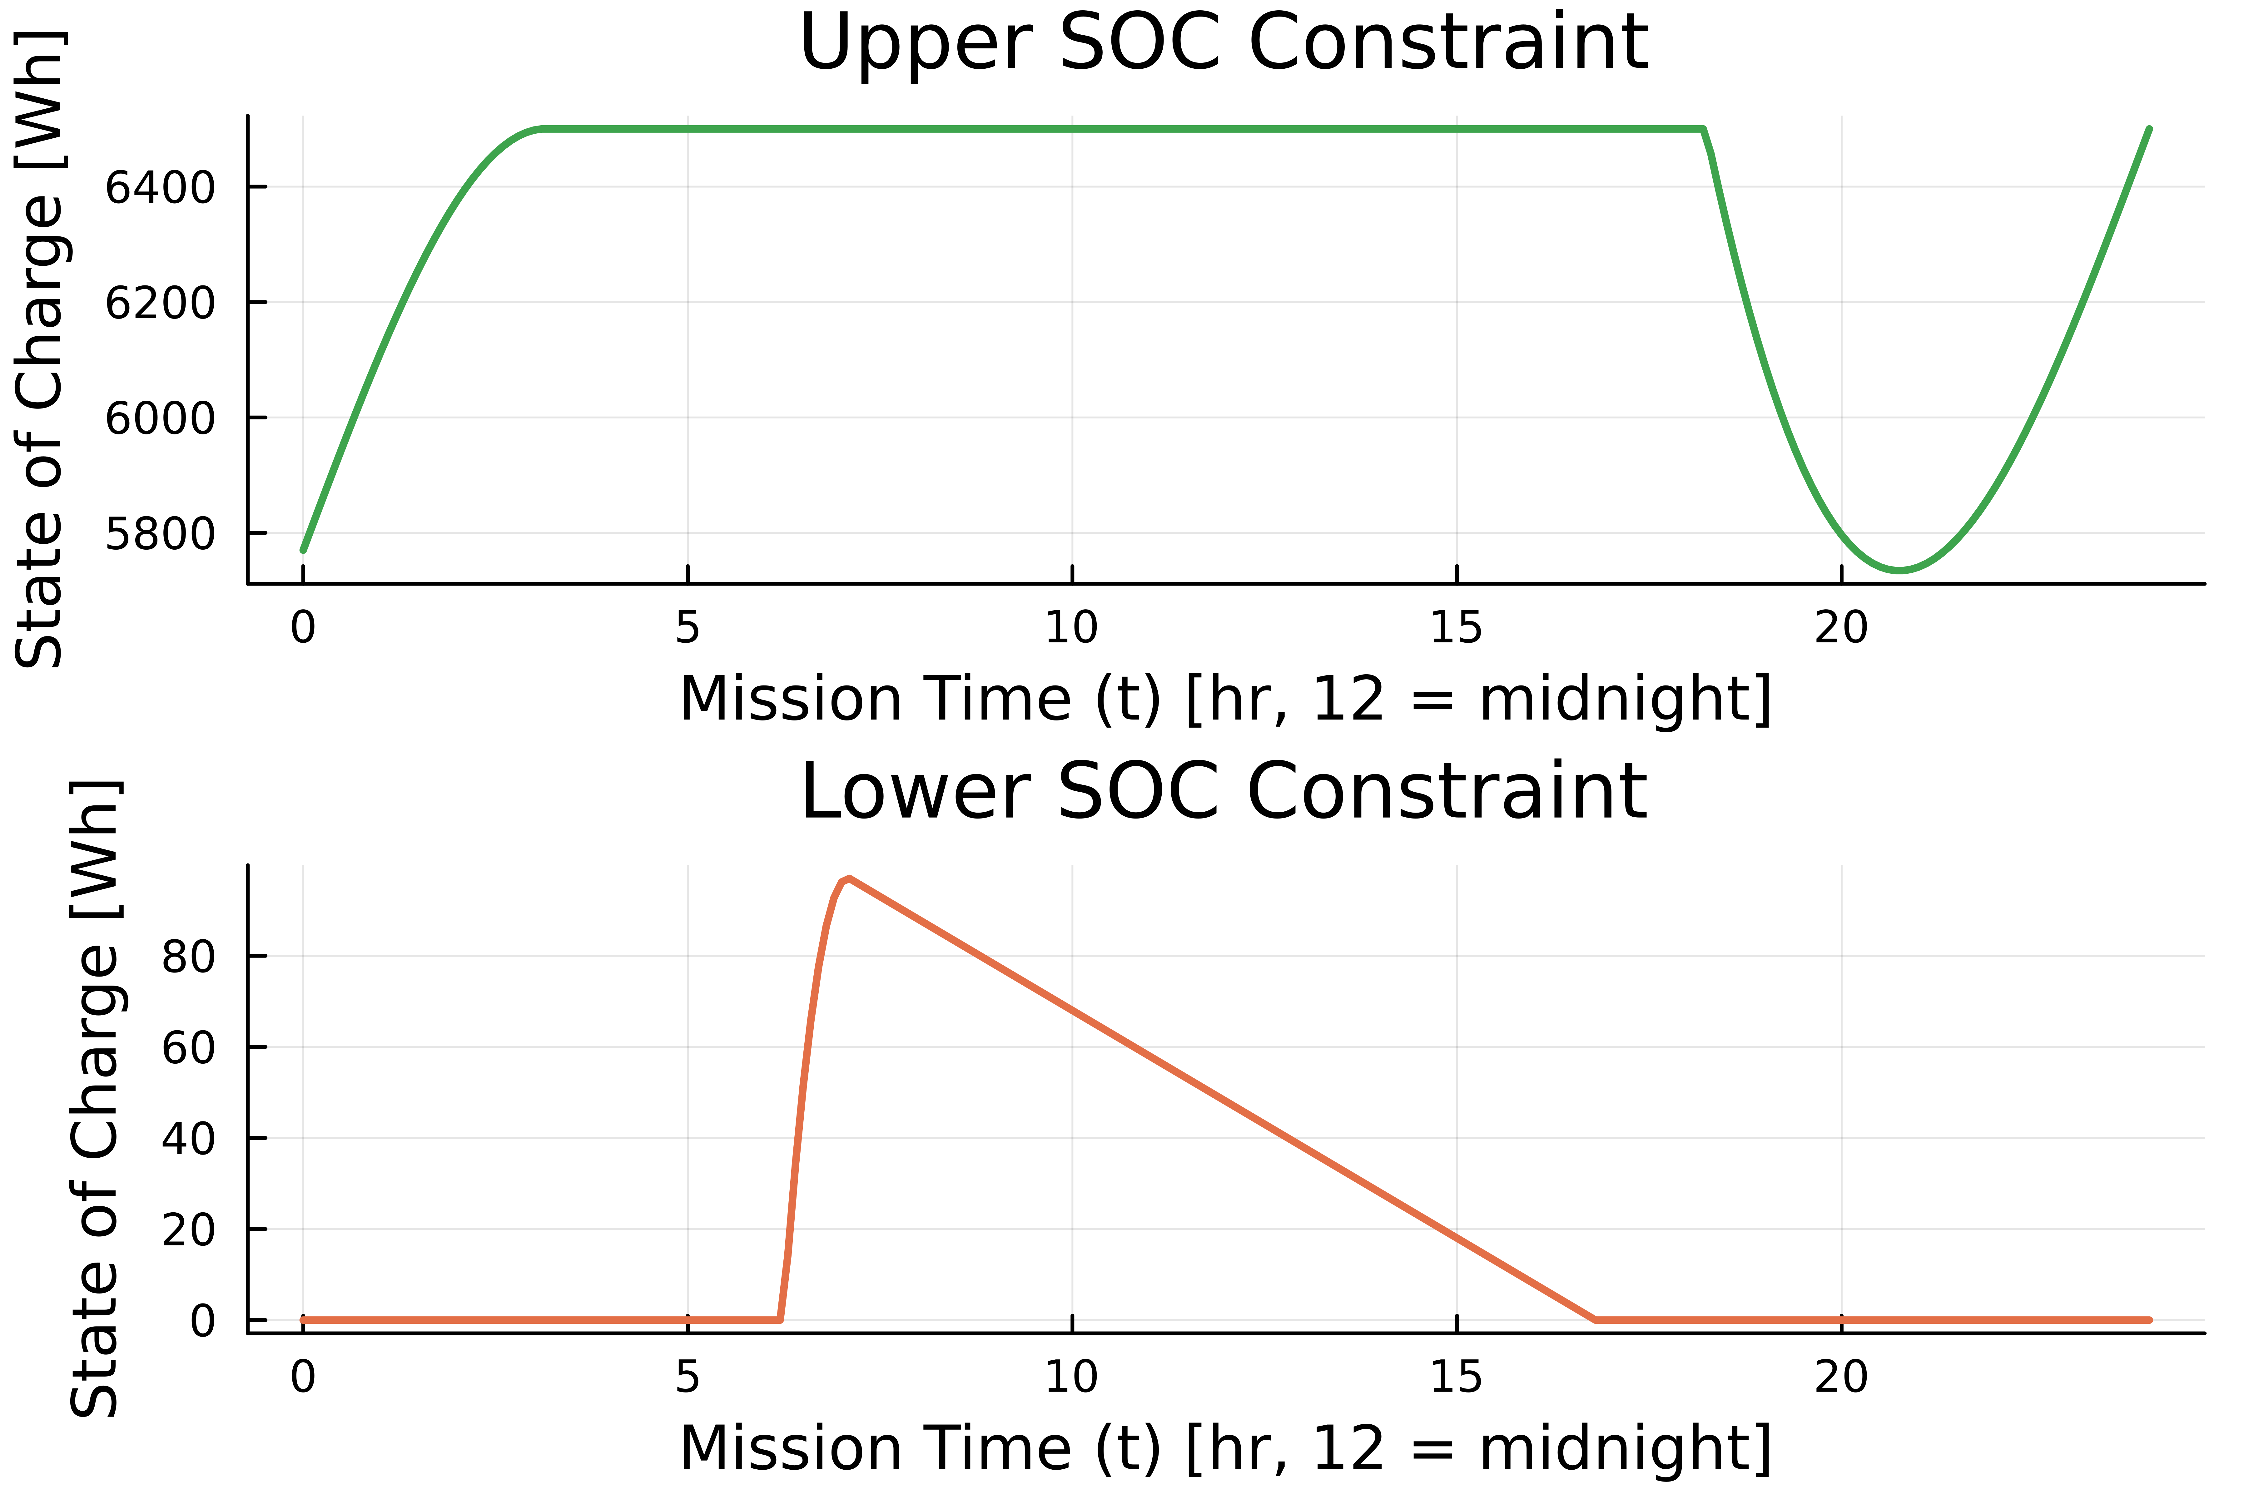
Revised Constraints

Slide 28
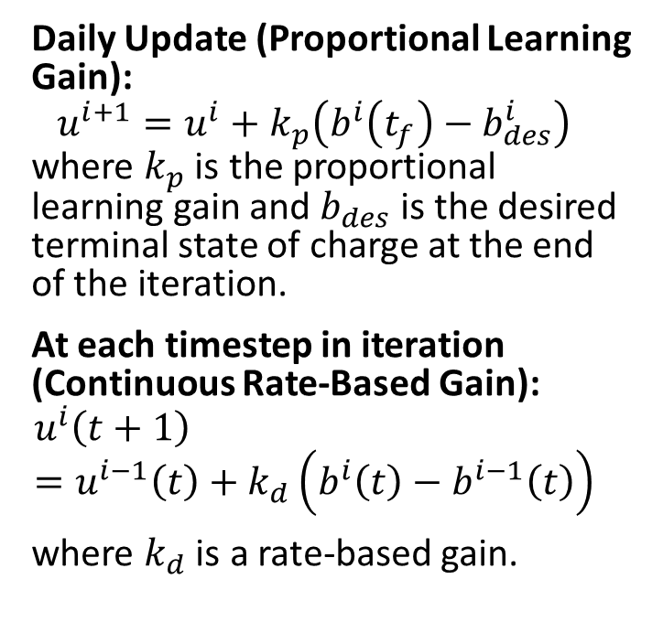
Iterative Learning Update Law
Daily Update (Proportional Learning Gain):
$$u^{i+1}=u^{i}+k_{p}\left(b^{i}\left(t_{f}\right)−b_{des}^{i}\right)$$
where $k_{p}$ is the proportional learning gain and $b_{des}$ is the desired terminal state of charge at the end of the iteration.
At each timestep in iteration (Continuous Rate-Based Gain):
$$u^{i}\left(t+1\right)=u^{i−1}\left(t\right)+k_{d}\left(b^{i}\left(t\right)−b^{i−1}\left(t\right)\right)$$
where $k_{d}$ is a rate-based gain.

Slide 29
Characterizing $P_{in}\left(t\right)$ as a mathematical function [3]
[3] R. L. Hulstrom, Insolation Models and Algorithms, 2003, pp. 61–141.

Slide 30
$P_{in}\left(t\right)$ in the real world: ERA5 Model [4]
[4] Hersbach, Hans, et al. "The ERA5 global reanalysis." Quarterly journal of the royal meteorological society 146.730 (2020): 1999-2049.

Slide 31
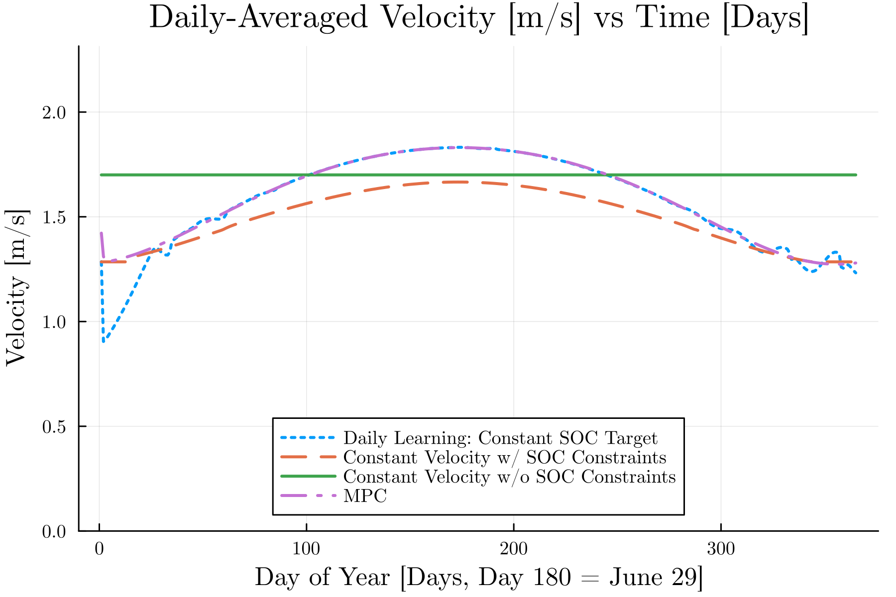
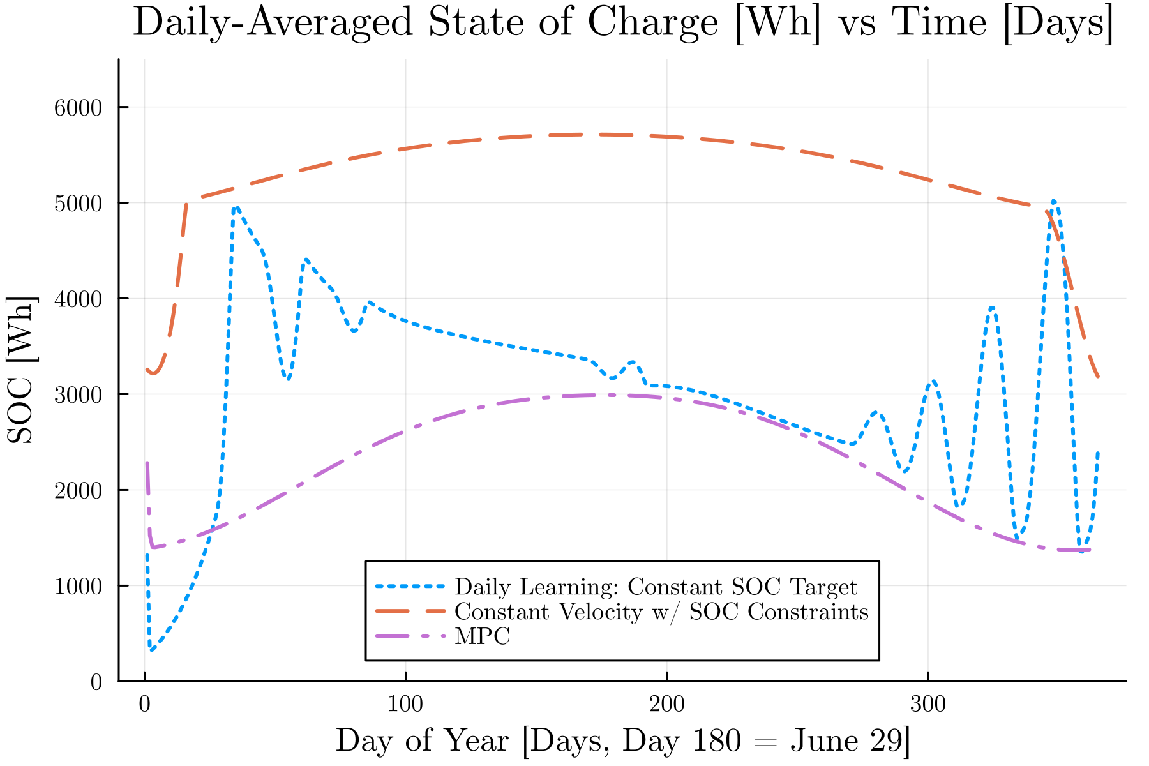
Results – Model Irradiance

Slide 32
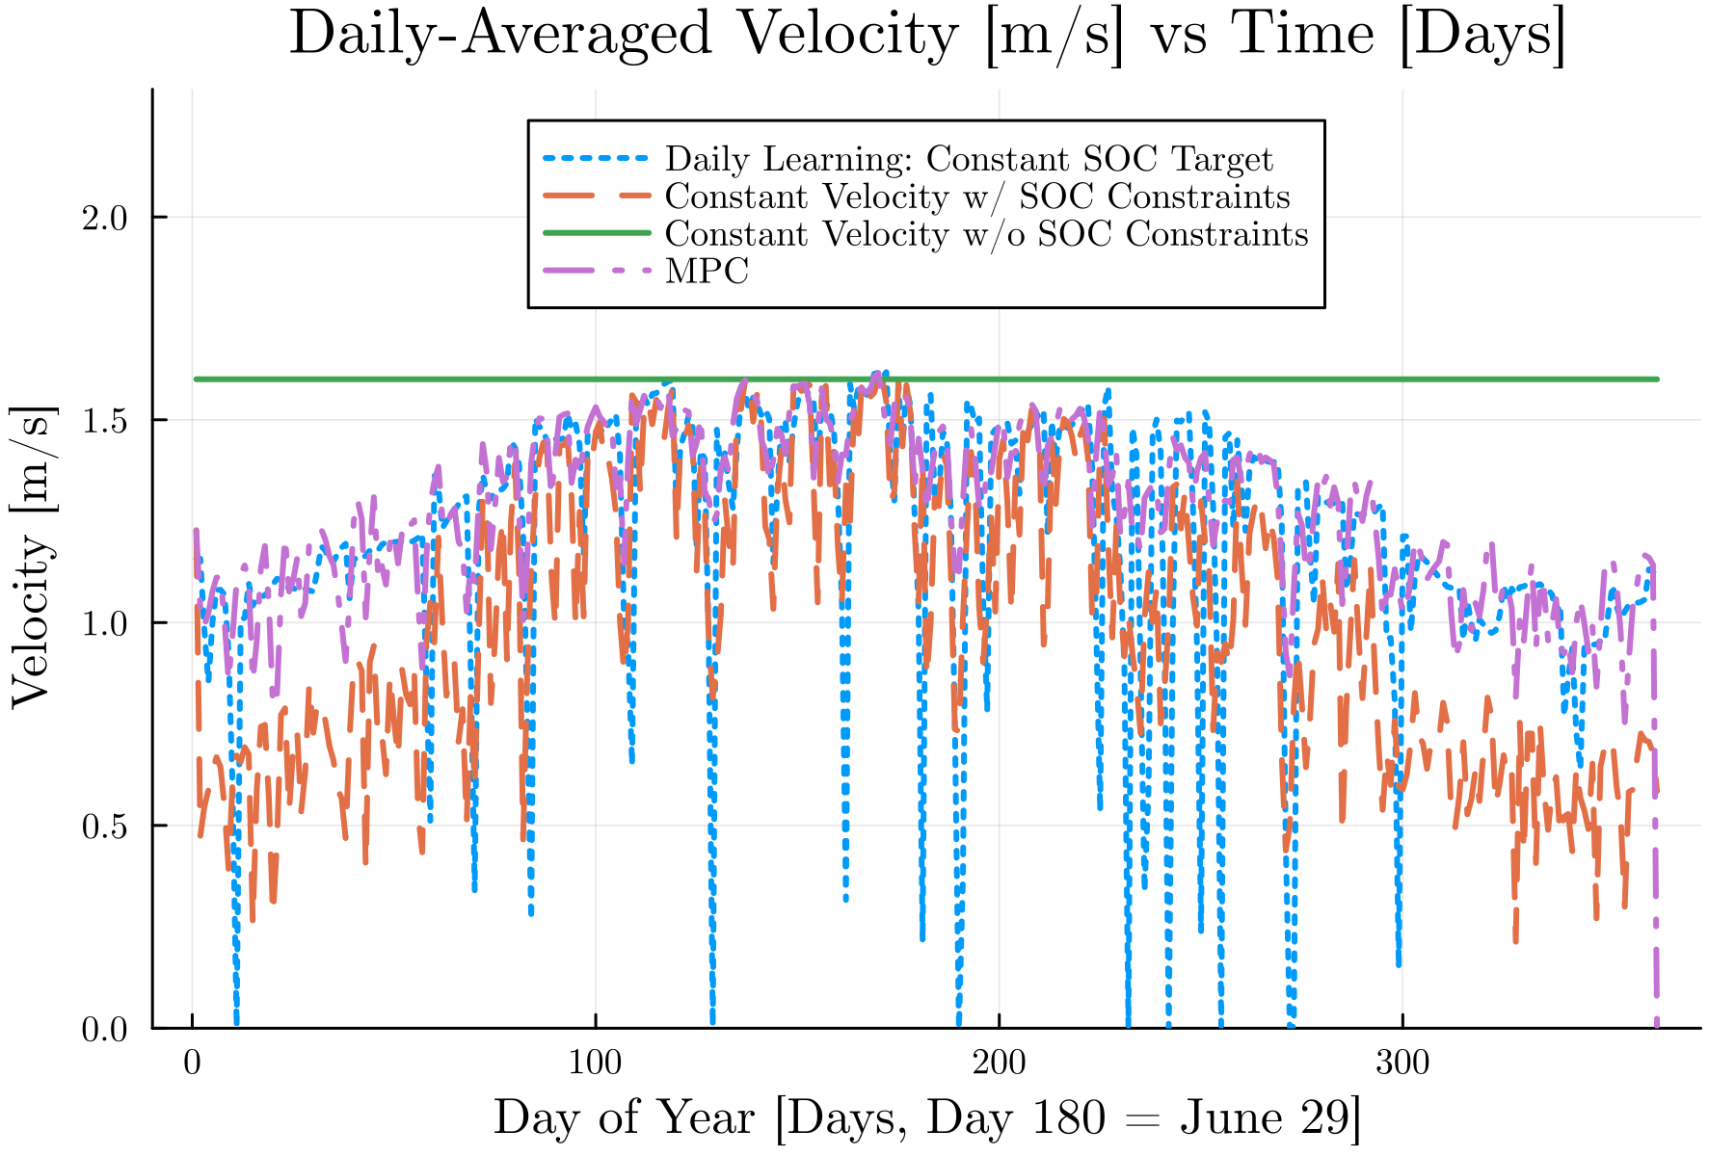
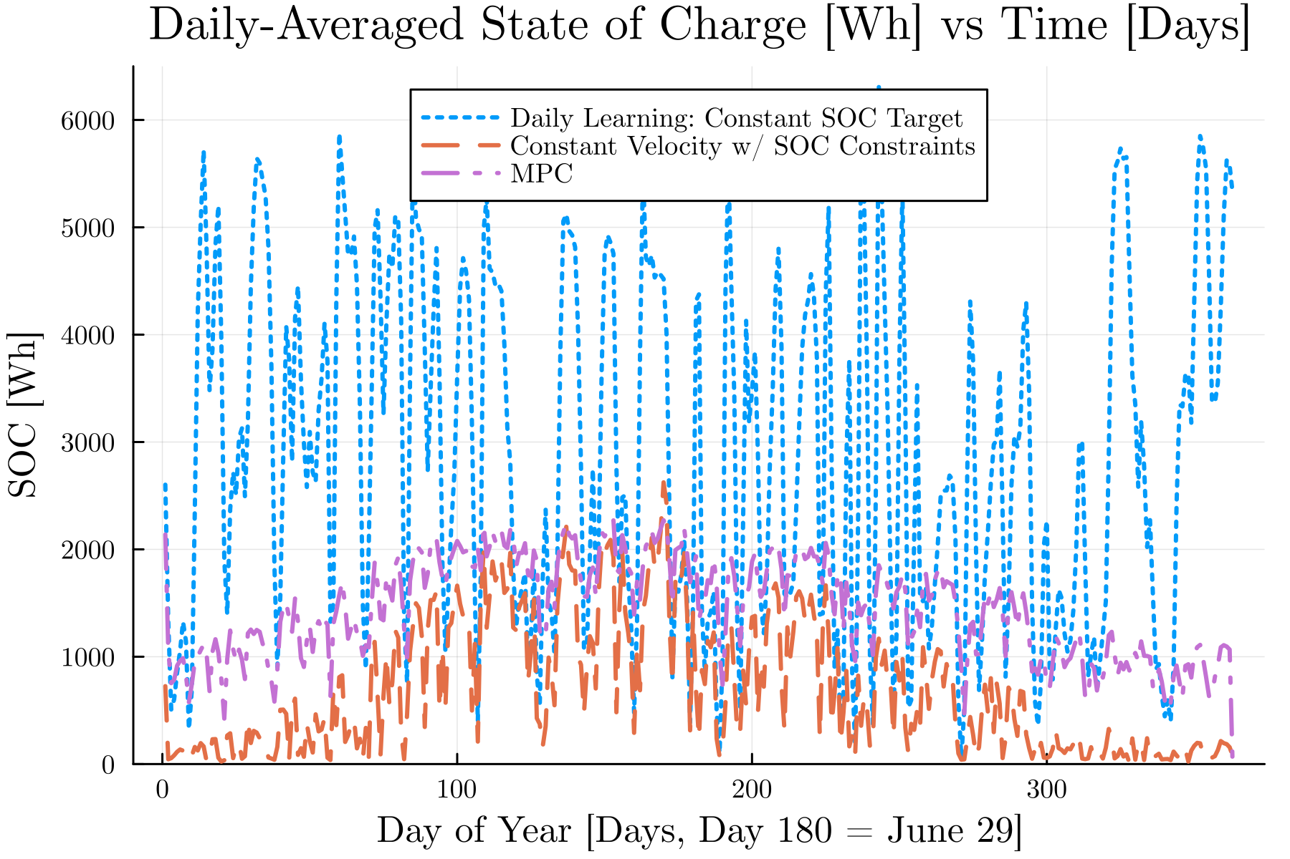
Results – Real World Irradiance

Slide 33
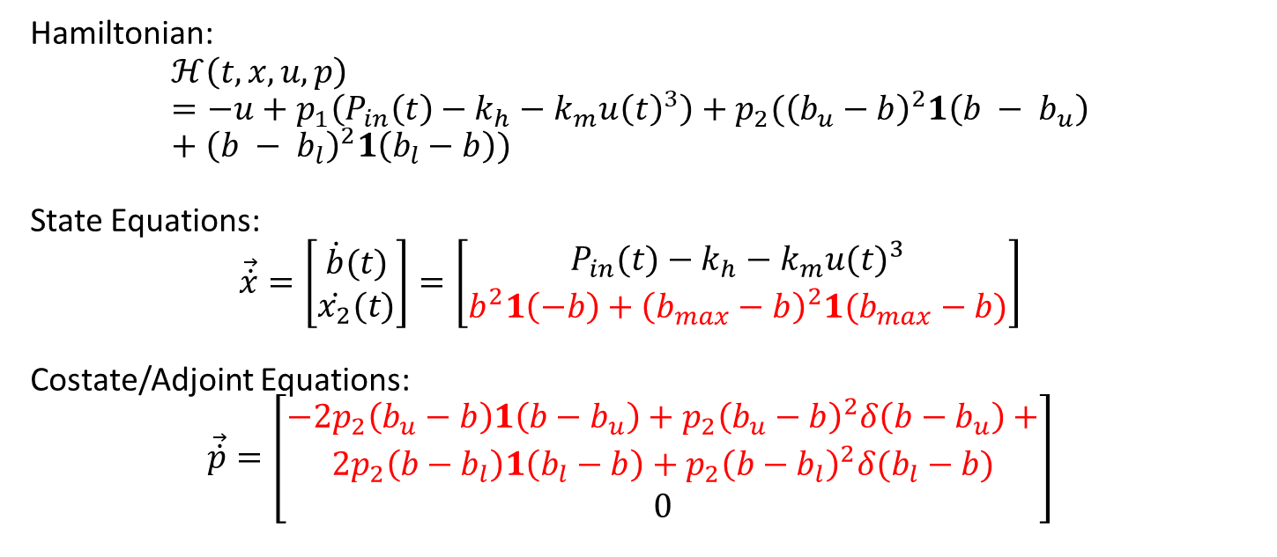
Applying Indirect Methods
Hamiltonian:
$$ℋ\left(t,x,u,p\right)=−u+p_{1}\left(P_{in}\left(t\right)−k_{h}−k_{m}u{\left(t\right)}^{3}\right)+p_{2}({\left(b_{u}−b\right)}^{2}1\left(b − b_{u}\right)+{\left(b − b_{l}\right)}^{2}1\left(b_{l}−b\right))$$
State Equations:
$$\vec{\dot{x}}=\left[\begin{matrix}\dot{b}(t) \\ \dot{x_{2}}(t)\end{matrix}\right]=\left[\begin{matrix}P_{in}(t)−k_{h}−k_{m}{u(t)}^{3} \\ b^{2}1\left(−b\right)+{\left(b_{max}−b\right)}^{2}1(b_{max}−b)\end{matrix}\right]$$
Costate/Adjoint Equations:
$$\vec{\dot{p}}=\left[\begin{matrix}\begin{aligned}−2p_{2}\left(b_{u}−b\right)1\left(b−b_{u}\right)+p_{2}{\left(b_{u}−b\right)}^{2}δ\left(b−b_{u}\right)+ \\ 2p_{2}\left(b−b_{l}\right)1\left(b_{l}−b\right)+p_{2}{\left(b−b_{l}\right)}^{2}δ(b_{l}−b)\end{aligned} \\ 0\end{matrix}\right]$$

