Slide 1
Clarity-Driven Ergodic Control for Persistent Tip-and-Cue Missions with Synchronized Rendezvous
David Li, Kavin M. Govindarajan, Chris Vermillion
CDC 2025

Slide 2
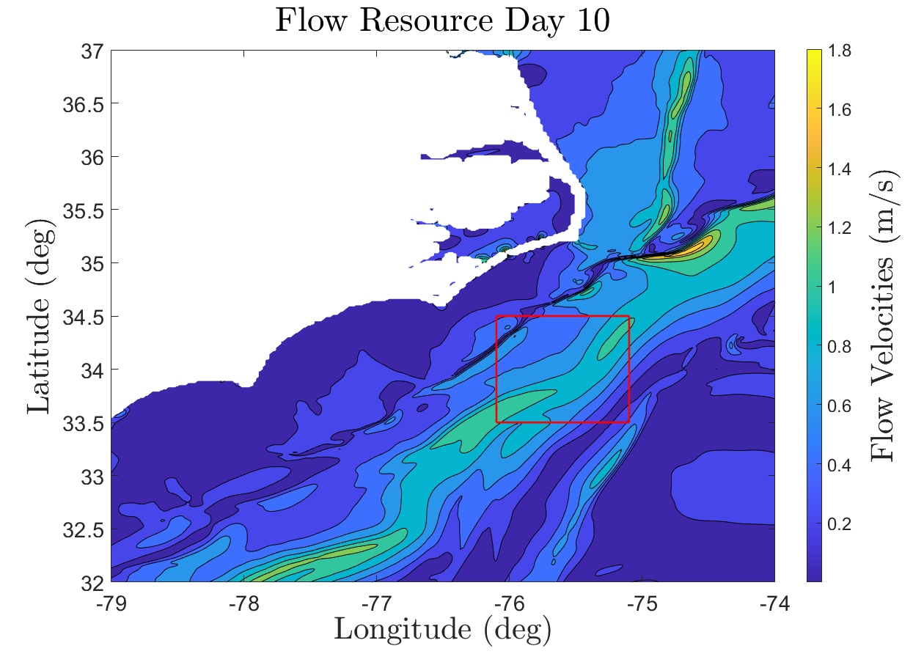
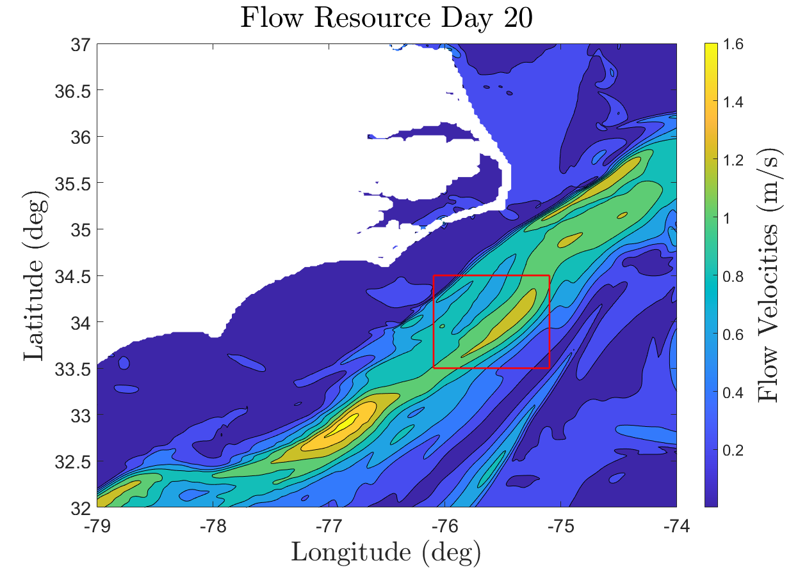
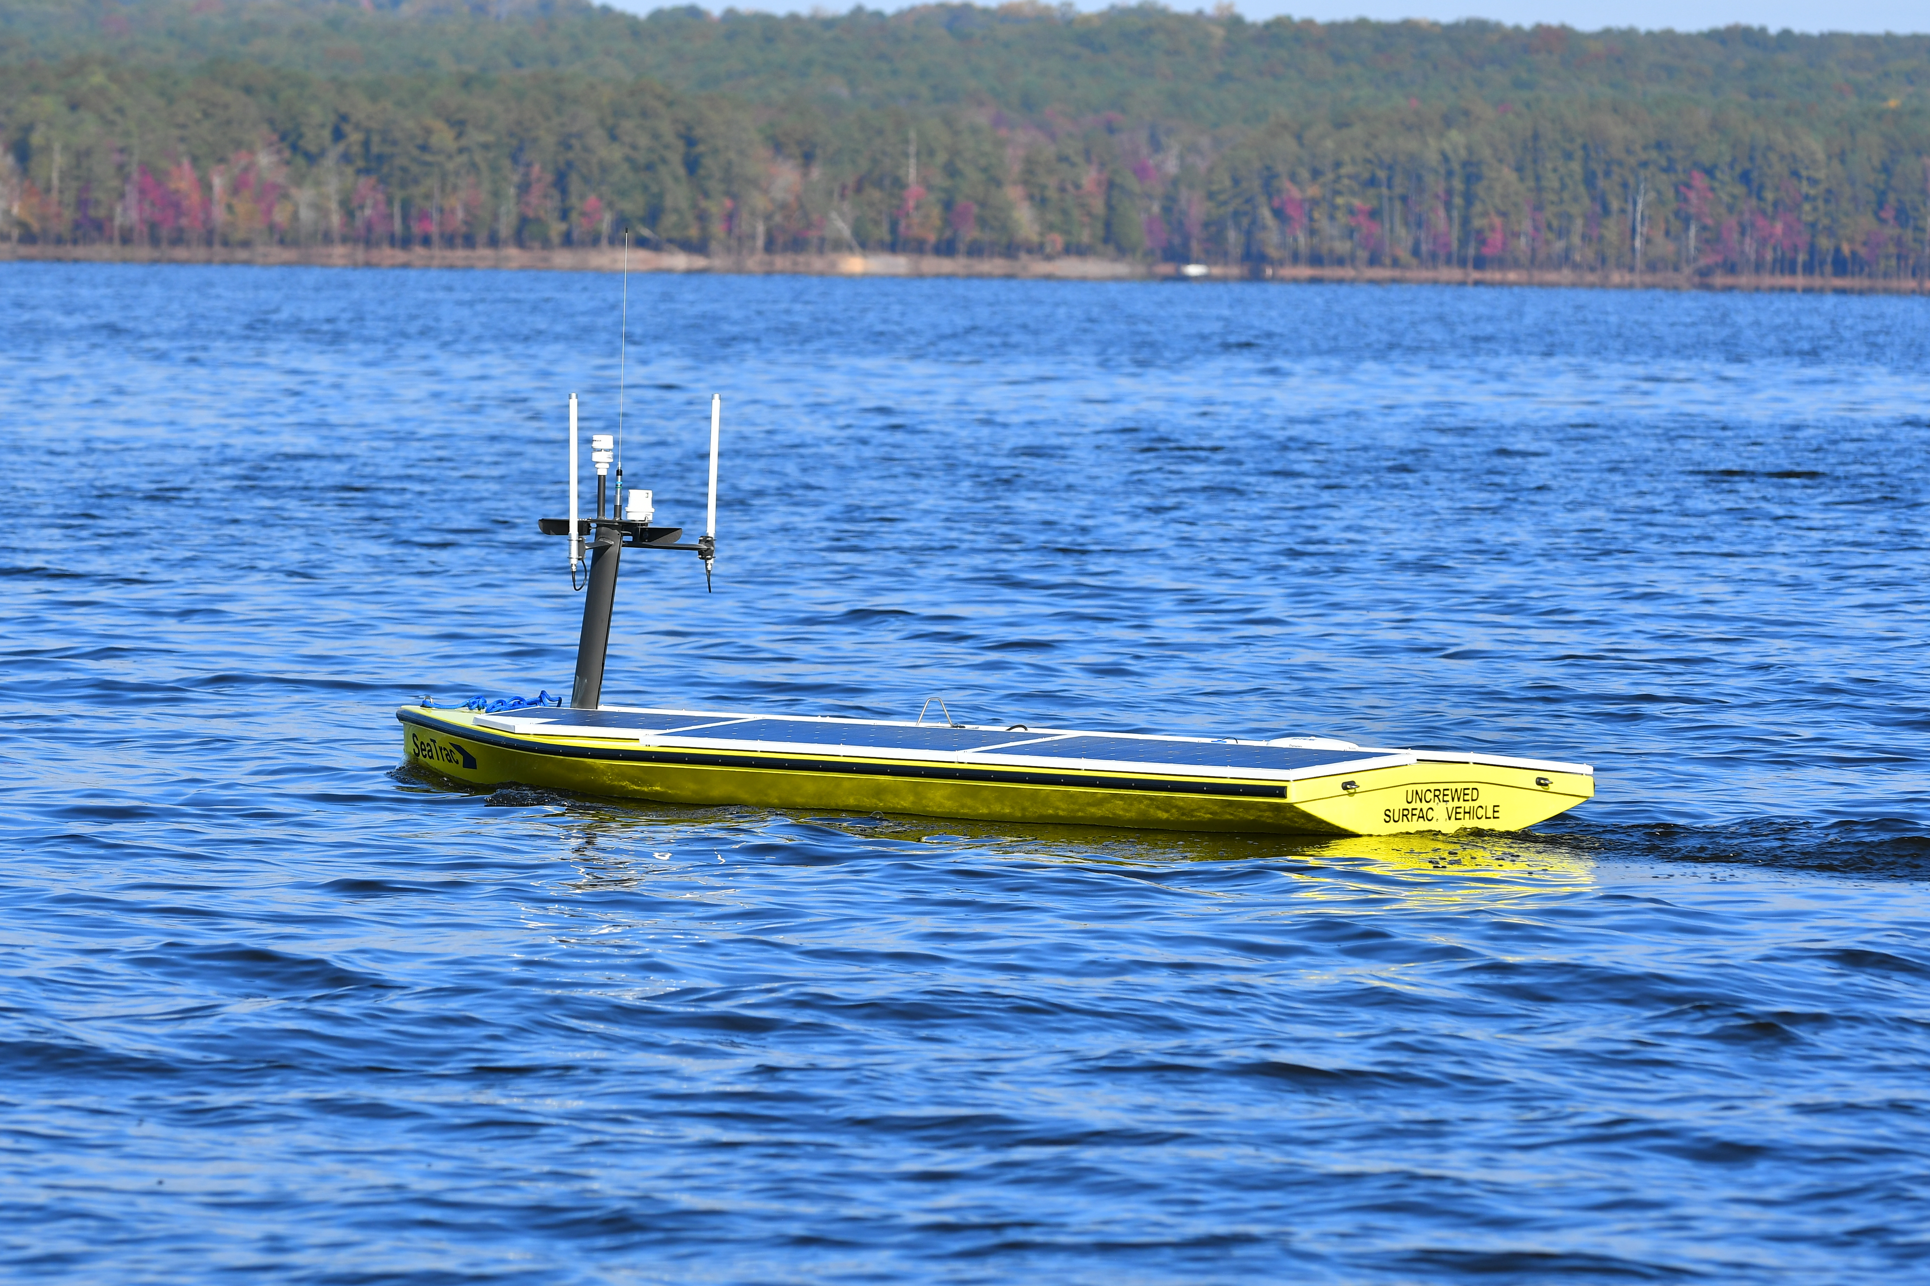
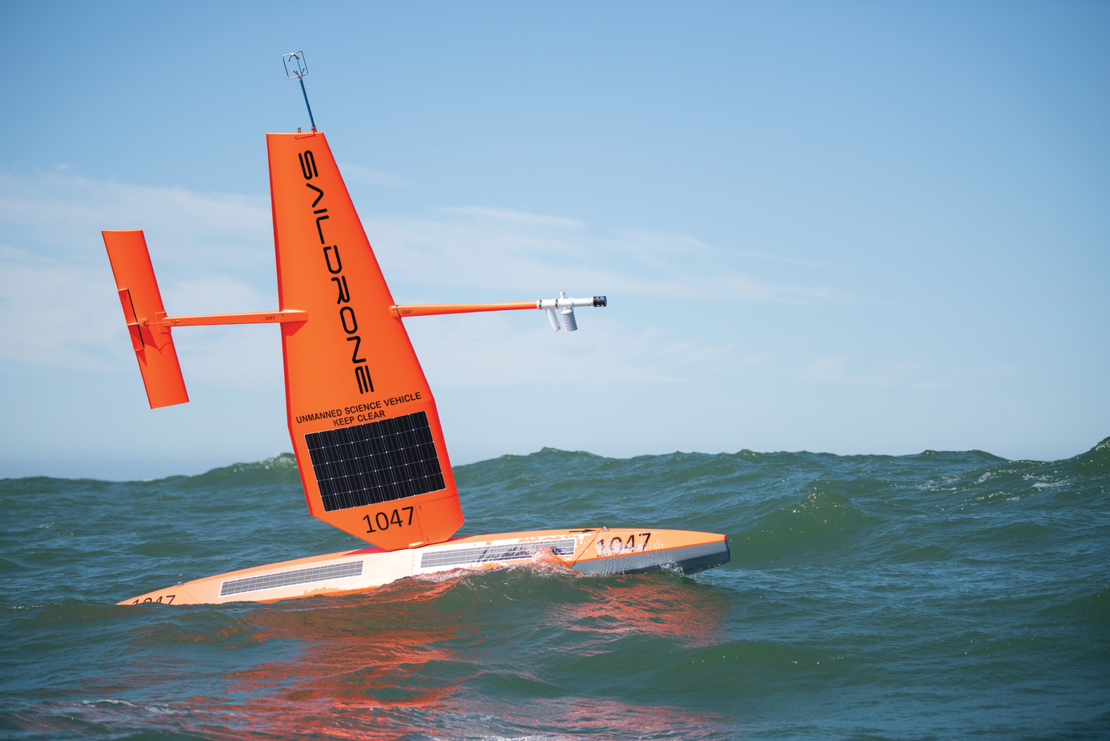
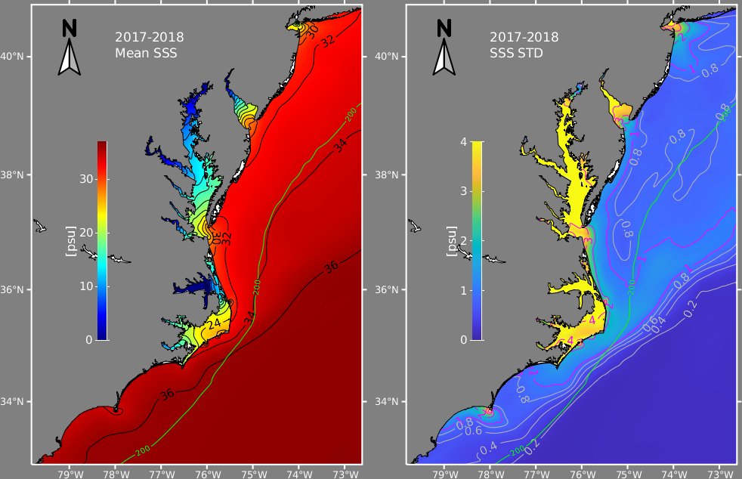
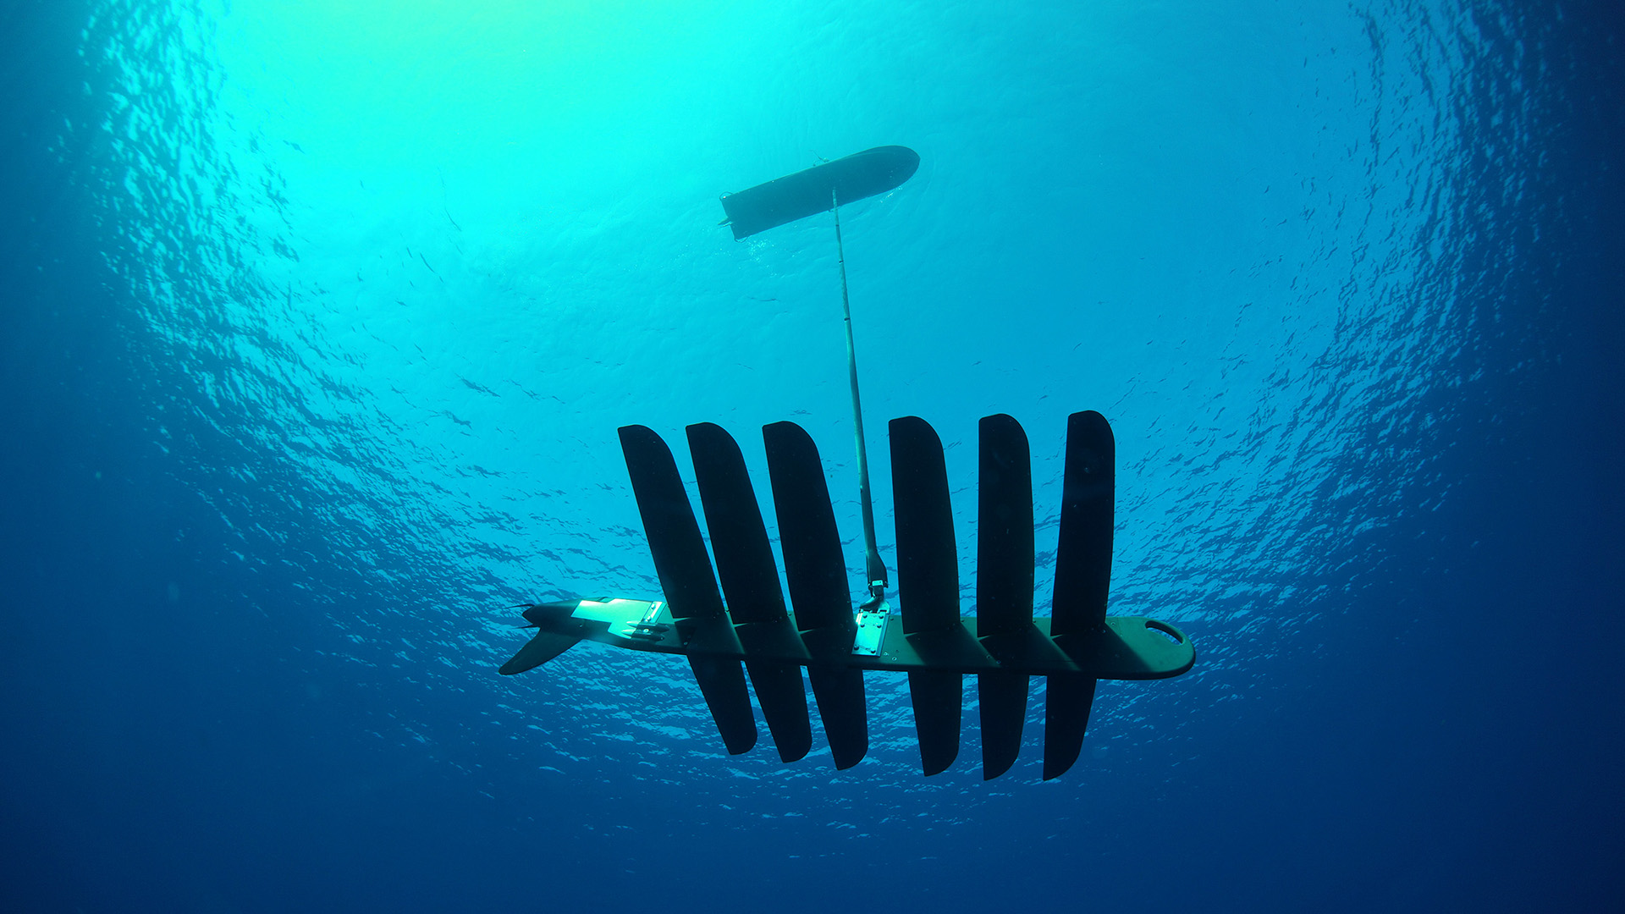
Idea 1: Persistent exploration via sustainably powered robots
Spatiotemporally varying environments
Sustainably powered robots
Undersea currents
Solar-powered autonomous surface vessel (ASV)
Saildrone
Sea surface salinity
Liquid Robotics wave glider

Slide 3
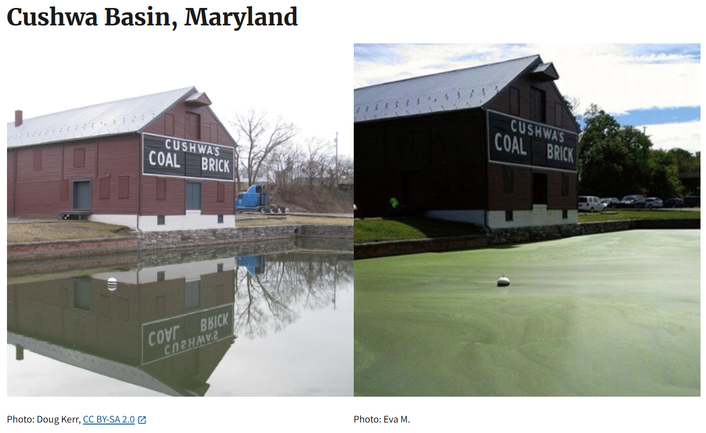
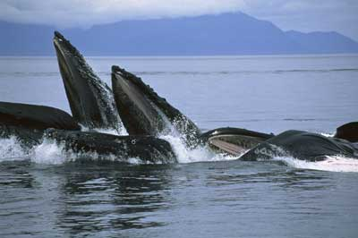
Idea 2: Targeted exploration via a tip-and-cue framework
Characteristics of tip events:
Events are sparse in both space and time
You can’t know about the events until you're nearby
Events are short-lived but actionable
Decisions to go investigate have real costs
Algal blooms
Feeding events
Notes:
Add a diagram showing the host and agent

Slide 4
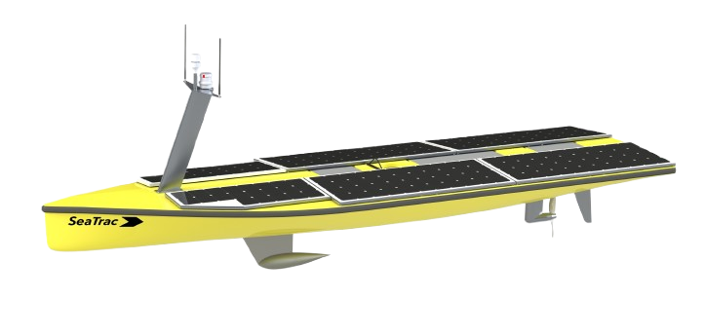
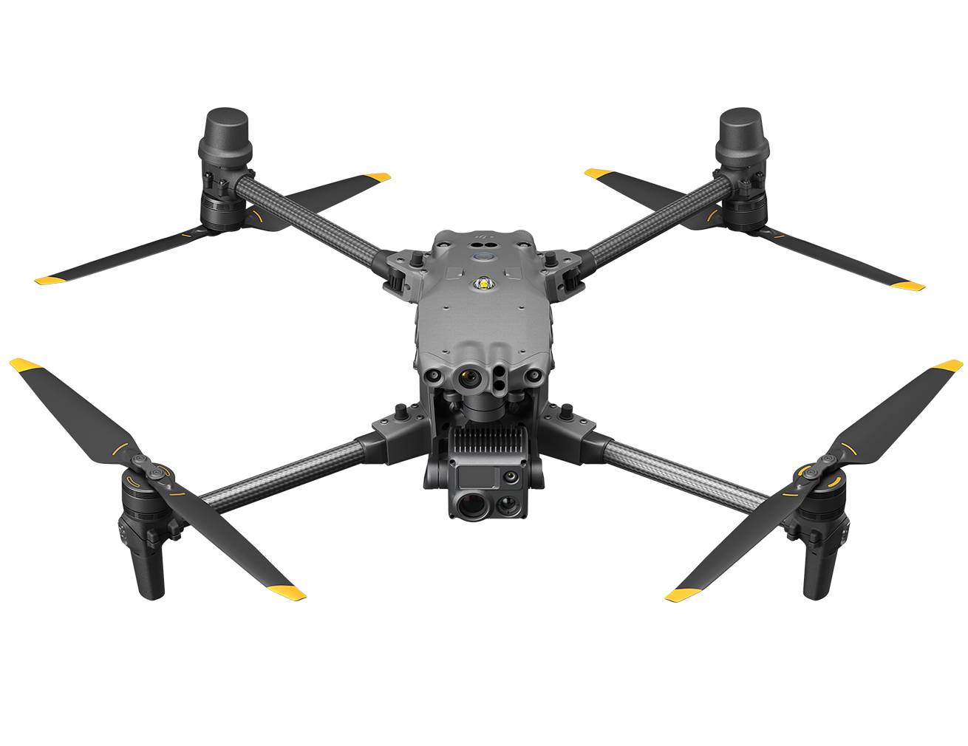
How do we accomplish both?
Persistent exploration
Host (SeaTrac SP-48)
Targeted exploration
Combined system where host deploys agent
Agent (quadrotor)

Slide 5
Existing literature
Scouting (host planning):
Coverage-maximizing planning:
Govindarajan, Kavin, et al. "Coverage-maximizing solar-powered autonomous surface vehicle control for persistent gulf stream observation." 2022 American Control Conference (ACC). IEEE, 2022.
Tan, Chee Sheng, Rosmiwati Mohd-Mokhtar, and Mohd Rizal Arshad. "A comprehensive review of coverage path planning in robotics using classical and heuristic algorithms." IEEE Access 9 (2021): 119310-119342.
Information-driven planning:
S. Bai, T. Shan, F. Chen, L. Liu, and B. Englot, “Information-driven path planning,” Current Robotics Reports, vol. 2, no. 2, pp. 177–188, 2021.sf
G. A. Hollinger and G. S. Sukhatme, “Sampling-based motion planning for robotic information gathering.” in Robotics: Science and systems, vol. 3, no. 5, 2013, pp. 1–8.
M. Popovic, J. Ott, J. Ruckin, and M. J. Kochenderfer, “Learning-based methods for adaptive informative path planning,” Robotics and Autonomous Systems, vol. 179, p. 104727, 2024.
K. B. Naveed, D. Agrawal, C. Vermillion, and D. Panagou, “Eclares: Energy-aware clarity-driven ergodic search,” in 2024 IEEE International Conference on Robotics and Automation (ICRA). IEEE, 2024, pp. 14 326–14 332.
Energy-aware persistent planning:
K. M. Govindarajan, D. R. Agrawal, D. Panagou, and C. Vermillion, “Fusion of indirect methods and iterative learning for persistent velocity trajectory optimization of a sustainably powered autonomous surface vessel,” arXiv preprint arXiv:2503.10884, 2025.
Govindarajan, Kavin M., et al. "Clarity-Driven Adaptive Mission Planning for a Solar-Powered Autonomous Surface Vessel.“ (Under review). Transactions on Control Systems Technology (TCST). IEEE, 2026.
Tip-servicing (agent planning):
Known task locations:
F. Zeng, Z. Chen, J.-P. Clarke, and D. Goldsman, “Nested vehicle routing problem: Optimizing drone-truck surveillance operations,” Transportation Research Part C: Emerging Technologies, vol. 139, p. 103645, 2022.
Widely observable (e.g. space satellite):
Cudzilo, Becky, K. C. Foley, and Chandler Smith. "The Ability of a Small Satellite Constellation to Tip and Cue Other Commercial Assets." (2012).
Sung, Jinbong, et al. "Spaceborne SAR Antenna Development Status and Plans Suitable for Tip and Cue Monitoring." 2024 International Symposium on Antennas and Propagation (ISAP). IEEE, 2024.
The gap:
Combined host + agent network
Information is only locally available
Rendezvous planning
  Information objective
  Energy awareness (persistence)

Slide 6
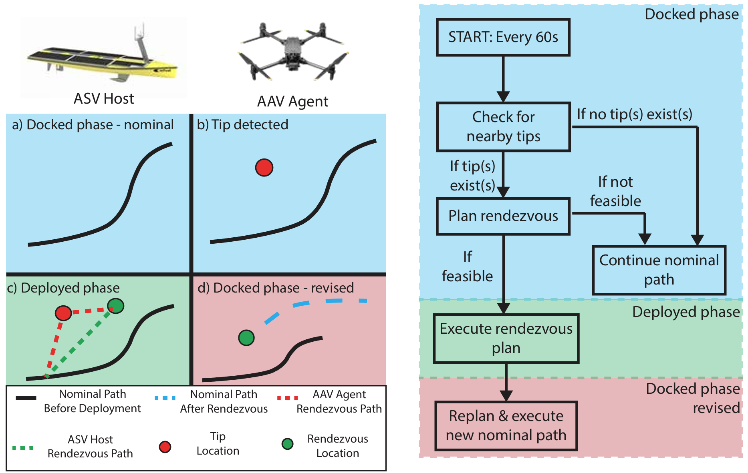

Concept of Operations

Slide 7

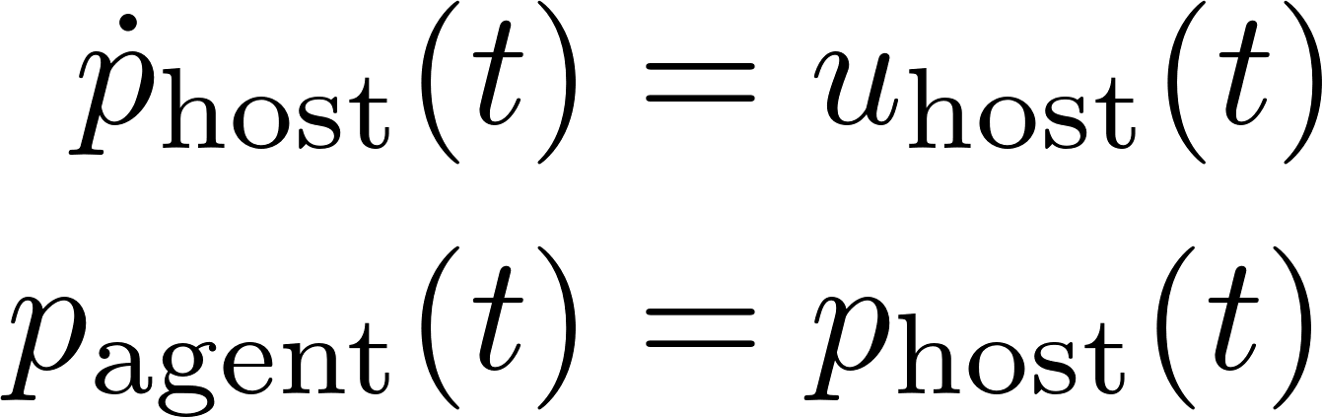
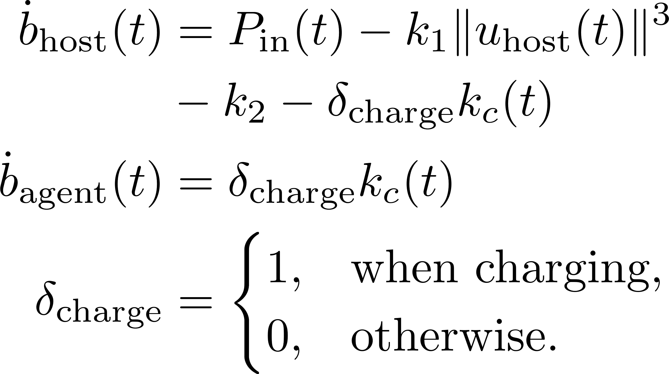
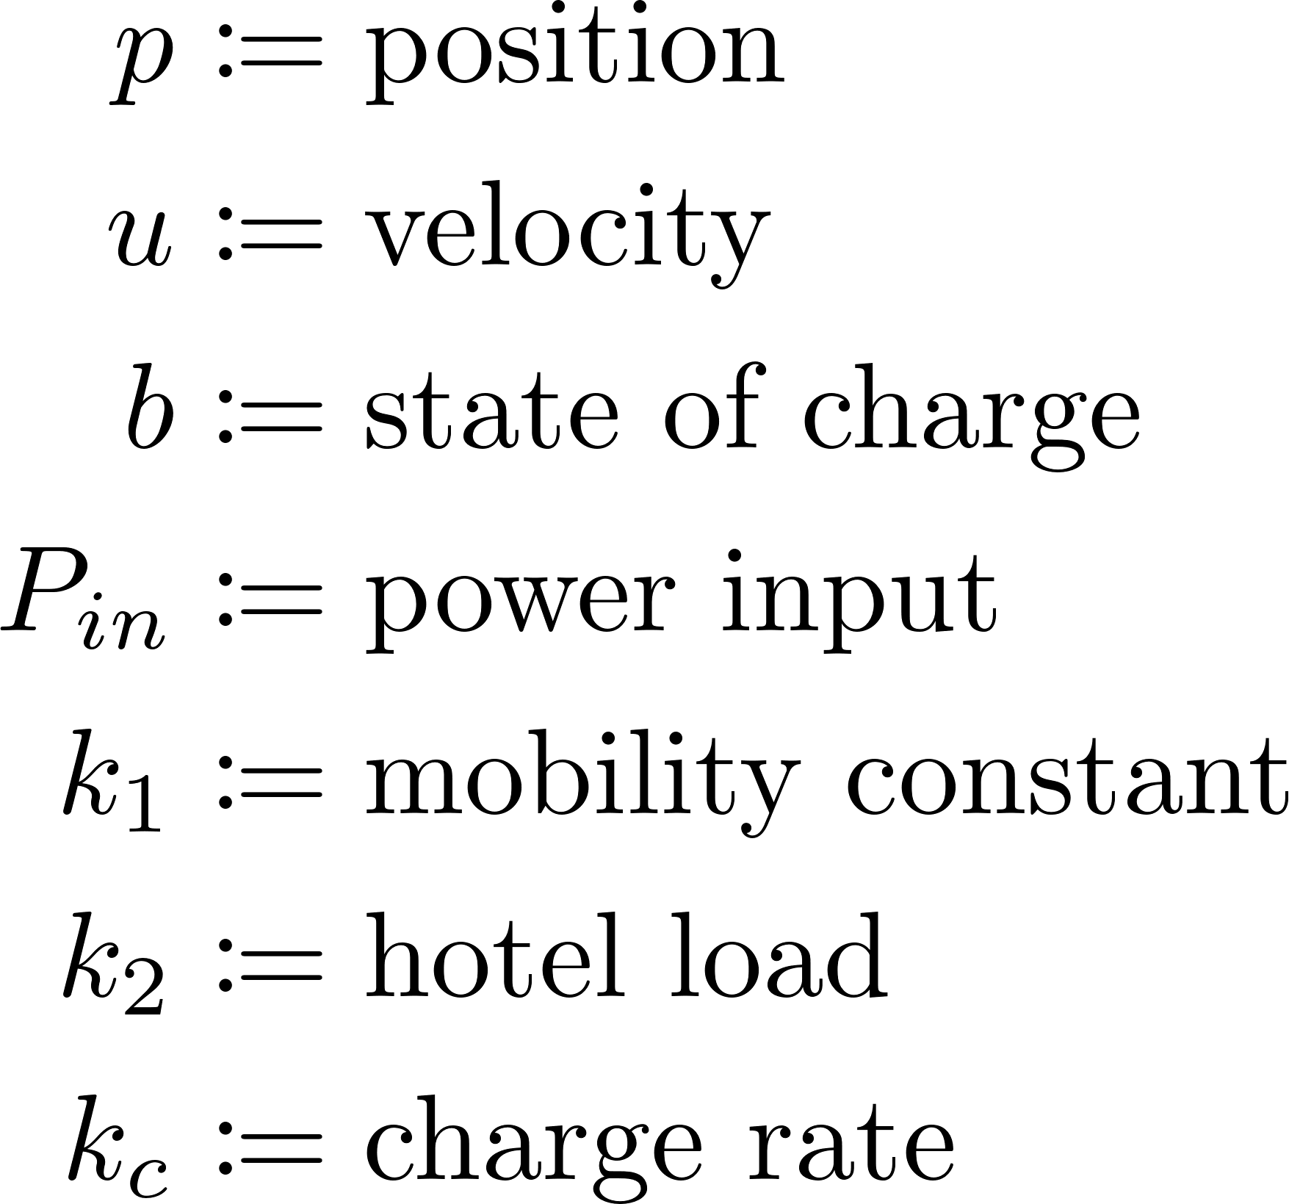
Docked Phase: Dynamics
Agent and host move together:
Host can charge the agent:

Slide 8
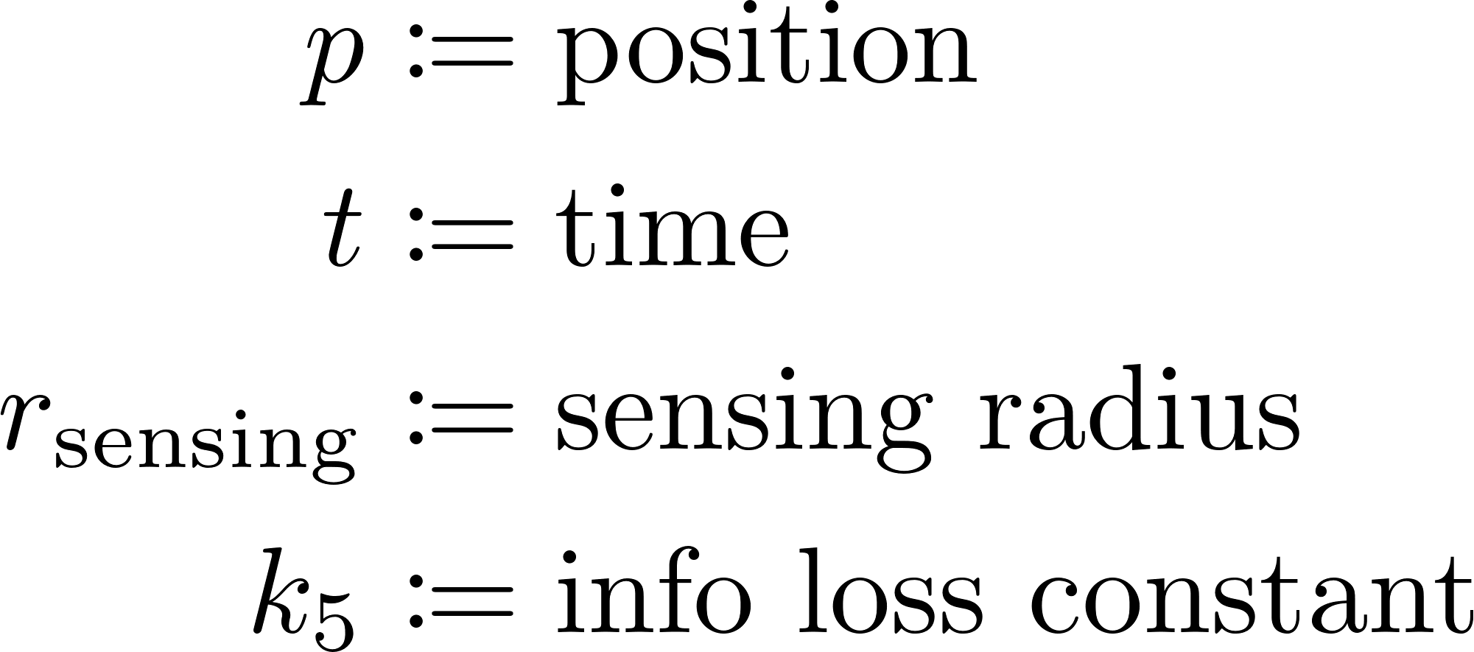
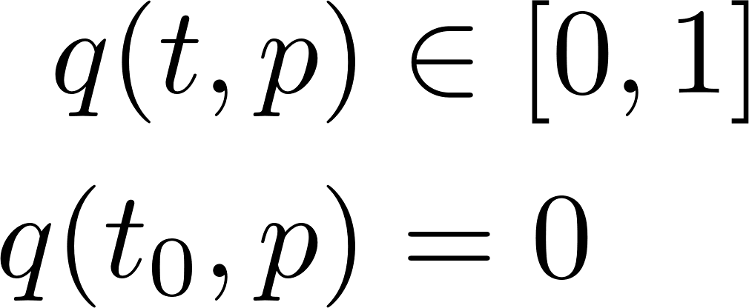
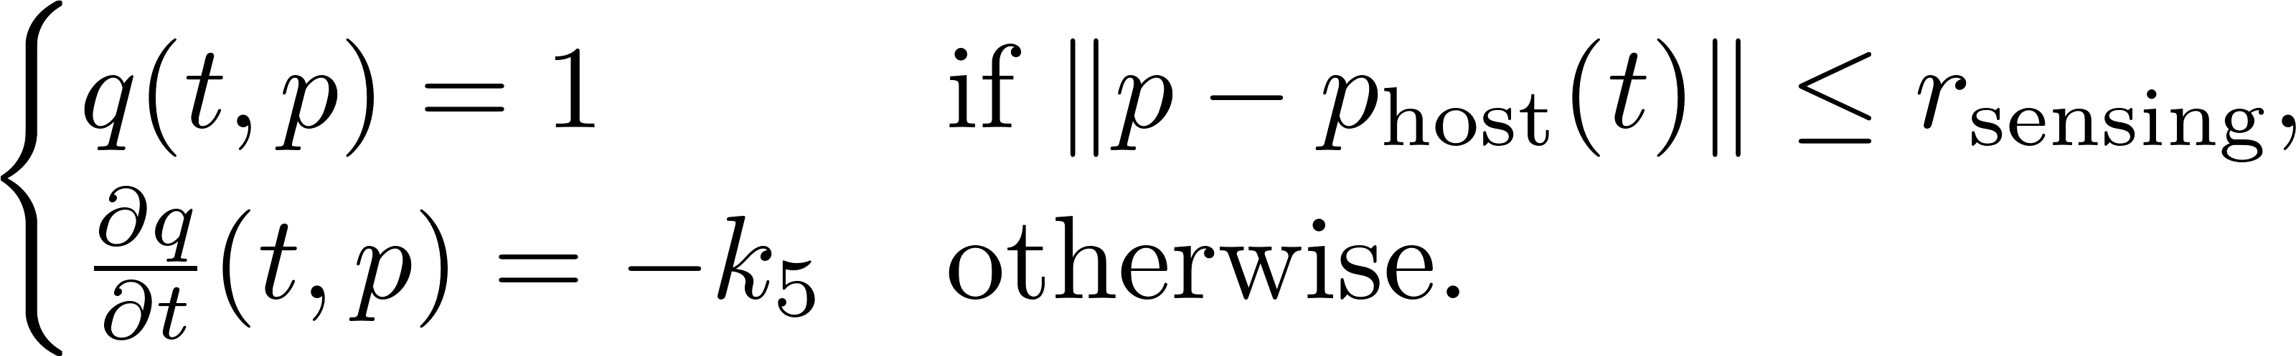
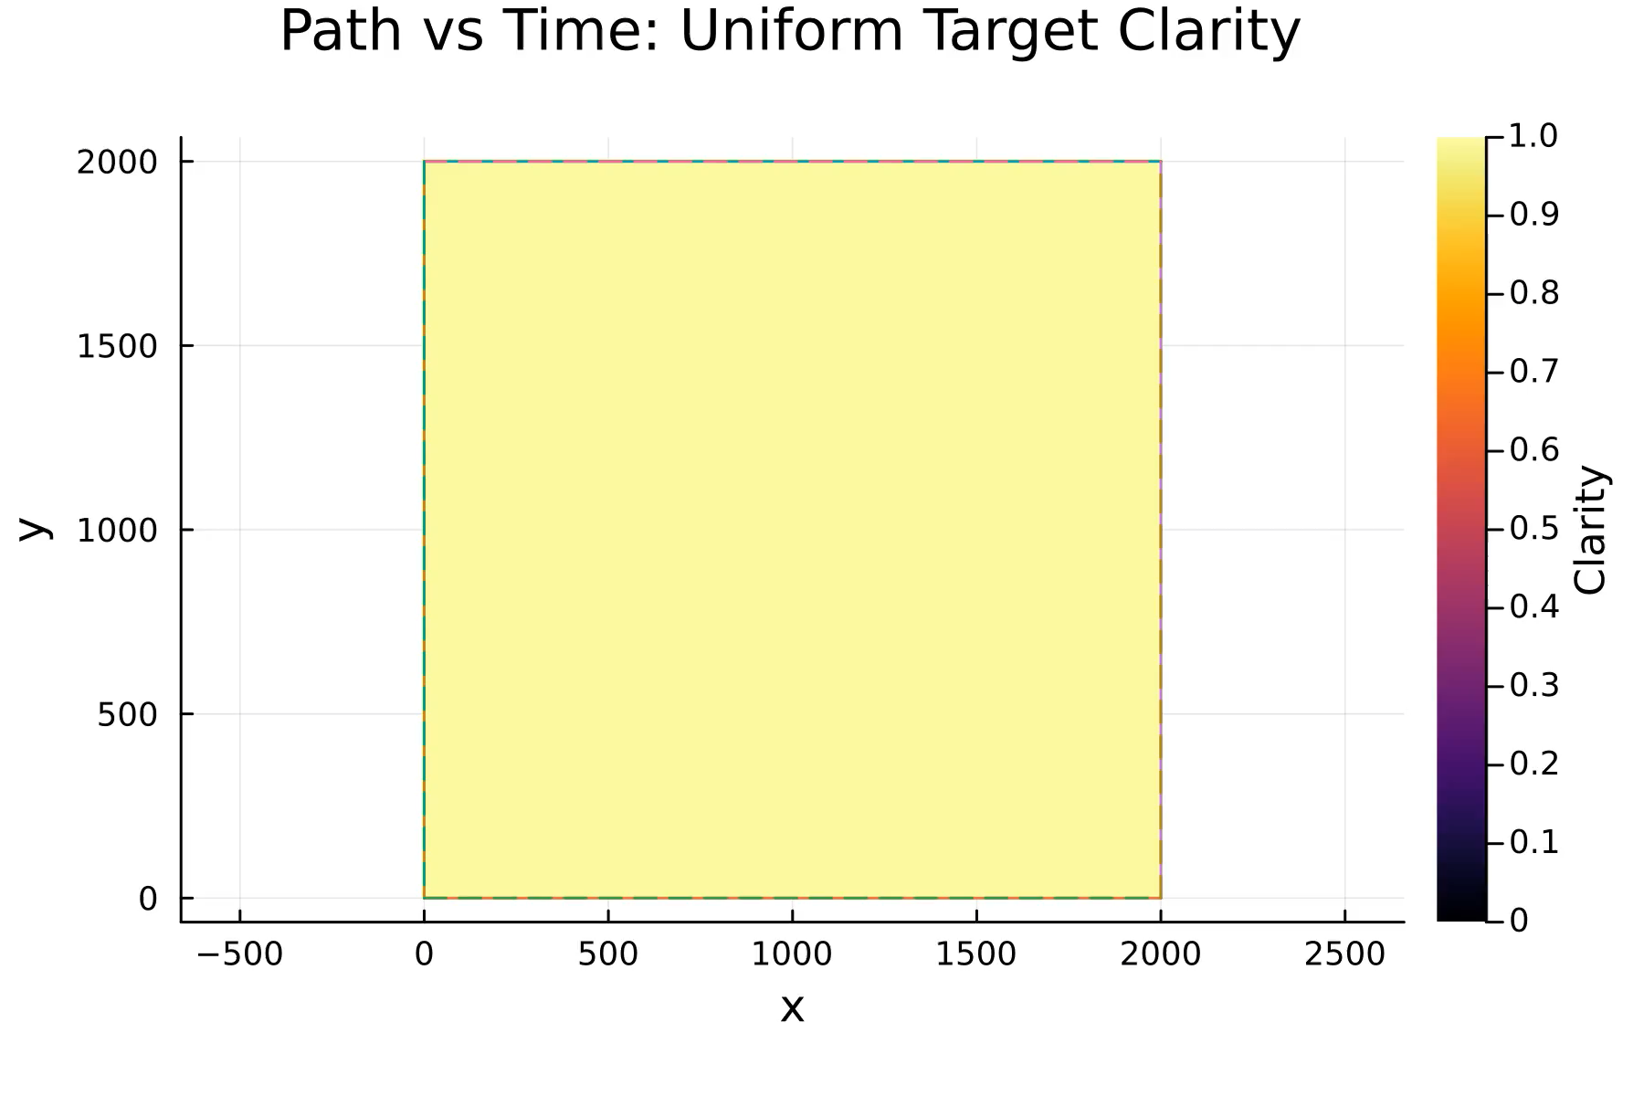
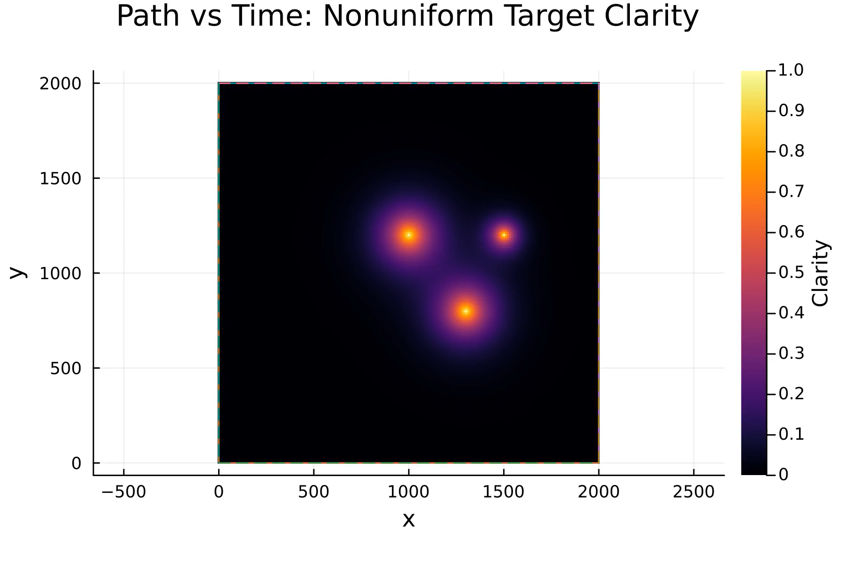
Docked Phase: Clarity-driven Ergodic Planning
Clarity [1] measures the host’s quality of information:
Given a target clarity distribution, plan path using ergodic control:
[1] Agrawal, Devansh R., and Dimitra Panagou. "Sensor-based planning and control for robotic systems: Introducing clarity and perceivability." IEEE Control Systems Letters 7 (2023): 2623-2628..

Slide 9
Concept of Operations

Slide 10
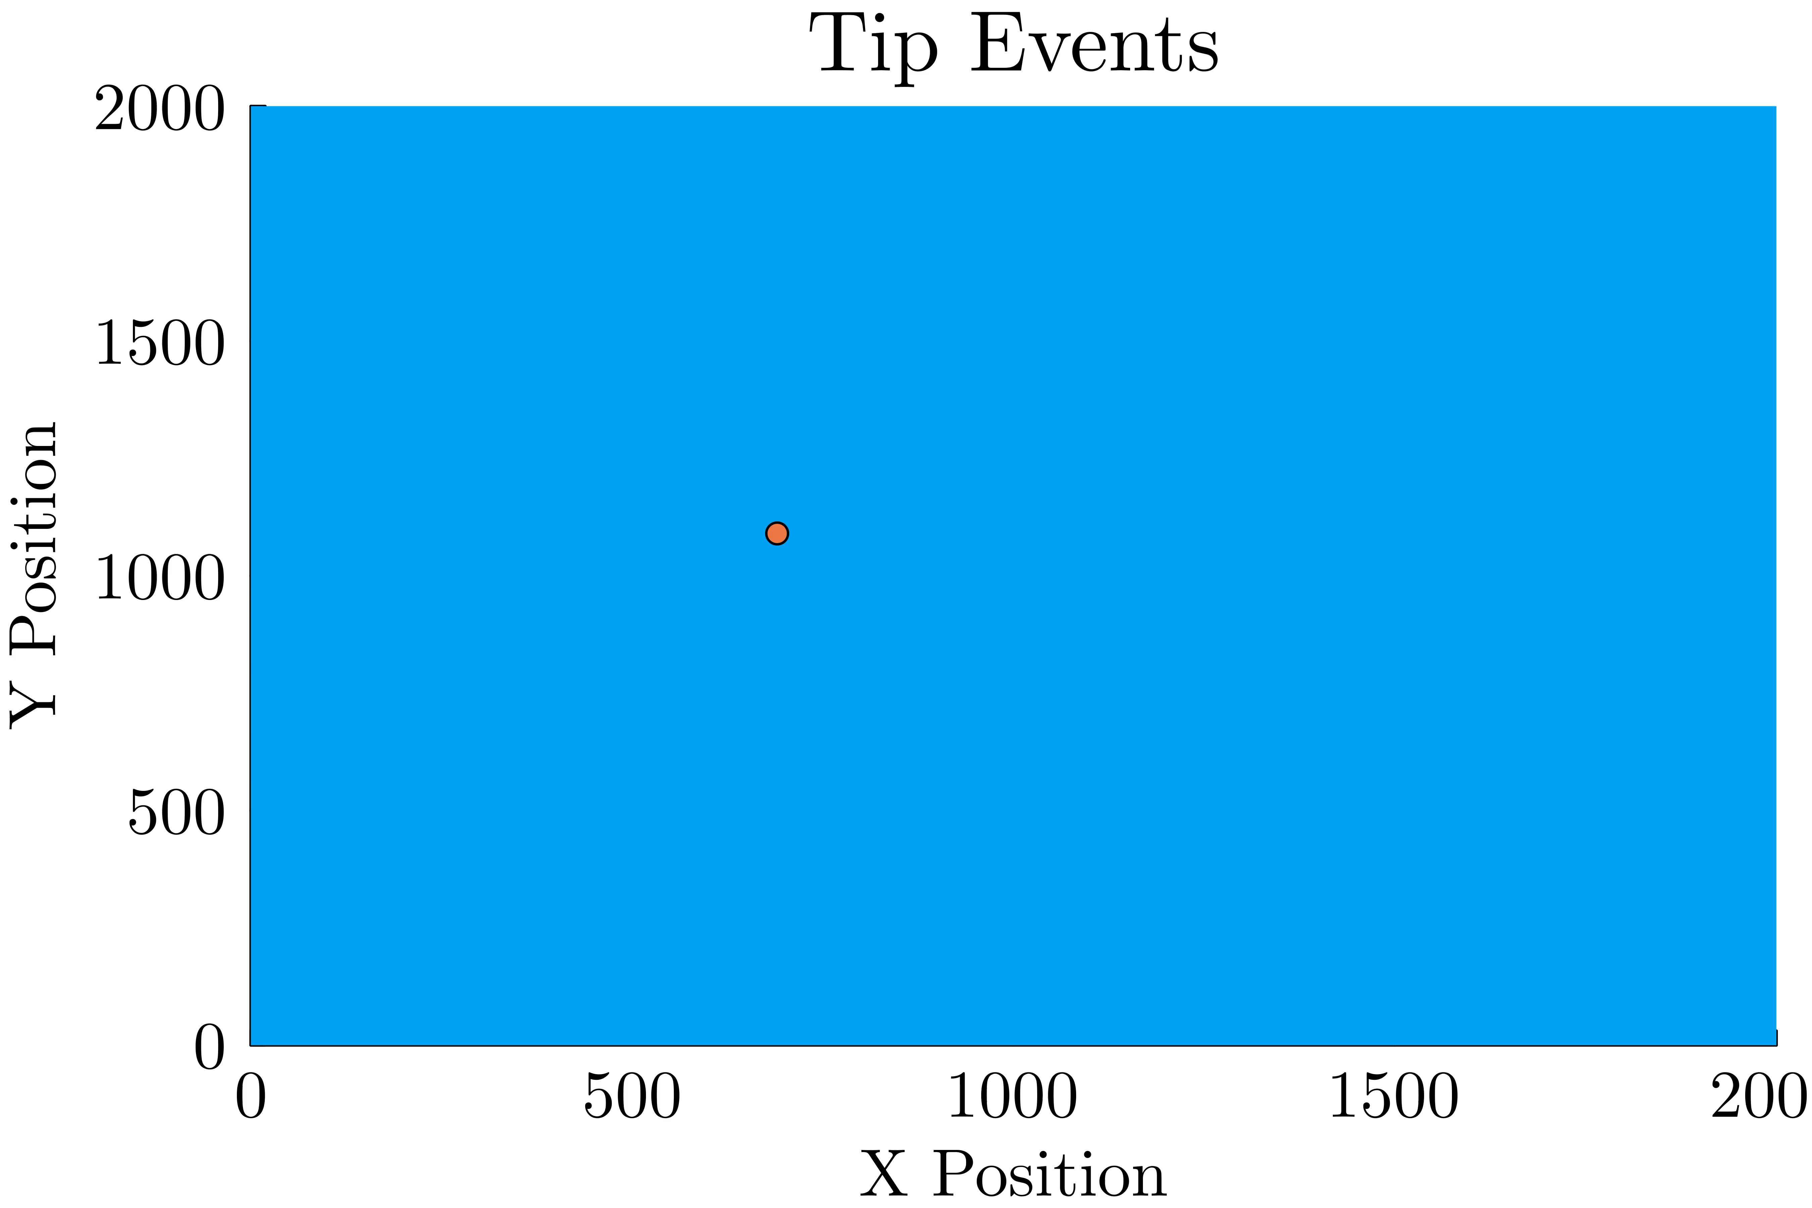
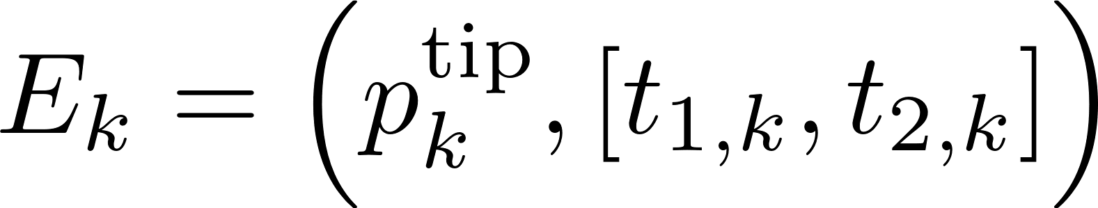
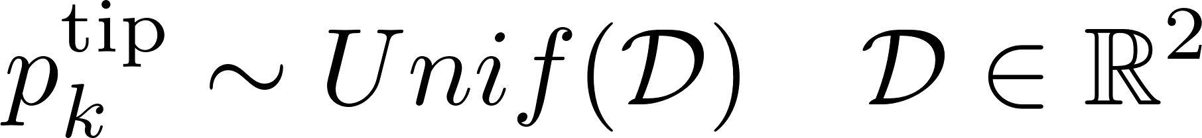
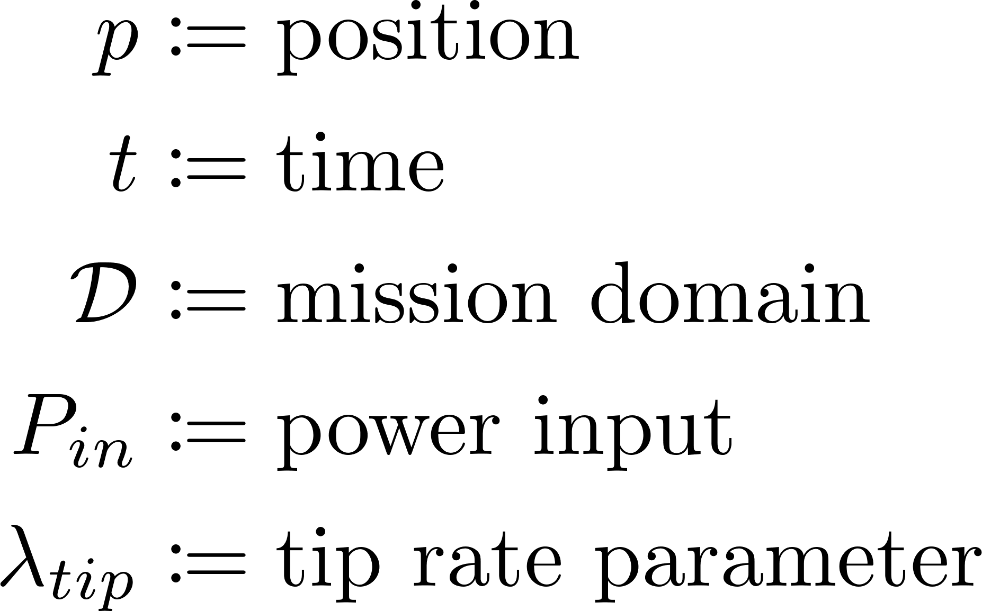
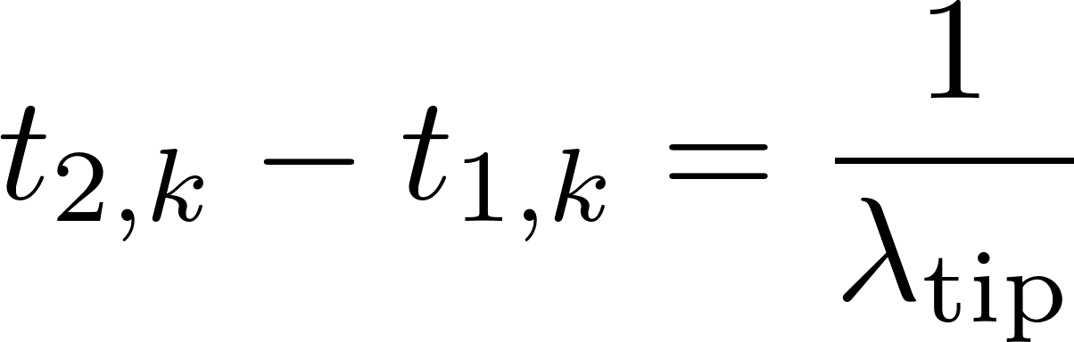

Tip Events
Define a tip event as a tuple:
where every $T_{tip}$ seconds:

Slide 11
Concept of Operations

Slide 12

Tip Detection & Rendezvous Planning

Slide 13
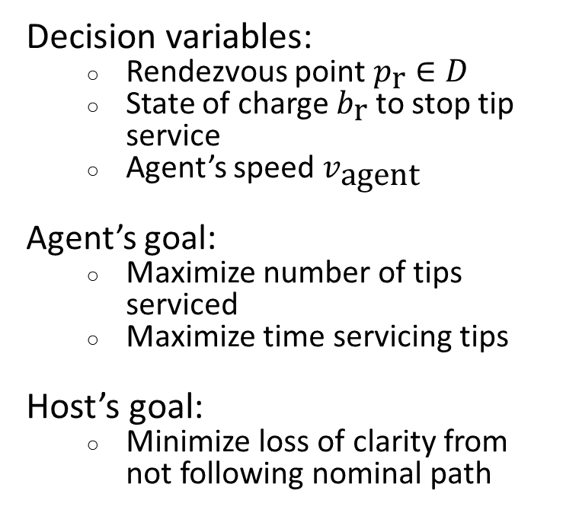
Rendezvous Planning Objectives
Decision variables:
  Rendezvous point $p_{\text{r}}∈D$
  State of charge $b_{\text{r}}$ to stop tip service
  Agent’s speed $v_{\text{agent}}$
Agent’s goal:
  Maximize number of tips serviced
  Maximize time servicing tips
Host’s goal:
  Minimize loss of clarity from not following nominal path
Notes:
Add mathematical objective function

Slide 14
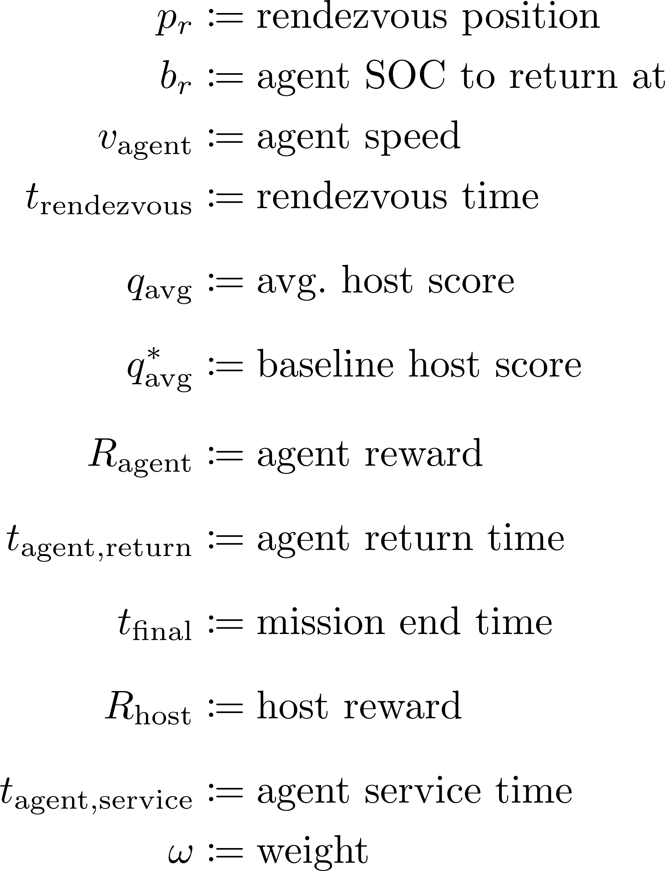


Rendezvous Planning Objective
Objective:
where we maximize the portion of time spent servicing the tip:
and minimize loss in clarity due to deviating from the nominal path:
Notes:
Add mathematical objective function

Slide 15
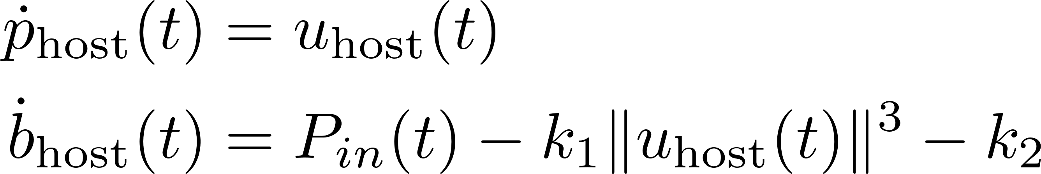
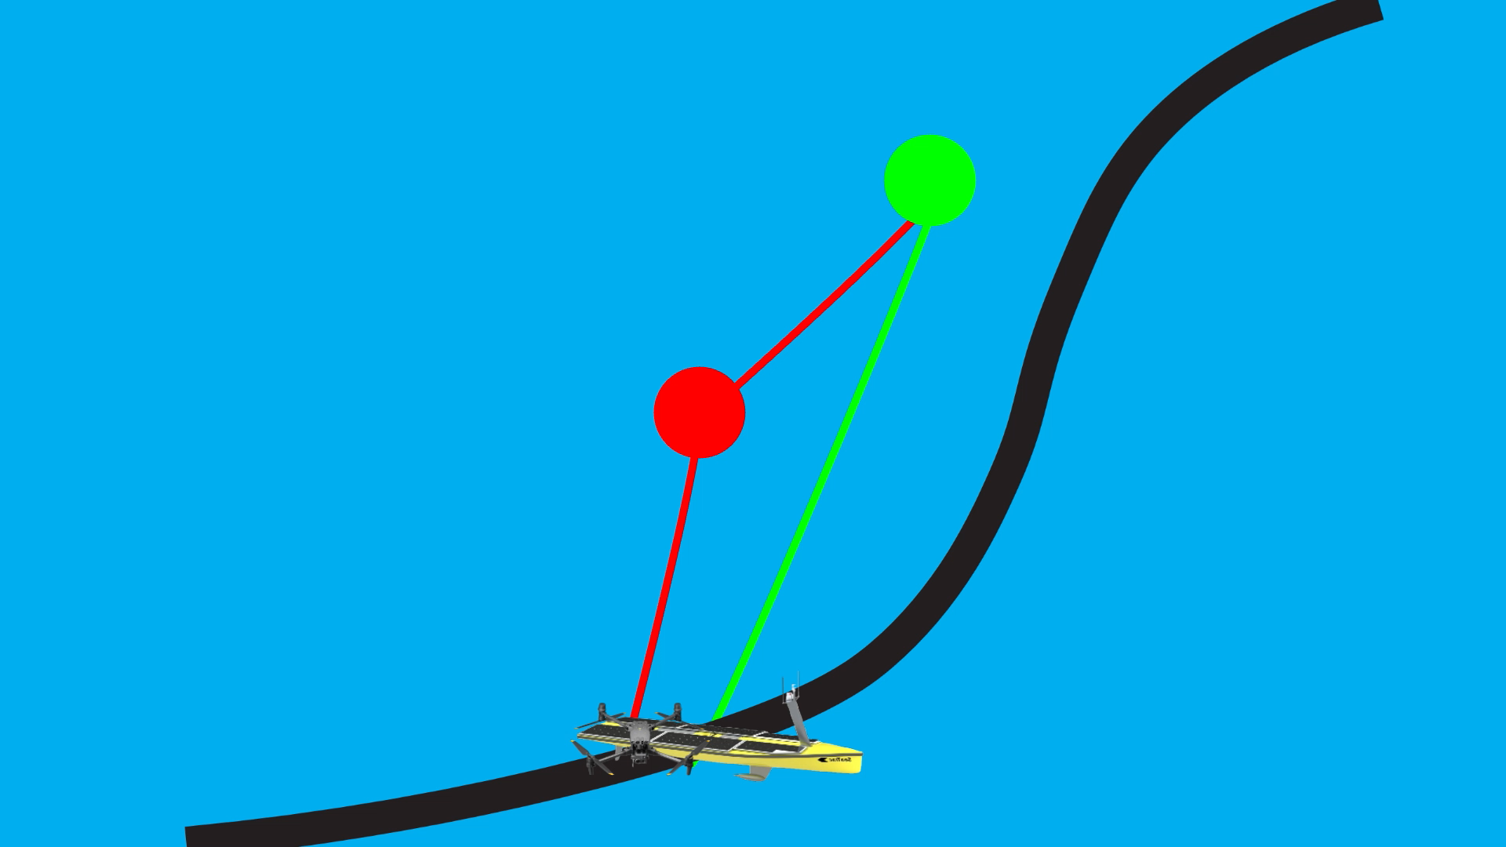
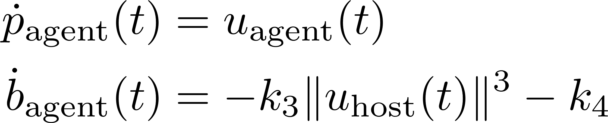
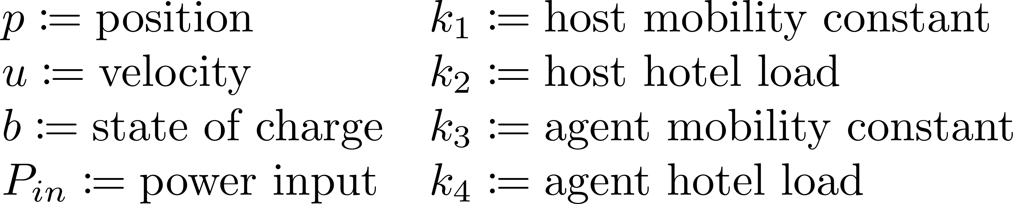
Deployed Phase: Dynamics
Host:
Agent:

Slide 16
Concept of Operations

Slide 17
Docked Phase: Revised
Agent and host move together:
Host can charge the agent:

Slide 18
Putting it all together

Slide 19
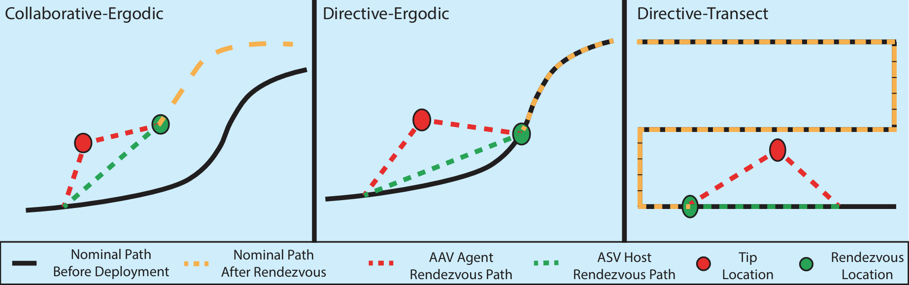
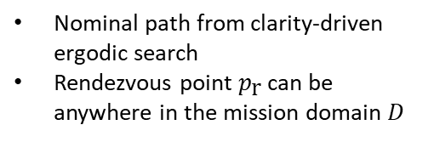
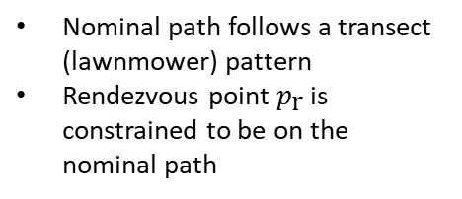
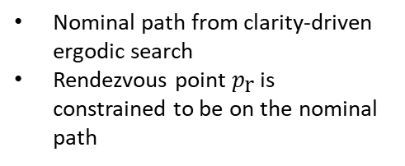
Comparison Mission Strategies
Nominal path from clarity-driven ergodic search
Rendezvous point $p_{\text{r}}$ can be anywhere in the mission domain $D$
Nominal path from clarity-driven ergodic search
Rendezvous point $p_{\text{r}}$ is constrained to be on the nominal path
Nominal path follows a transect (lawnmower) pattern
Rendezvous point $p_{\text{r}}$ is constrained to be on the nominal path

Slide 20
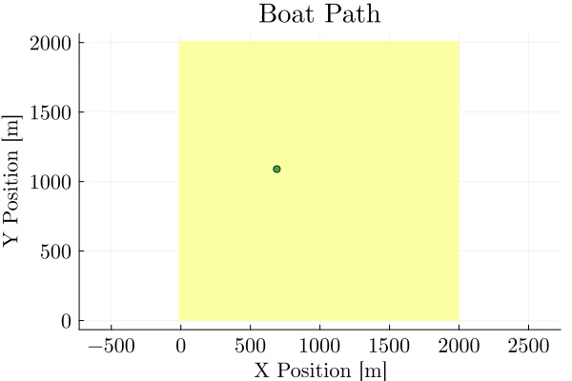




Results
Collaborative-ergodic strategy
Directive-ergodic strategy
Directive-transect strategy

Slide 21
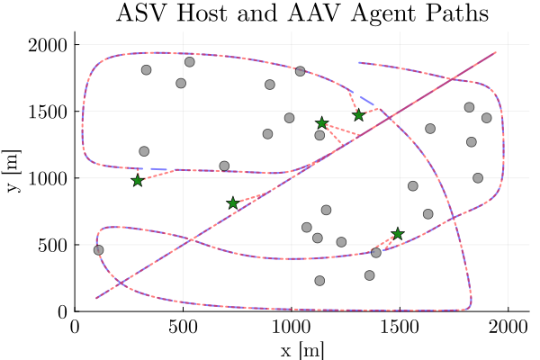
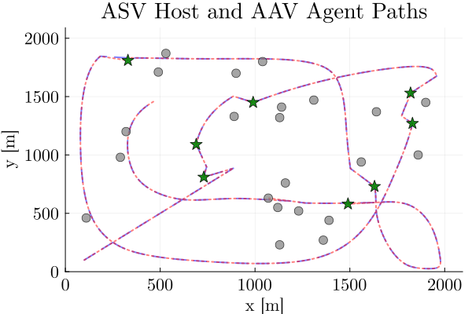
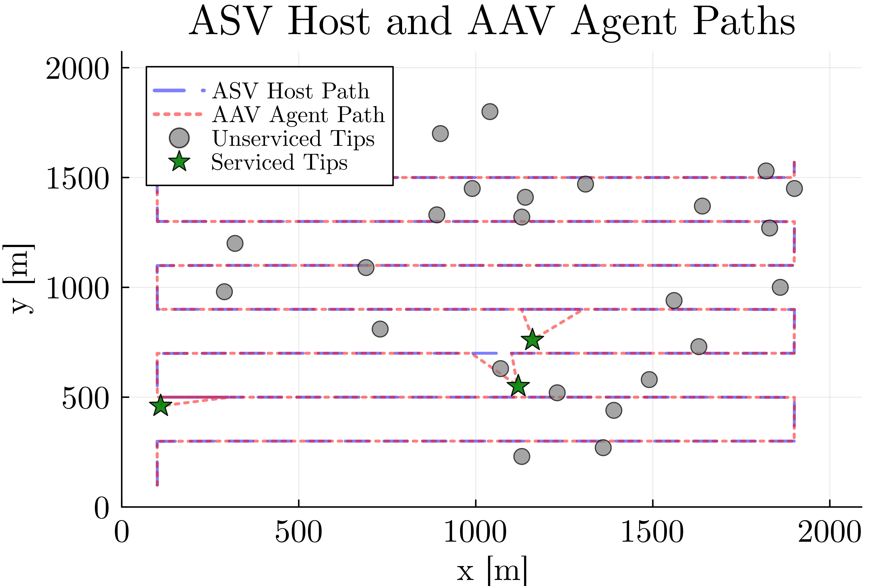
Results
Constrained

Slide 22
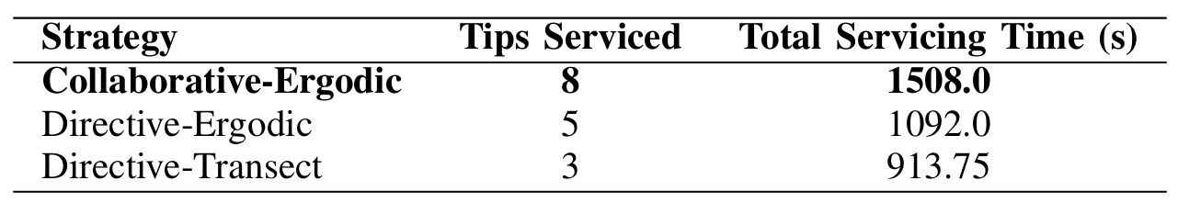
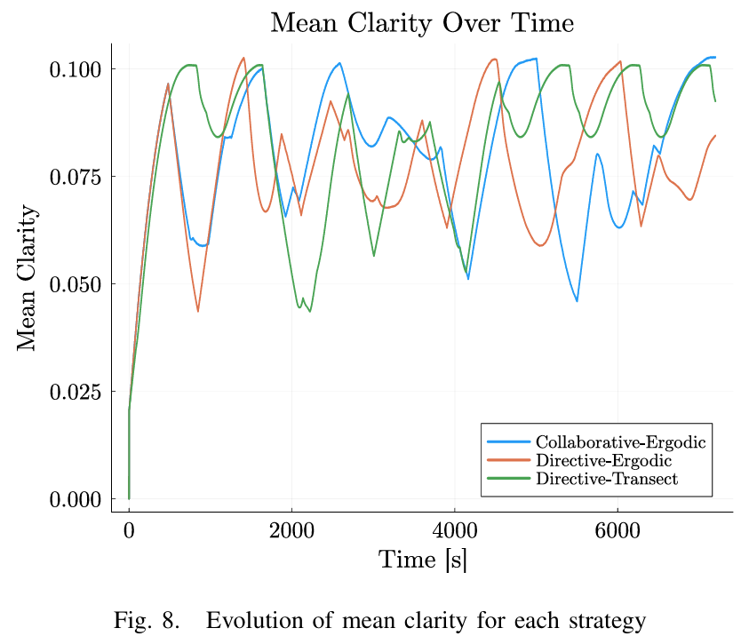
Results

Slide 23
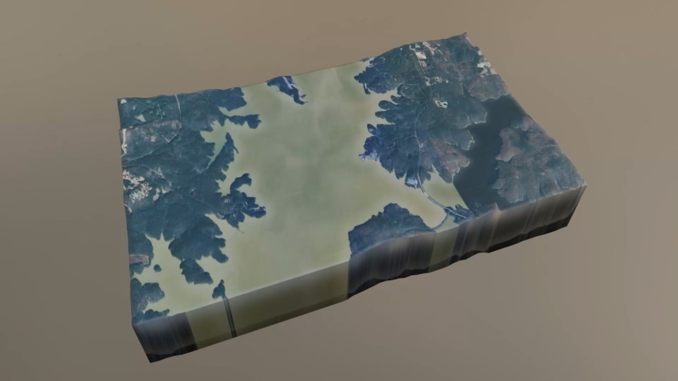

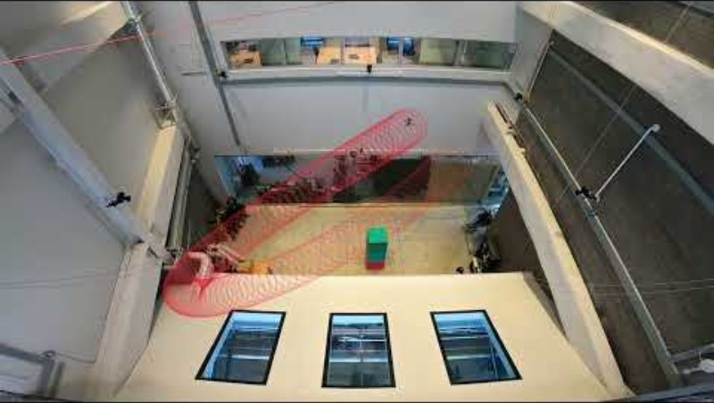

Conclusion & Future work
Takeaways/Contributions:
Combined persistent information-driven planning with a tip-and-cue framework
Rendezvous planner:
  Maximizes number of and time spent servicing tips
  Minimizes information loss for scouting mission
Ongoing work:
Add flexibility to the collaborative-ergodic strategy via multiple agents/hosts
Investigate the theoretical optimality and feasibility properties of this approach
Information value of energy for tip servicing decision-making
Questions?
Email: kmgovind@umich.edu
Github: https://github.com/corelab-umich/OptimalRendezvous
Supported by:
NSF Award Number 2223844

Slide 24
Backup Slides

Slide 25
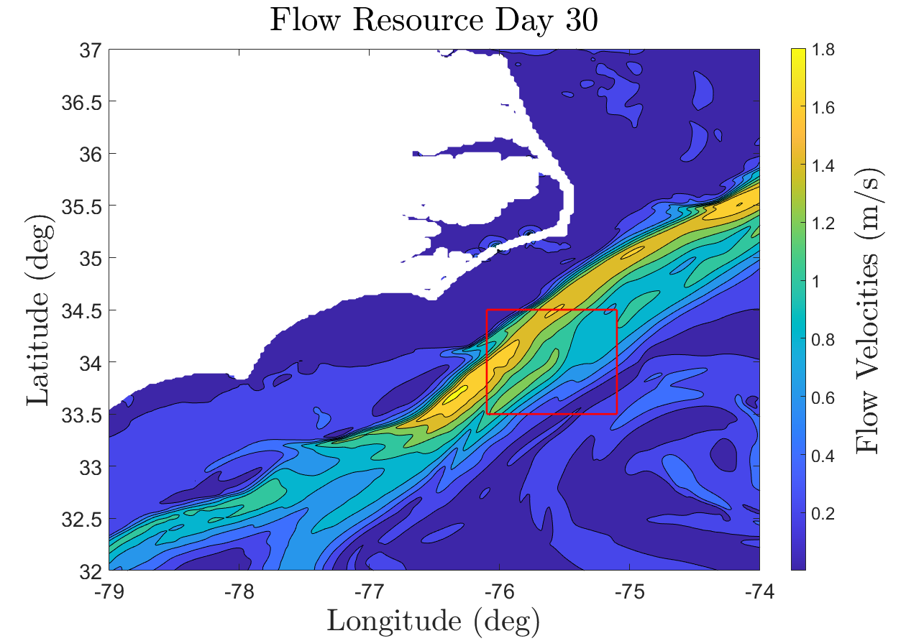
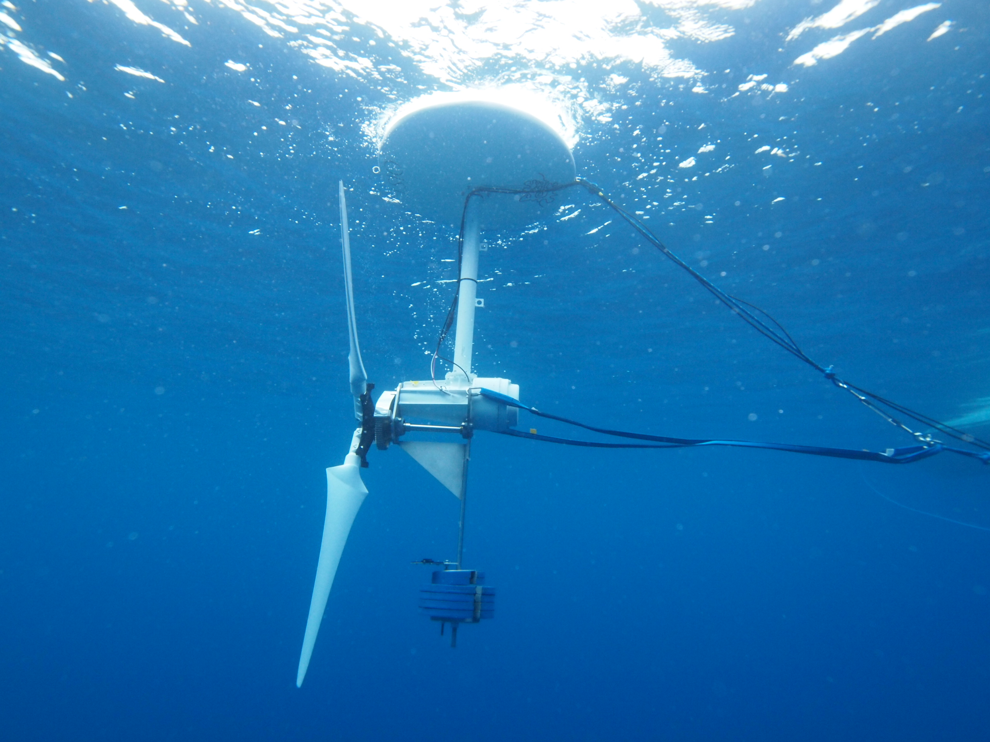
Why do we want to run persistent missions?
Marine Hydrokinetic Energy -
Flow Velocity vs Depth Data
Understanding Ocean Circulation -
Sea Surface Salinity (SSS)
160 TWh/yr of Technical Energy Capacity ~ 14.5 million homes [1]
Mean SSS off the Atlantic Coast of the United States [2]
Two features:
Data varies with space and time
We want to collect data over long periods of time
[1] K. Haas, “Assessment of energy production potential from ocean currents along the United States coastline,” Georgia Inst. of Technology, Atlanta, GA (United States), Tech. Rep., 2013.
[2] Bane, John, et al. "Atmospheric forcing of the Hatteras coastal ocean during 2017–2018: The PEACH program." Dynamics of Atmospheres and Oceans 102 (2023): 101364.

Slide 26
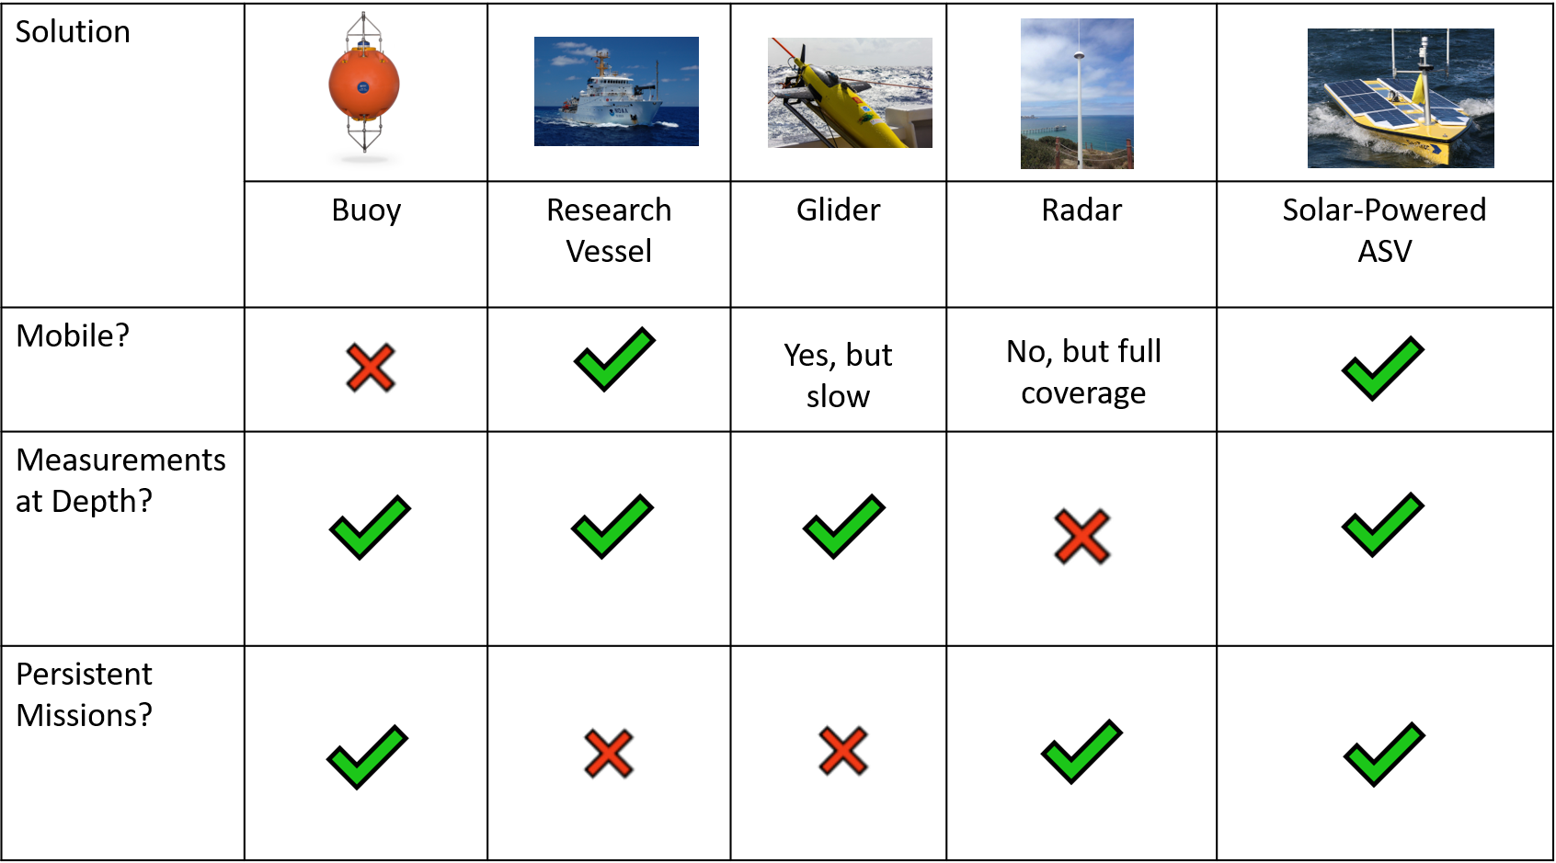
How do we collect oceanographic measurements?

Slide 27
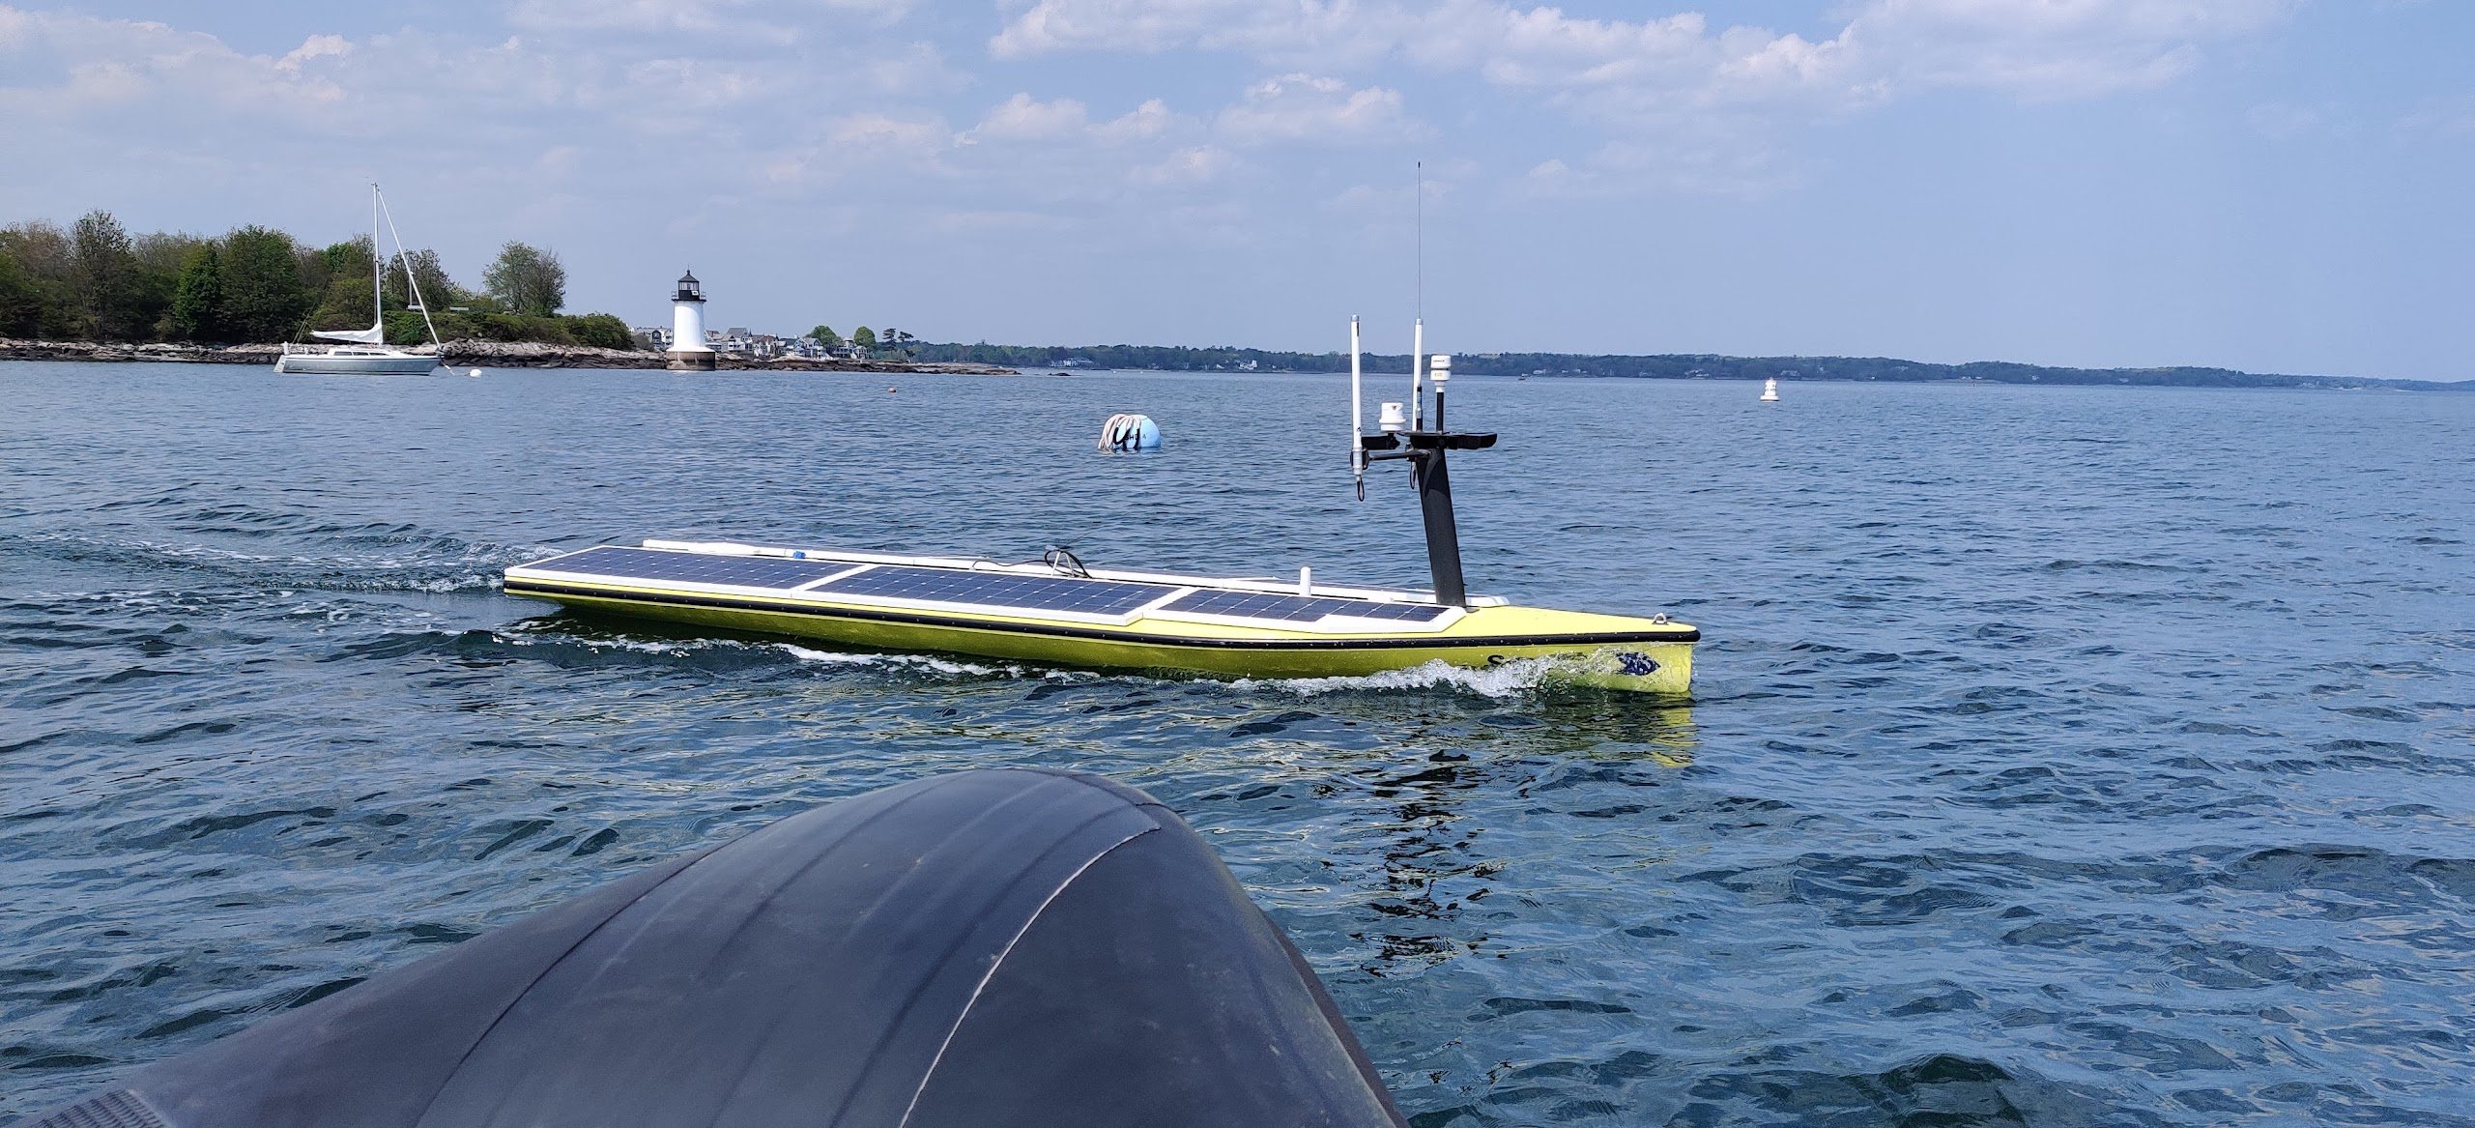
A Solar-powered ASV
Attribute | Value
Length | 4.8 meters
Beam | 1.39 meters
Draft | 0.42 meters
Weight | 300 kilograms
Solar Panel Area | 4.17 meters²
Brushless Motor | 500 Watts
Battery Capacity | 6.75 kiloWatt Hours
Top Speed | 4.5 knots
Cruise Speed | 3 knots
SeaTrac SP-48 ASV

Slide 28
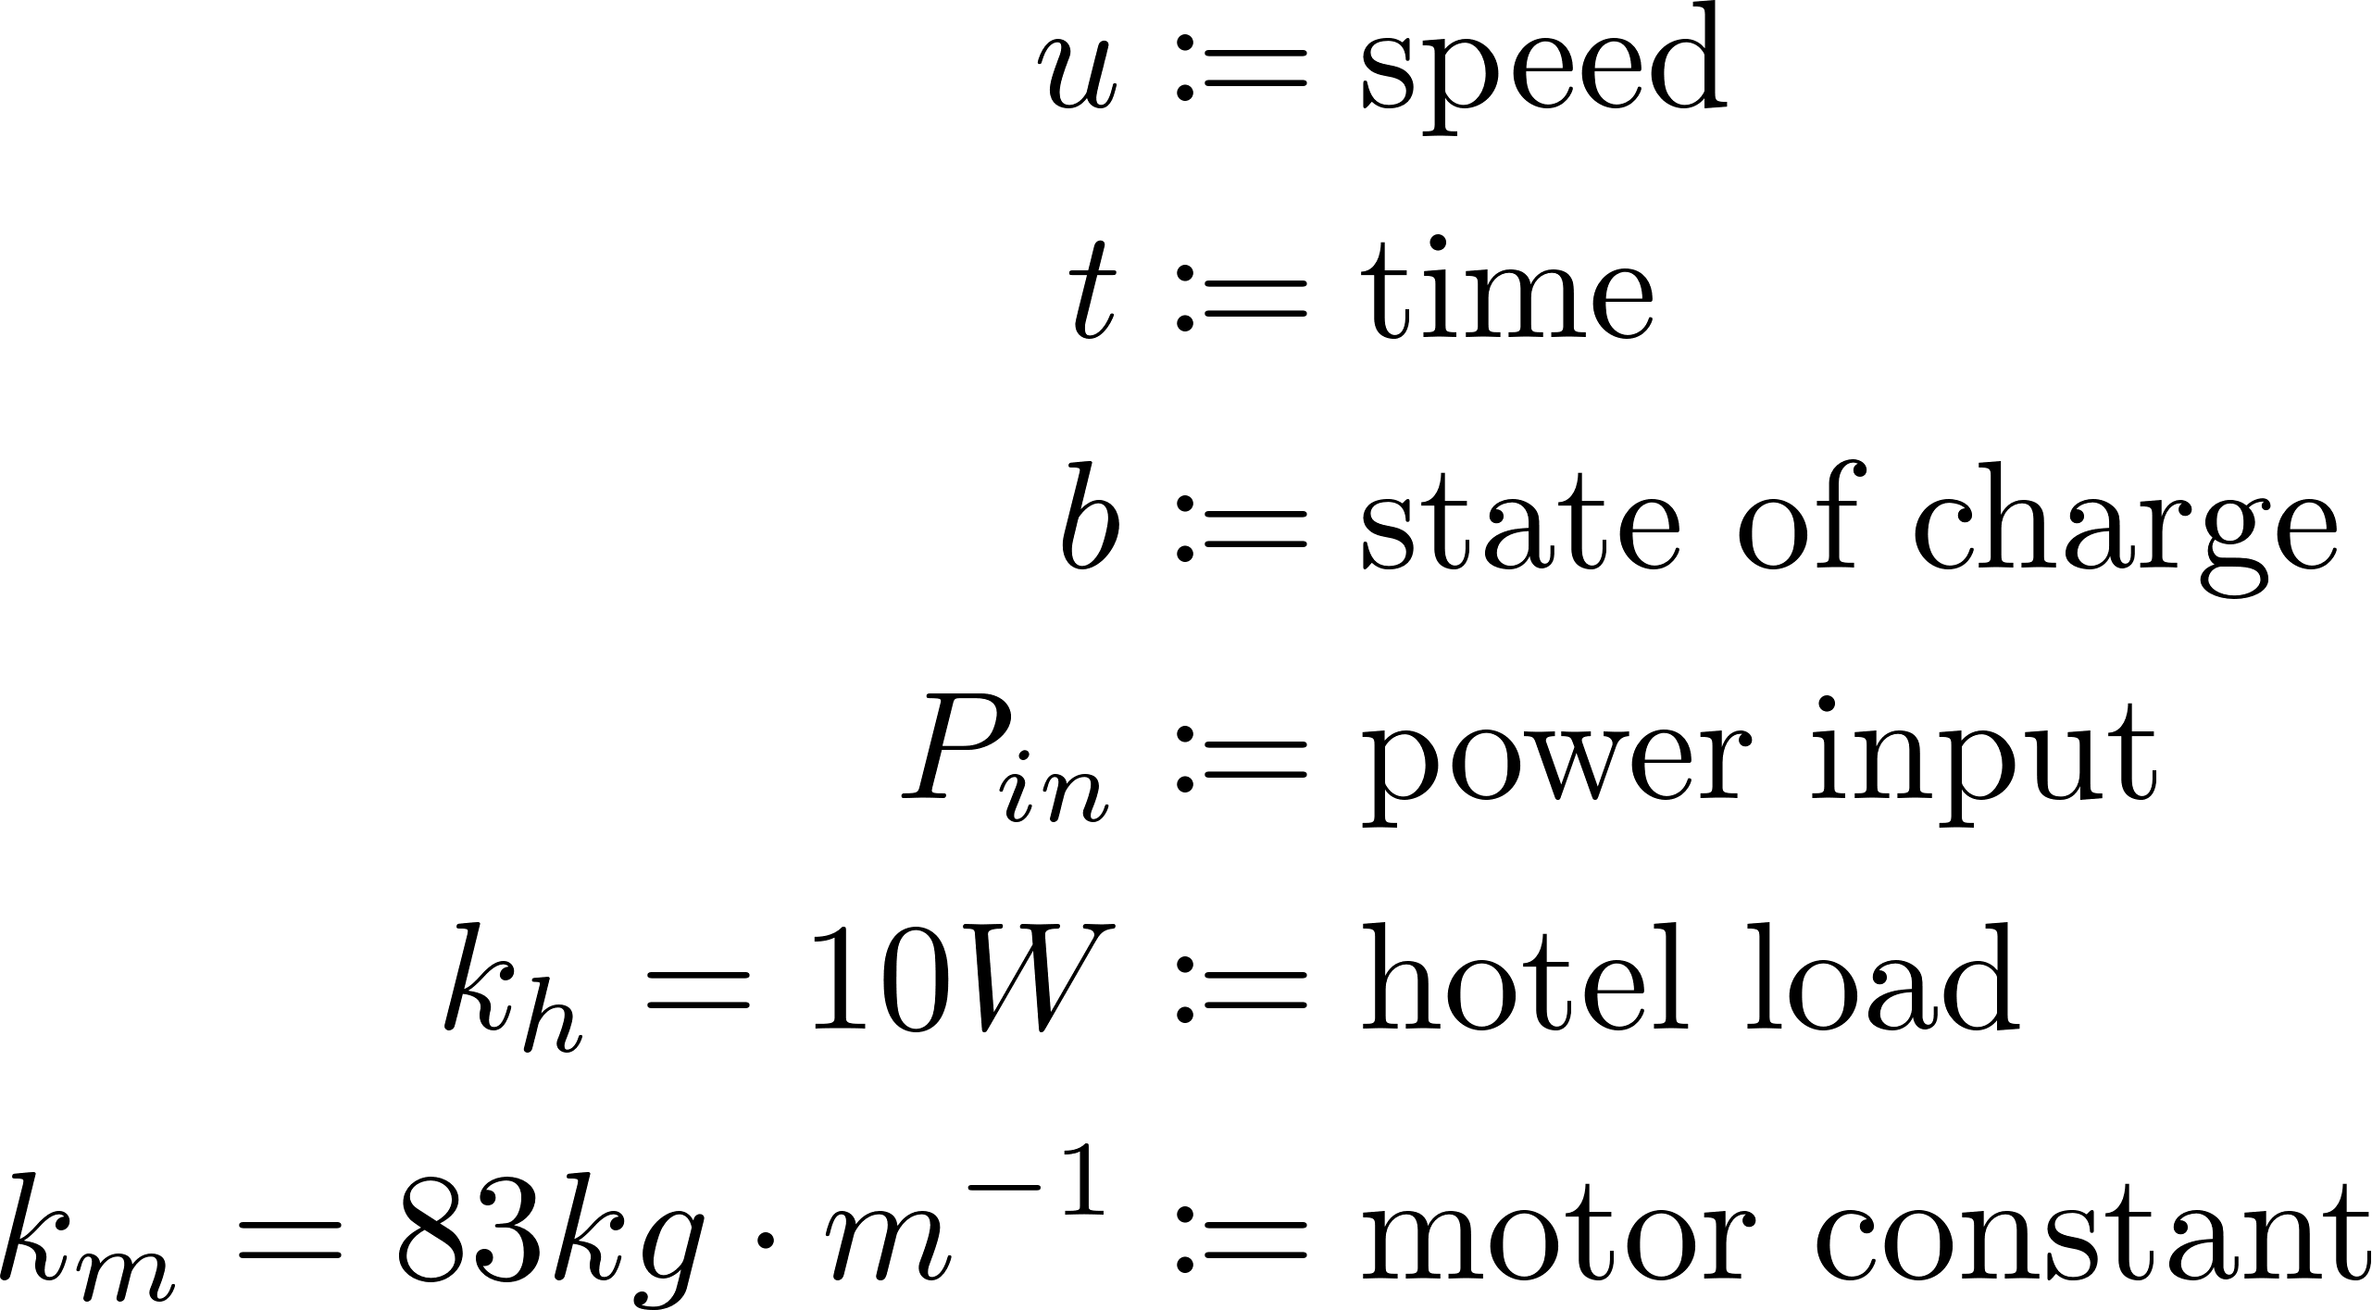
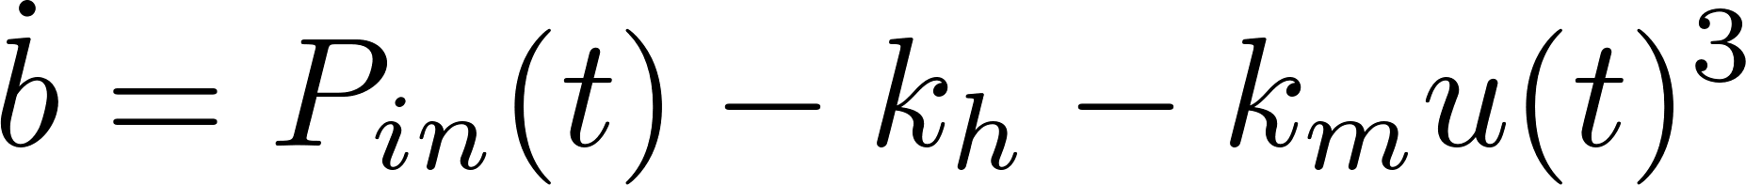
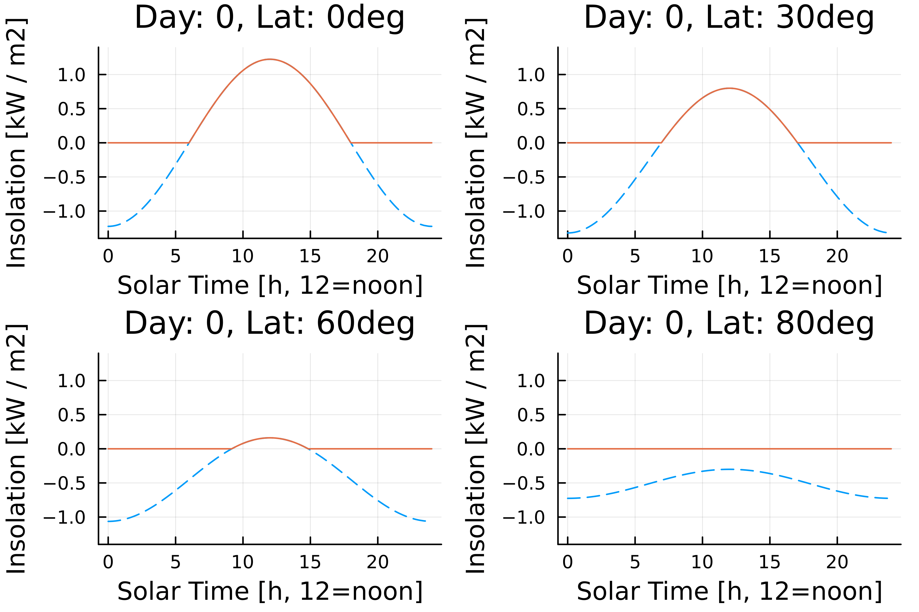

Energy model
Battery dynamics
Battery constraint
Speed constraint
Irradiance model
Historical model
Notes:
Important to present, but this is not where the novelty lies

Slide 29
High-Level Solution: Concept of Operations

Slide 30
Example tip and cue mission

Slide 31

Mission Strategies
Collaborative-Ergodic (Our Proposed Approach)
  Nominal path is generated using clarity-driven ergodic search
  Rendezvous point $p_{\text{r}}$ can be anywhere in the mission domain $D$
Directive-Ergodic
  Nominal path is generated using clarity-driven ergodic search
  Rendezvous point $p_{\text{r}}$ is restrained to be on the nominal path
Directive-Transect
  Nominal path follows a “lawnmower pattern”
  Rendezvous point $p_{\text{r}}$ is restrained to be on the nominal path

Slide 32


How can we control the ASV?
Direction:
Speed:
Finite horizon
Infinite horizon
  “Segmented” missions via recharging [3][4]
  Finite-horizon MPC with terminal reward for infinite-horizon performance [5]
[3] B. Haydon, J. Reed, and C. Vermillion, “Persistent mission planningof an energy-harvesting autonomous underwater vehicle for gulf streamcharacterization,” IEEE Transactions on Control Systems Technology,vol. 32, no. 2, pp. 653–662, 2023.
[4] G. Notomista, C. Pacchierotti, and P. R. Giordano, “Online robottrajectory optimization for persistent environmental monitoring,” IEEEControl Systems Letters, vol. 6, pp. 1472–1477, 2021.
[5] K. Govindarajan, B. Haydon, and C. Vermillion, “Predictive velocitytrajectory control for a persistently operating solar-powered autonomoussurface vessel,” in 2023 American Control Conference (ACC), 2023, pp.2077–2083.

Slide 33
Concept of Operations
Components:
Tip events
ASV (host) and AAV (agent)
What we need: rendezvous planner
Ensure timely tip detection and response
Coordination of host and agent

Slide 34

What does a mission look like?

Slide 35


Clarity
Clarity $q\left(t,p\right)∈[0, 1]$ quantifies the host’s knowledge of tip events at location $p$ and time $t$
  $q=1$ indicates full knowledge and $q=0$ indicates no knowledge
$∀p∈D, q\left(t_{0},p\right)=0$
$∀t≥t_{0},∀p∈D, \left\{\begin{aligned}q\left(t, p\right)=1 \text{if} ||p−p_{\text{host}}(t)||≤r_{\text{sensing}} \\ \frac{∂q}{∂t}\left(t,q\right)=−k_{5} \text{otherwise}\end{aligned}\right.$

Slide 36





Derivable Quantities
Objective Function to be Maximized

Slide 37
Contingency Plan
A contingency happens when a tip event concludes earlier than expected (by the host)
In the event of a contingency:
  Host continues towards the original rendezvous plan at its own, unchanged speed
  Agent returns to the host as quickly as possible
  Once docked, host replans its trajectory for the docked phase

Slide 38

Constraints
$v_{\text{host}}∈[0, v_{\text{host}\text{, }\text{max}}]$
$b_{\text{agent}}\left(t_{\text{rendezvous}}\right)≥b_{\text{agent}\text{, }\text{min}}$
$b_{\text{agent}}\left(t_{\text{agent}\text{, }\text{service}}\right)≥b_{\text{r}}$
$b_{\text{host}}\left(t_{\text{rendezvous}}\right)∈\left[b_{\text{host}\text{, }\text{m}\text{in}}, b_{\text{host}\text{, }\text{max}}\right]$
$b_{\text{host}}\left(t_{\text{final}}\right)∈\left[b_{\text{host}\text{, }\text{min}}, b_{\text{host}\text{, }\text{max}}\right]$

Slide 39


Real time realization: Results
Ideal Irradiance Model
Historical Irradiance Model

Slide 40
Conclusion
Takeaways:
Proposed ILC approach nearly matches MPC performance w/o need for a forecast
Proposed ILC approach is less computationally intensive
  MPC: 21 hrs 36 min
  ILC: 20 seconds
Ongoing work:
Real-world information-gathering mission
Swapping distance metric for information metric
Questions?
Email: kmgovind@umich.edu
Github: https://github.com/corelab-umich/OptimalRendezvous
Supported by:
NSF Award Number 2223844

